Slide 1
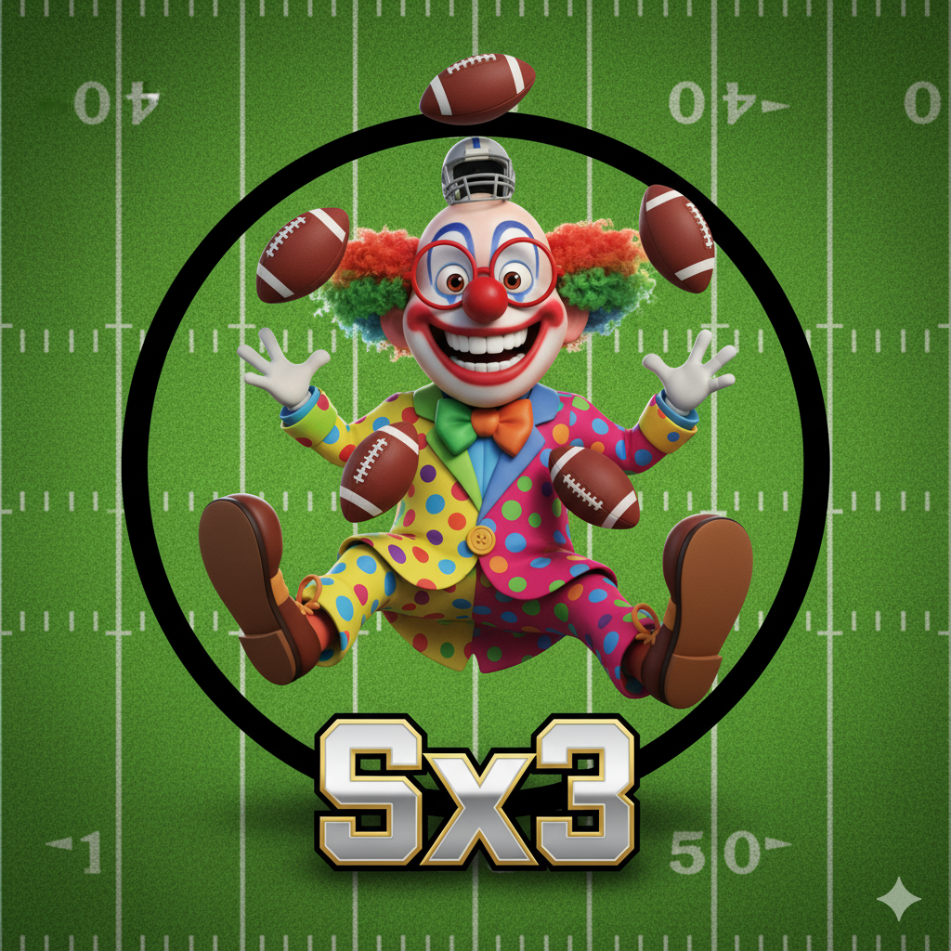
Welcome Back Bozos!

Slide 2
last year, a team had:
King Henry
Drake London
Brian Thomas Jr
🔥

Slide 3
😬
🤩
🫣
😧
😢
😭
😠
🤢
💩
WIN LOSS
Yes, that’s an 11-loss streak.
Yes, that’s the longest streak in Sx3 history.

Slide 4
this ‘depth’ might have contributed to the problem:
3 QBs Darnold, Love, Mahomes
B. Strange
P. Washington
Allen Lazard
Kyle Pitts
🤡

Slide 5
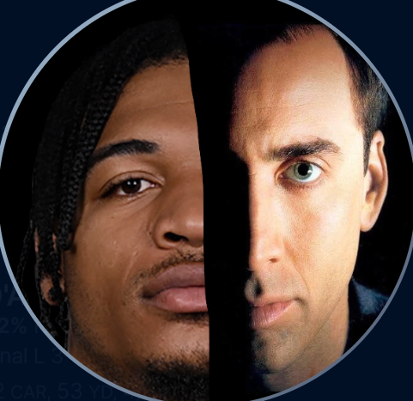
it didn’t help that this team abandoned its namesake
rostered neither
Ja’Marr Chase, nor Nic Cage

Slide 6


Trevor Sux

Slide 7
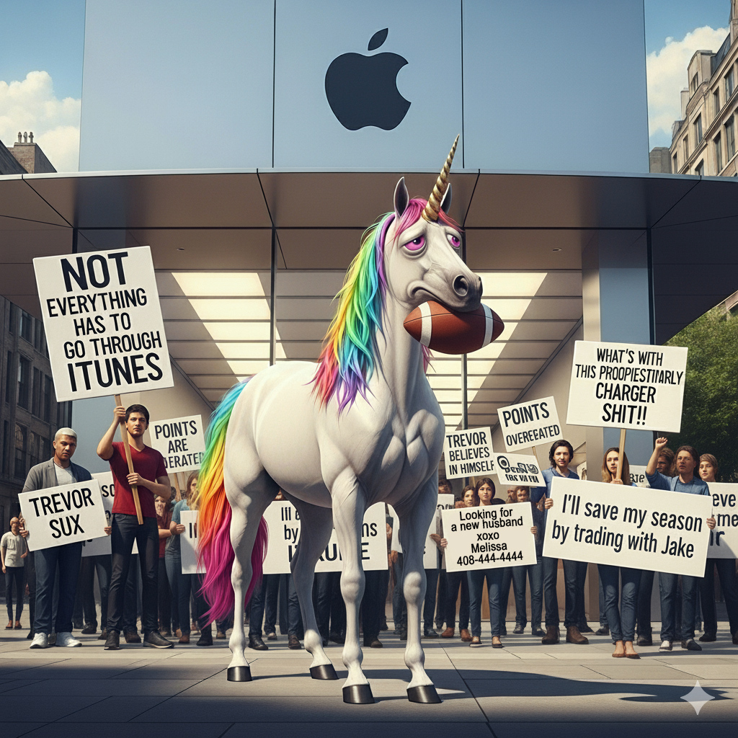

3-11 | Regular Season
1,691 | Pts For (12^{th.}… 11th was 1831)
47% | Lifetime Win % (10th)
2 | -ni-corns
HALF | of his FAAB budget goes unspent, on average
Only 1 | Mini-Game won, all-time (2021 team pts wk)
wk1 | L | 115 | 149 | Jim
wk2 | L | 95 | 142 | Jeff
wk3 | W | 137 | 125 | Aaron
wk4 | W | 189 | 132 | Gregg
wk5 | W | 176 | 118 | Jake
wk6 | L | 137 | 146 | Eddiey
wk7 | L | 132 | 147 | Bill
wk8 | L | 121 | 143 | Kurt
wk9 | L | 113 | 140 | Andrew
wk10 | L | 94 | 121 | Darren
wk11 | L | 99 | 188 | Albert
wk12 | L | 92 | Rumble
wk13 | L | 102 | Rumble
wk14 | L | 82 | Rumble
🦄15 | L | 128 | 142 | Kurt
🦄16 | L | 156 | 164 | Gregg
Darnold
Love
Mahomes
D Henry
Swift
J Ford
Tyreek
London
BTJ
Doubs
Lazard
P. Washington
Wan’Dale
Pitts
B. Strange

Slide 8
Trevor…
SHOW US THE 🦄!!!

Slide 9
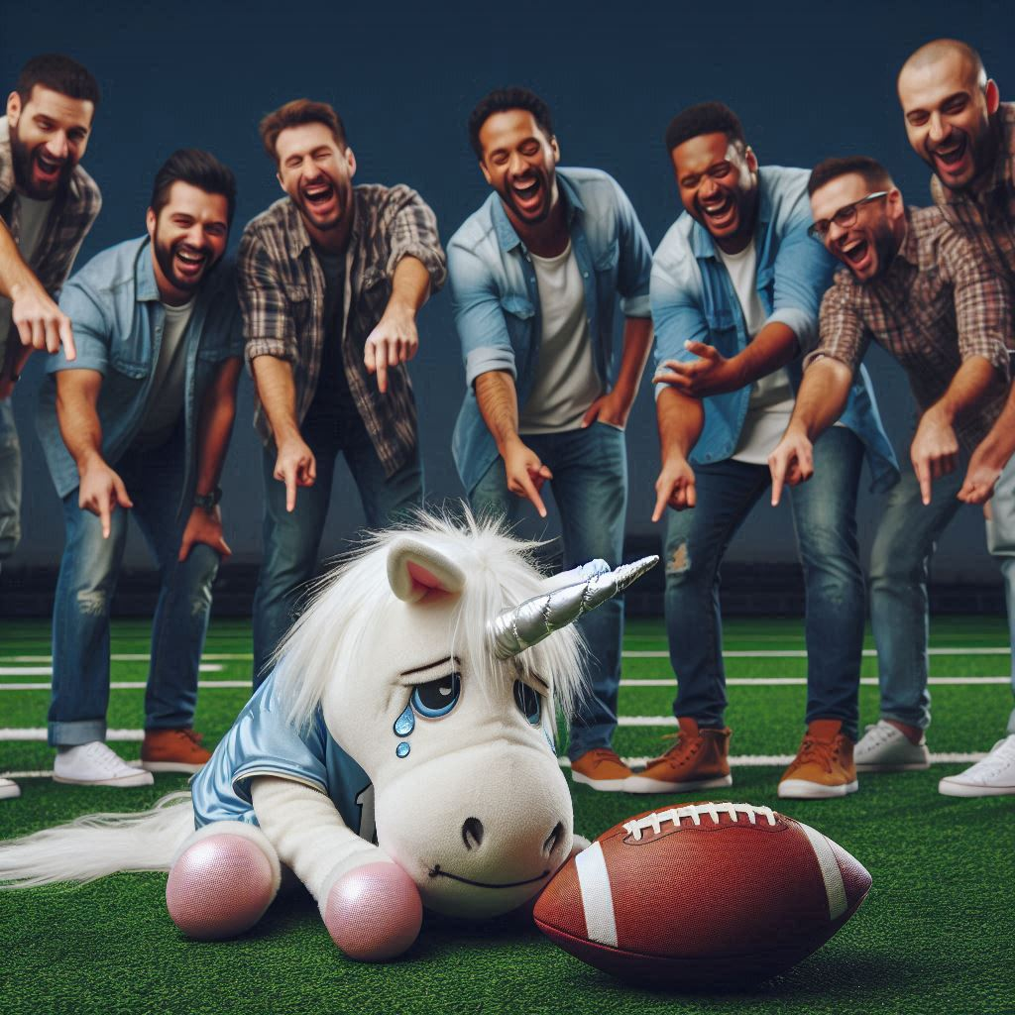
Trevor’s
Team Name is…

Slide 10
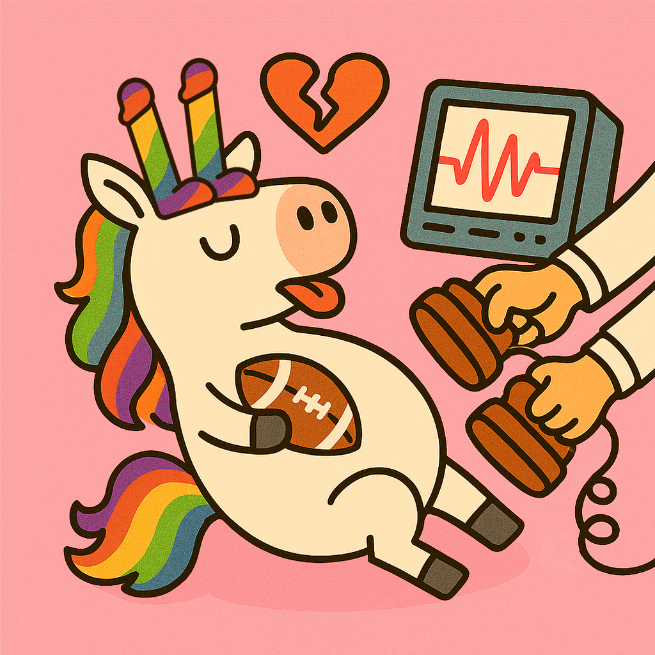
TWO-NI-CORONARY

Slide 11
Some Runners Up
Jake Deserves Better
I Watch Scat Porn on Apple Vision Pro
The Older I Get, the More I Look Like a Lesbian
iSuck
Melissa Was Right
Should I Still Do This?

Slide 12
meanwhile…

Slide 13
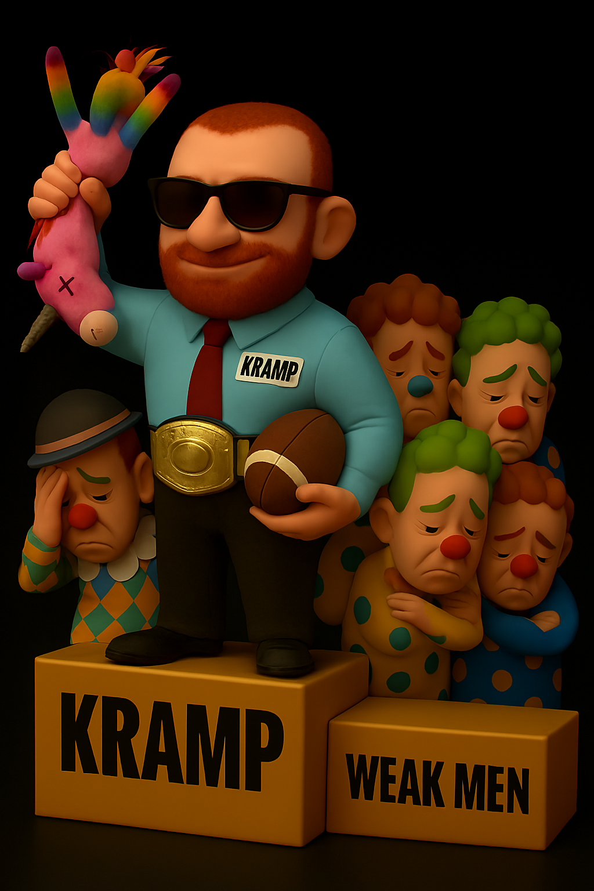
Eddiey
Doesn’t
Sux.

Slide 14

9-5 | Reg Season (1st)
2066 | Pts (1st)
Worst to First | 2023 🦄 2024 🏆
194 | 2024 Playoffs Weekly Points Avg
14 | Oven Doors Torn Off
416 | Different old leather football helmets
2,947 | Incoherent Chat Rants
Wk1 | L | 127 | 146 | Bill
wk2 | L | 130 | 137 | Darren
Wk3 | W | 184 | 181 | Albert
wk4 | W | 174 | 154 | Jeff
wk5 | W | 177 | 158 | Aaron
Wk6 | W | 146 | 137 | Trevor
wk7 | L | 106 | 134 | Jim
wk8 | W | 169 | 134 | Gregg
wk9 | W | 106 | 94 | Jake
wk10 | W | 157 | 148 | Kurt
wk11 | L | 127 | 147 | Andrew
wk12 | L | 128 | Rumble
wk13 | W | 164 | Rumble
Wk14 | W | 164 | Rumble
🏆15 | <bye> | <bye> | <bye> | <bye>
🏆16 | W | 208 | 125 | Albert
🏆17 | W | 217 | 143 | Aaron
Jayden Daniels
JT
Aaron Jones
Tyrone Tracy
Mattison
Akers
Ja’Marr
Nabers
McConkey
Odunze
Downs
Kraft

Slide 15

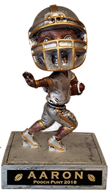
Congrats Eddiey!!!

Slide 16
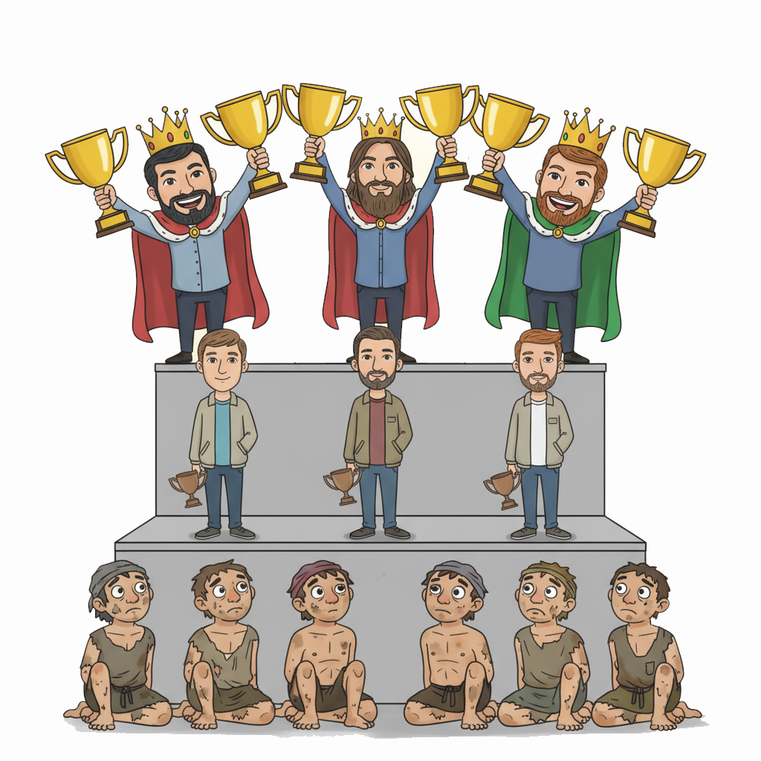

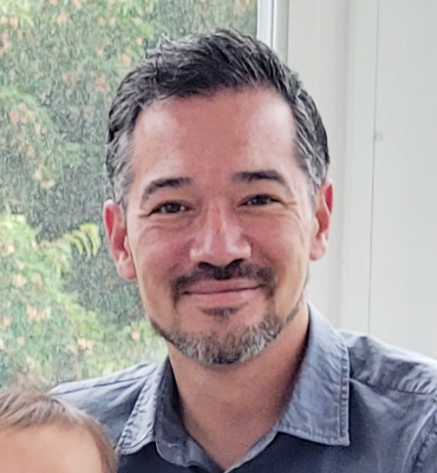

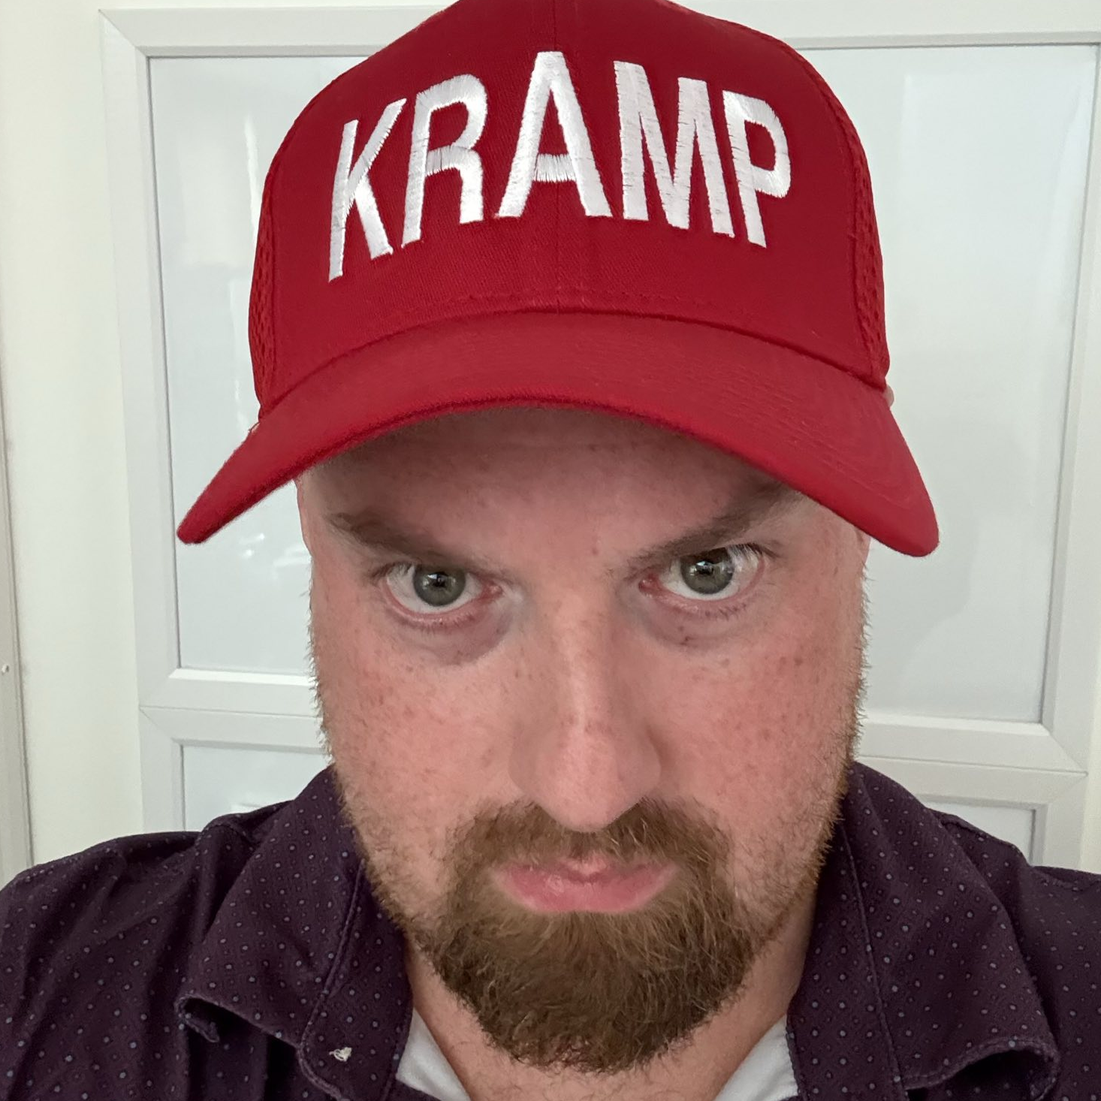
OG
OG

Slide 17
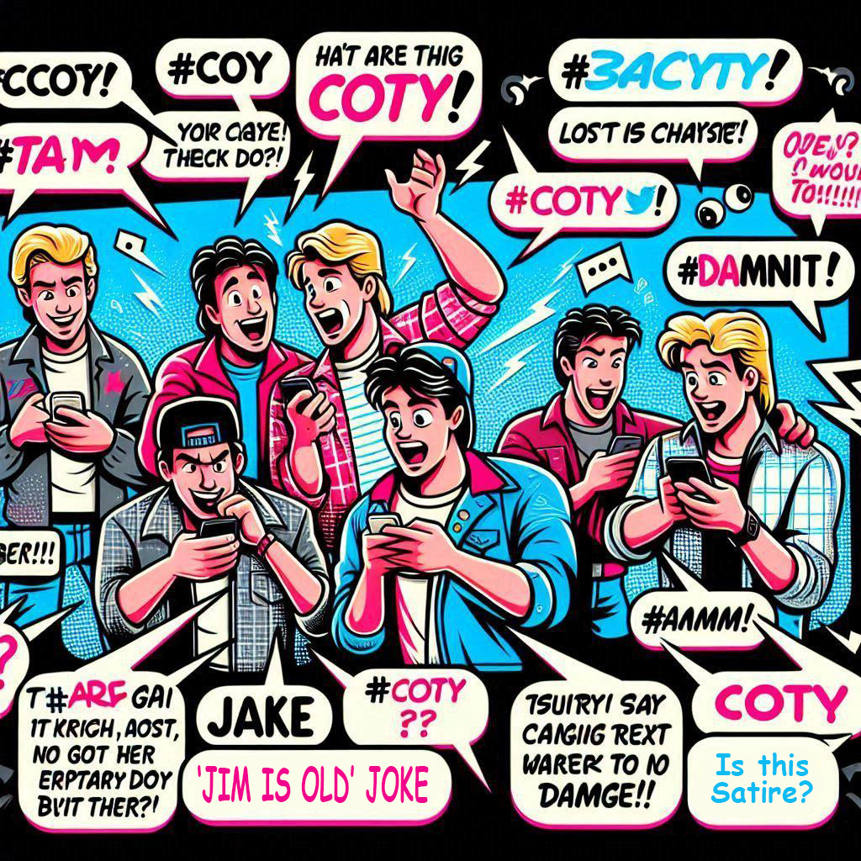
#COTY

Slide 18


Slide 19
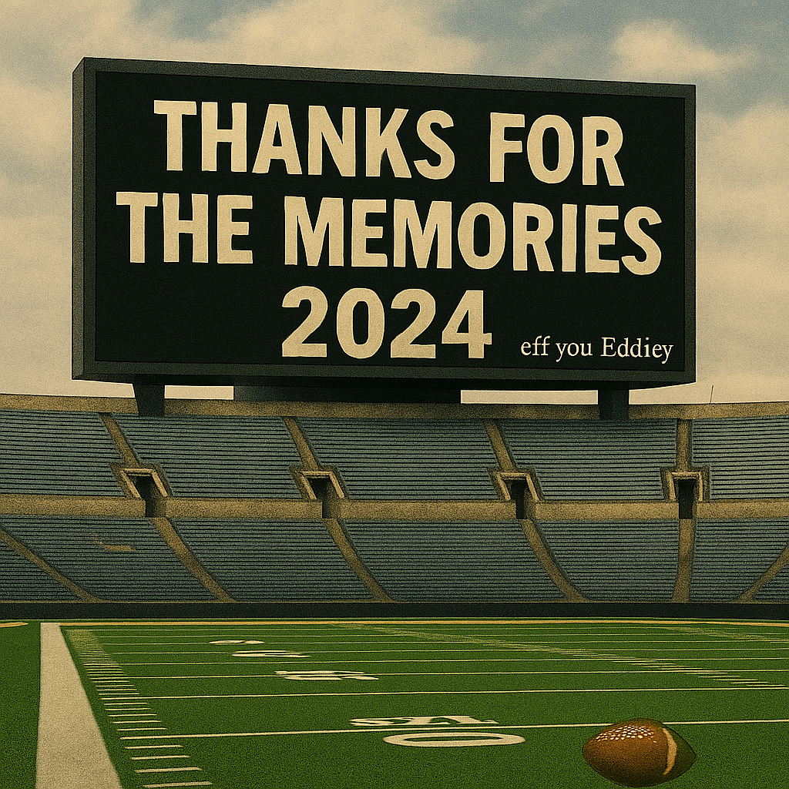
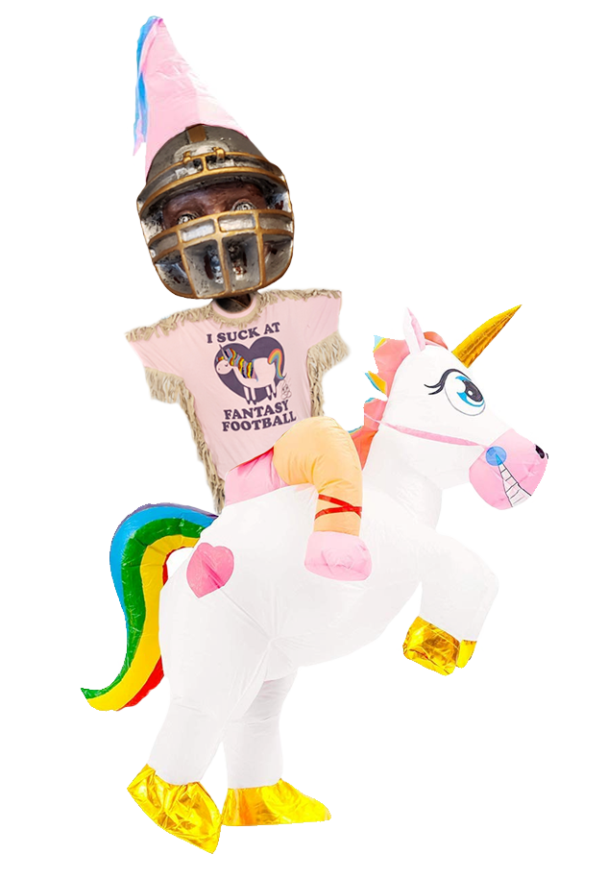



Final Results
Eddiey
Aaron
Jeff
Jim
Trevor
Albert | 4th
Jake | 5th
Andrew | 6th
Jim | 7th
Bill | 8th
Darren | 9th
Kurt | 10th
Gregg | 11th
Mini Games
Pts Reg Ssn $60 | Eddiey | 2,066 (5th All Time)
Pts Team Wk $60 | Darren | 231 (wk 14, 3rd all time)
Pts Player Wk $60 | Eddiey | Ja’Marr (61.4, 3rd all time)
Closest Defeat $30 | Darren | Lost to Jim 0.02 wk 11
Pts Team Wk 17 $60 | Eddie | 206.88
1st Season-Ending Injury $30 | Andrew | Rashee wk5

Slide 20


Slide 21
7 times, 6 managers left more than $10 unspent in drafts
Which manager did it twice?
 | Avg | Total | 2024 | 2023 | 2022 | 2021 | 2020 | 2019
Aaron | 1.3 | 8 | 2 | 0 | 3 | 0 | 1 | 2
Albert | 1.5 | 9 | 0 | 6 | 2 | 0 | 1 | 0
Andrew | 3.8 | 23 | 0 | 3 | 2 | 1 | 3 | 14
Bill | 2.2 | 13 | 1 | 0 | 1 | 0 | 2 | 9
Darren | 0.2 | 1 | 0 | 0 | 0 | 0 | 1
Eddie | 0.4 | 2 | 0 | 0 | 0 | 1 | 1
Gregg | 4.0 | 16 | 2 | 0 | 1 | 13
Jake | 5.0 | 30 | 0 | 1 | 0 | 1 | 10 | 18
Jeff | 3.3 | 20 | 0 | 0 | 0 | 3 | 2 | 15
Jim | 5.0 | 30 | 2 | 19 | 0 | 7 | 1 | 1
Kurt | 4.3 | 26 | 2 | 5 | 1 | 4 | 0 | 14
Trevor | 2.2 | 13 | 5 | 0 | 6 | 0 | 2 | 0

Slide 22
What was the most we’ve ever spent on a kicker?
Year | Mgr | Player | Pos | Draft $ (Auction) | K finish | Mgr Finish
2019 | Trent-Shall | Harrison Butker | K | $17 | K1 | 9th
2020 | Kurt | Greg Zuerlein | K | $15 | K6 | 5th
2019 | Jake | Justin Tucker | K | $7 | K4 | 10th
2021 | Kurt | Greg Zuerlein | K | $5 | K12 | 8th

Slide 23
Who’s been the most top-heavy drafter?
(Highest % of Auction Budget spent on top 3 players)
 | 2019 | 2020 | 2021 | 2022 | 2023 | 2024 | Top 3 %
Darren |  | 138 (69%) | 132 (66%) | 116 | 114 | 137 (69%) | 64%
Eddie |  | 120🏆 | 116 | 127 (64%) | 128🦄 | 131 66% 🏆 | 62%
Trevor | 127 (64%) | 111 | 116 | 128 64% 🏆 | 122 | 118🦄 | 60%
Andrew | 120 | 111 | 116 | 110🦄 | 123 | 111 | 58%
Albert | 122 | 126🦄 | 111 | 76 | 111 | 117 | 55%
Jake | 90 | 101 | 123 | 105 | 114 | 123 | 55%
Kurt | 94 | 89 | 97 | 119 | 103 | 106 | 51%
Bill | 97 | 104 | 99 | 95 | 97🏆 | 114 | 51%
Aaron | 90 | 102 | 107🏆 | 116 | 103 | 87 | 50%
Gregg |  |  | 92 | 112 | 114 | 85 | 50%
Jim | 85🦄 | 83 | 112 | 98 | 111 | 108 | 50%
Jeff | 60🏆 | 60 | 79🦄 | 108 | 136 (68%) | 104 | 46%

Slide 24
I Can’t Quit You
Most Instances where a Manager Drafts the Same Player Year over Year (2017-2024)
Year | Mgr | Player | Position | Draft $ | Pick # (Snake)
2017 | Andrew | Derrick Henry | RB |  | 73
2018 | Whitney | Derrick Henry | RB |  | 42
2019 | Trevor | Derrick Henry | RB | $17
2020 | Andrew | Derrick Henry | RB | $37
2021 | Jim | Derrick Henry | RB | $49
2022 | Andrew | Derrick Henry | RB | $45
2023 | Andrew | Derrick Henry | RB | $43
2024 | Trevor | Derrick Henry | RB | $38
Year | Mgr | Player | Position | Draft $ | Pick # (Snake)
2017 | Andrew | Justin Tucker | K |  | 144
2018 | Jeff | Justin Tucker | K |  | 166
2019 | Jake | Justin Tucker | K | $7
2020 | Jim | Justin Tucker | K | $3
2021 | Trevor | Justin Tucker | K | $1
2022 | Jim | Justin Tucker | K | $1
2023 | Jim | Justin Tucker | K | $3
2024 | Jim | Justin Tucker | K | $1

Slide 25
Biggest Bust
Draft Spend > $25, Season Points < 100
Year | Mgr | Player | Position | Draft $ | Pts End Season
2020 | Albert | Christian McCaffrey | RB | 69 | 90.4
2020 | Eddie | Saquon Barkley | RB | 62 | 15.4
2024 | Kurt | Christian McCaffrey | RB | 50 | 47.8
2020 | Darren | Michael Thomas | WR | 50 | 83.9
2023 | Aaron | Nick Chubb | RB | $49 | 23.1
2024 | Bill | Isiah Pacheco | RB | 47 | 56.9
2021 | Eddie | Calvin Ridley | WR | $42 | 71.1
2020 | Kurt | Joe Mixon | RB | 39 | 99.6
2022 | Jake | Javonte Williams | RB | 39 | 42
2024 | Kurt | Chris Olave | WR | 35 | 76.7
2019 | Bill | Antonio Brown | WR | $31 | 16.1
2020 | Andrew | Kenny Golladay | WR | 30 | 65.8
2022 | Aaron | Kyle Pitts | TE | 30 | 75.6
2021 | Aaron | Allen Robinson | WR | $28 | 80.8
2021 | Jeff | Chris Carson | RB | $27 | 48.1
2020 | Aaron | Odell Beckham Jr. | WR | 26 | 86.8
2024 | Gregg | Brandon Aiyuk | WR | 25 | 62.4
2021 | Eddie | Gus Edwards | RB | $25 | 0

Slide 26
Biggest Jackpots
Draft Spend < $10, Season Points > 240
Year | Mgr | Player | Position | Draft $ | Pts End Season
2021 | Eddie | Deebo Samuel | WR | $8 | 310
2021 | Jim | Ja'Marr Chase | WR | $7 | 300
2019 | Jake | Austin Ekeler | RB | $7 | 291.1
2023 | Aaron | Mike Evans | WR | $10 | 277.3
2023 | Jake | Raheem Mostert | RB | $2 | 267.7
2024 | Trevor | Brian Thomas Jr. | WR | $8 | 266.7
2021 | Trevor | Leonard Fournette | RB | $3 | 255.6
2024 | Kurt | Chase Brown | RB | $9 | 255
2020 | Bill | Justin Jefferson | WR | $5 | 251.9
2024 | Kurt | Brock Bowers | TE | $5 | 247.7
2022 | Albert | Tony Pollard | RB | $8 | 246.9
2023 | Kurt | Michael Pittman | WR | $9 | 242.8
2021 | Aaron | Hunter Renfrow | WR | $1 | 242.2
2024 | Aaron | Chuba Hubbard | RB | $3 | 241.6

Slide 27
Best Drafter? Worst Drafter?
Total Points End of Season for Drafted Team (since 2019)
 | 2019 | 2020 | 2021 | 2022 | 2023 | 2024 | Avg / Yr
Gregg |  |  | 2,689 | 2,877 | 2,697 | 2,490 | 2,688
Jeff | 2,887🏆 | 2,683 | 2,451🦄 | 2,067 | 2,820 | 2,461 | 2,561
Kurt | 2,812 | 2,387 | 1,901 | 3,123 | 2,683 | 2,226 | 2,522
Jake | 2,592 | 2,462 | 2,700 | 2,251 | 2,635 | 2,464 | 2,517
Trevor | 2,401 | 2,326 | 2,792 | 2,624🏆 | 2,480 | 2,479🦄 | 2,517
Bill | 2,464 | 2,514 | 2,195 | 2,300 | 2,732🏆 | 2,688 | 2,482
Jim | 2,152🦄 | 2,733 | 2,604 | 2,345 | 2,200 | 2,672 | 2,451
Aaron | 2,535 | 2,448 | 2,691🏆 | 2,055 | 2,351 | 2,526 | 2,434
Albert | 2,310 | 2,115🦄 | 2,463 | 2,134 | 2,713 | 2,863 | 2,433
Andrew | 2,644 | 2,511 | 2,443 | 2,306🦄 | 2,171 | 2,290 | 2,394
Darren |  | 2,117 | 2,882 | 2,089 | 2,086 | 2,625 | 2,360
Eddie |  | 1,924🏆 | 1,984 | 2,338 | 2,107🦄 | 2,575 🏆 | 2,185

Slide 28
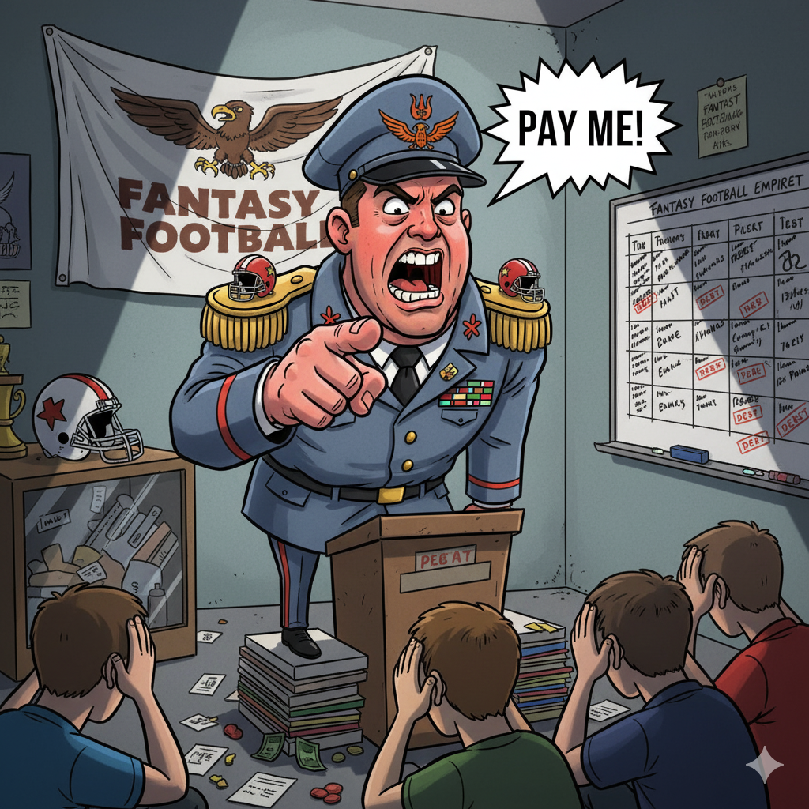
Dues
$125
Everyone but Jim
(applied 2022 winnings)

Slide 29
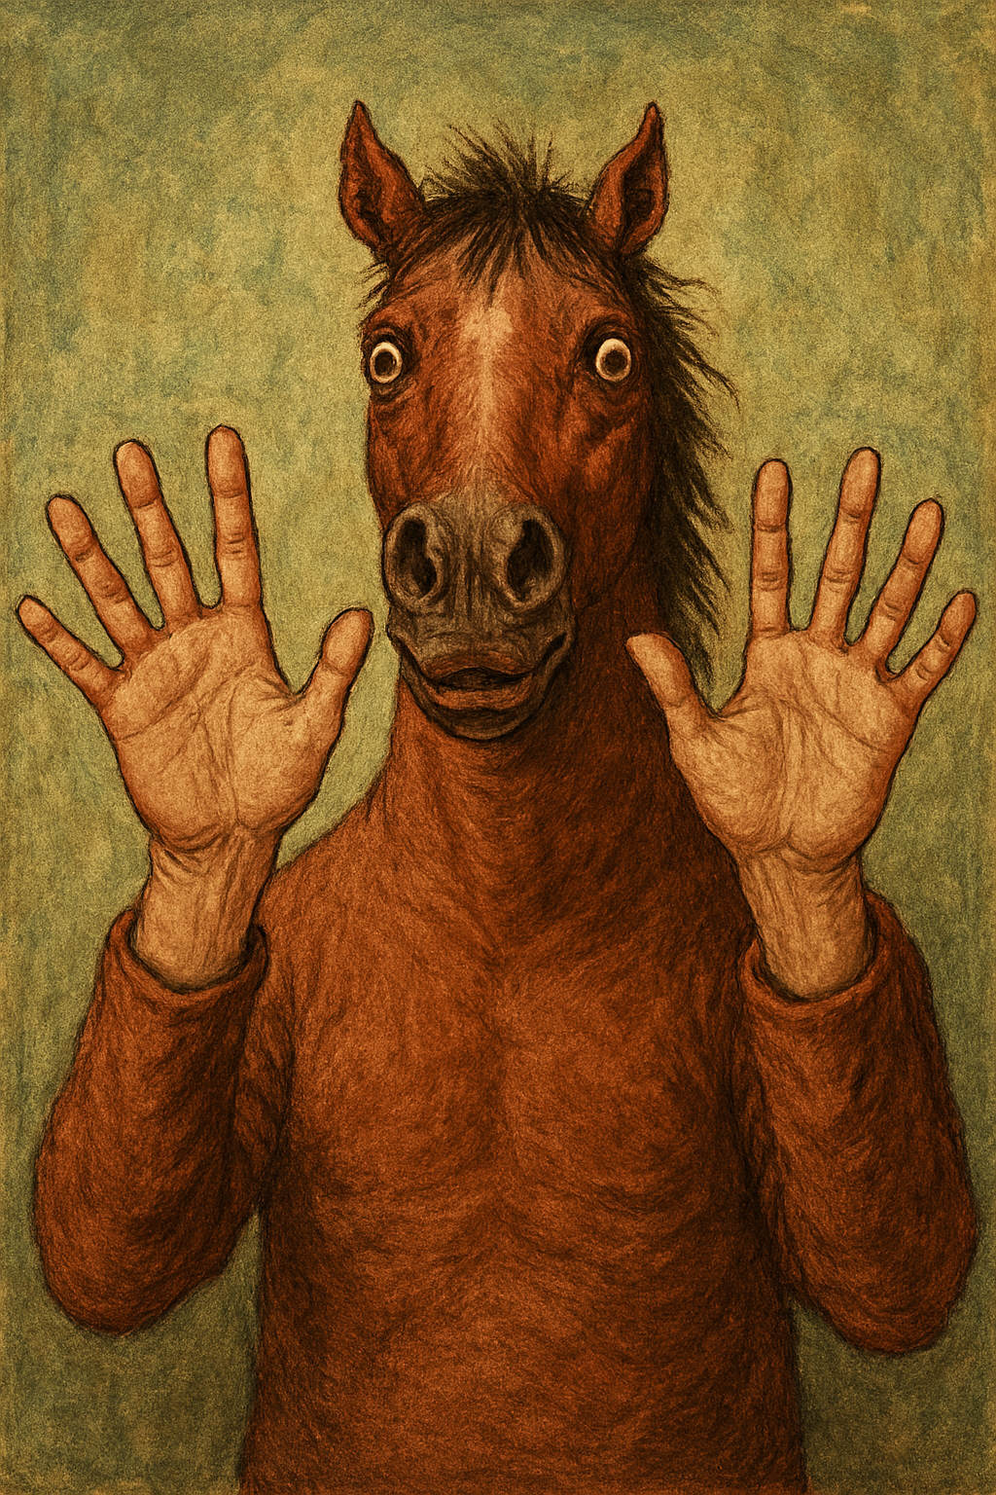
Website Reminder
Sx3ff.com
Sx3.fun became expensive 😠
It’ll warn you it’s unsecure – don’t worry

Slide 30
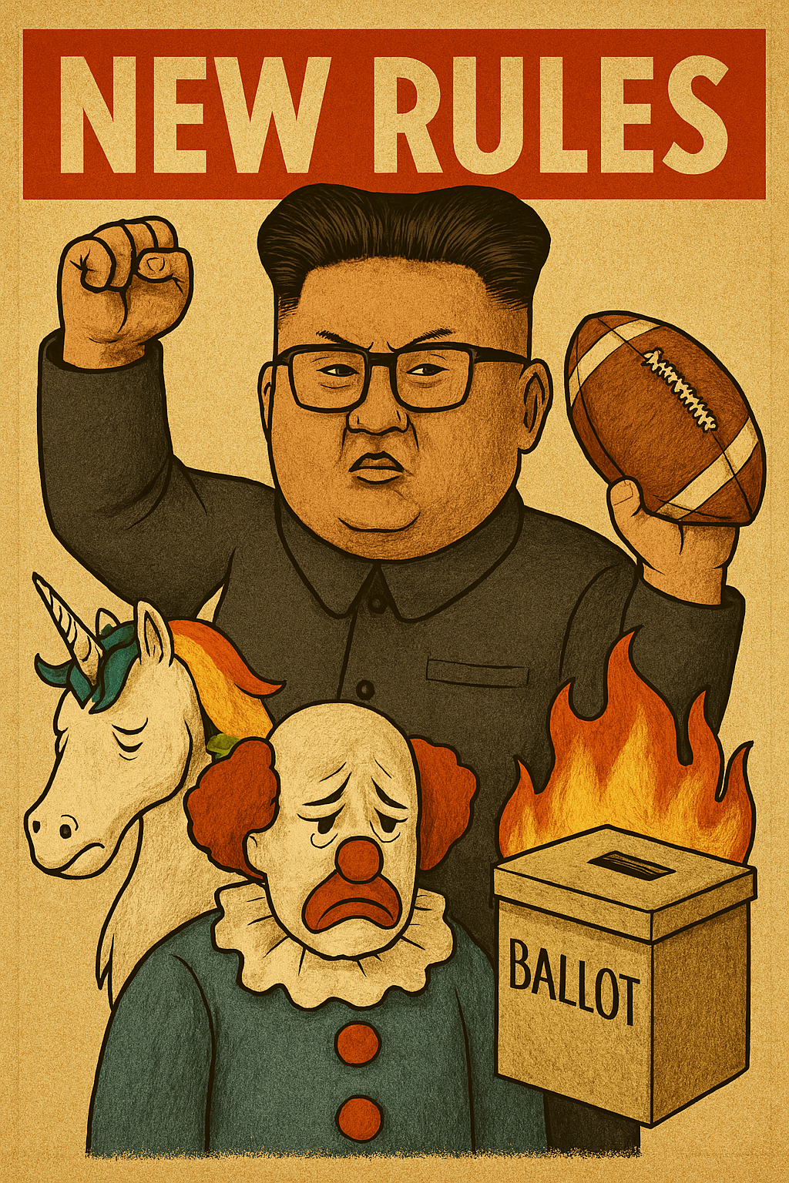
No changes this year.
Voting will happen for next year.
Shout if you have requests to be on the ballot.
(I won’t honor your requests).

Slide 31
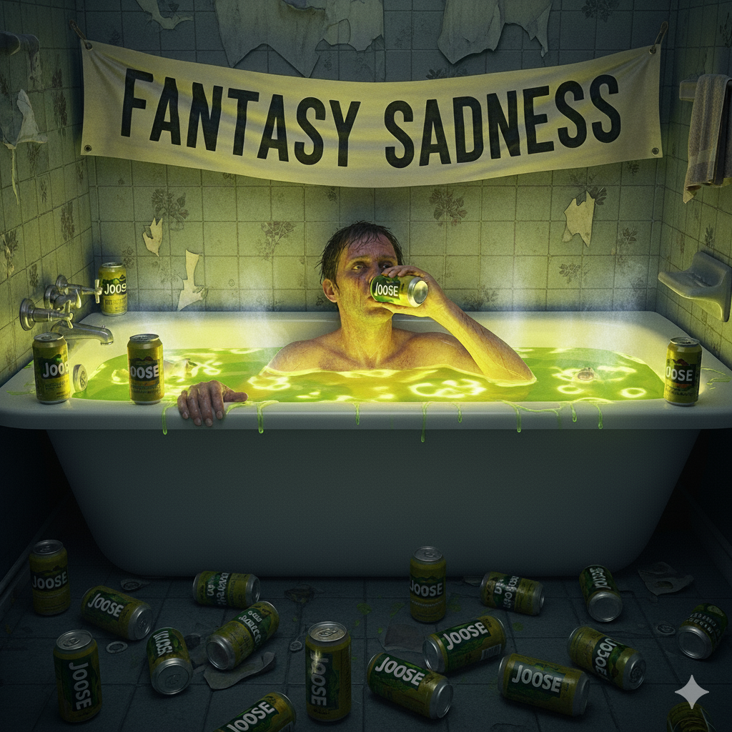
Draft Reminders
Nomination order has been randomly set
Nomination Time: 30 seconds (don’t take this long… at 15 secs everyone can harass you)
Bid Time: 10 seconds (resets to 10 secs w/ bids)
If you bid more than the next person, ALL of what you bid is deducted
Nominating a player = $1 bid
System forces you to have at least $1 for each roster spot … NO $0 players
H2H matchups for the year set after draft is complete. Those will default to match last year – Aaron will randomize once.
EVERYONE be on the lookout for disconnects and shout so we can pause

Slide 32
Fuck you guys.
THE END

