Slide 1


Welcome Back Bozos!

Slide 2
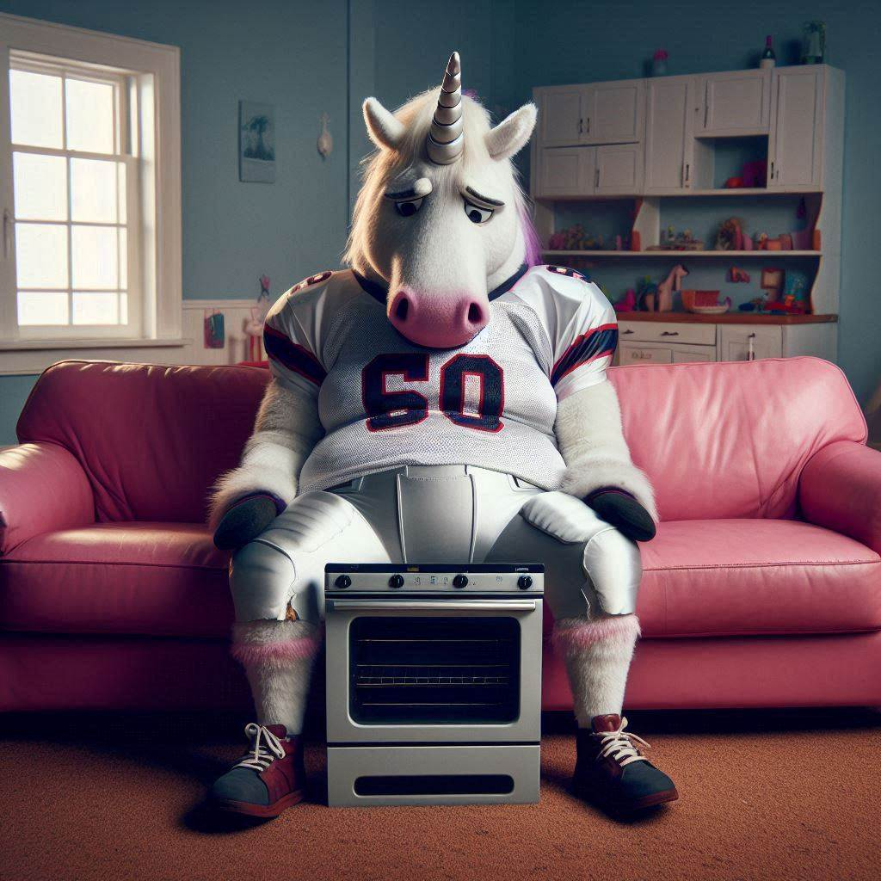

Eddiey Sux.

Slide 3
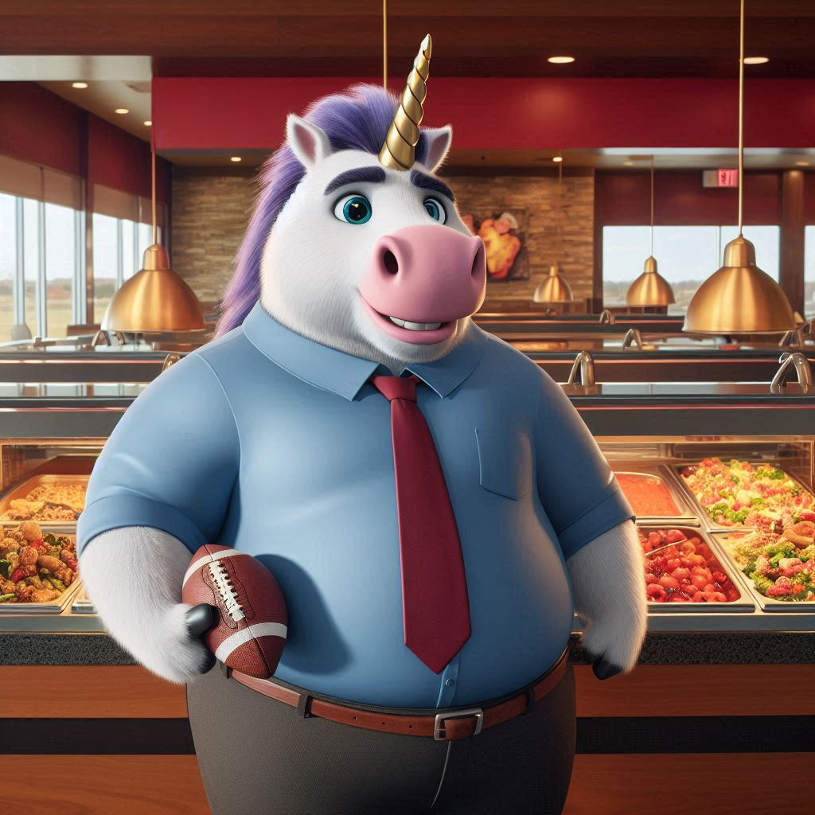

4-10 | Regular Season
1,844 | Pts For (11th)
39% | Liftetime Win % (12th)
0 | Coherent chat messages
PEACE | Saquon
STILL | Trying to offload Kittle
wk1 | L | 97 | 109 | Jim
wk2 | L | 99 | 105 | Jeff
wk3 | L | 121 | 138 | Gregg
wk4 | L | 85 | 125 | Bill
wk5 | W | 175 | 131 | Jake
wk6 | L | 115 | 129 | Darren
wk7 | L | 119 | 205 | Aaron
wk8 | W | 161 | 132 | Trevor
wk9 | W | 122 | 96 | Kurt
wk10 | L | 122 | 132 | Albert
wk11 | L | 104 | 111 | Andrew
wk12 | L | 130 | Rumble
wk13 | W | 201 | Rumble
wk14 | L | 103 | Rumble
🦄15 | L | 116 | 157 | Kurt
🦄16 | L | 108 | 148 | Andrew
Baker
DeVito
Flacco
Stafford
J Ford
Chubba
Tyjae
Dillon
Kareem
Ja’Marr
D. Smith
Ja-Mo
C Watson
Jakobi
Elijah
Kittle

Slide 4
Eddiey…
SHOW US THE 🦄!!!

Slide 5
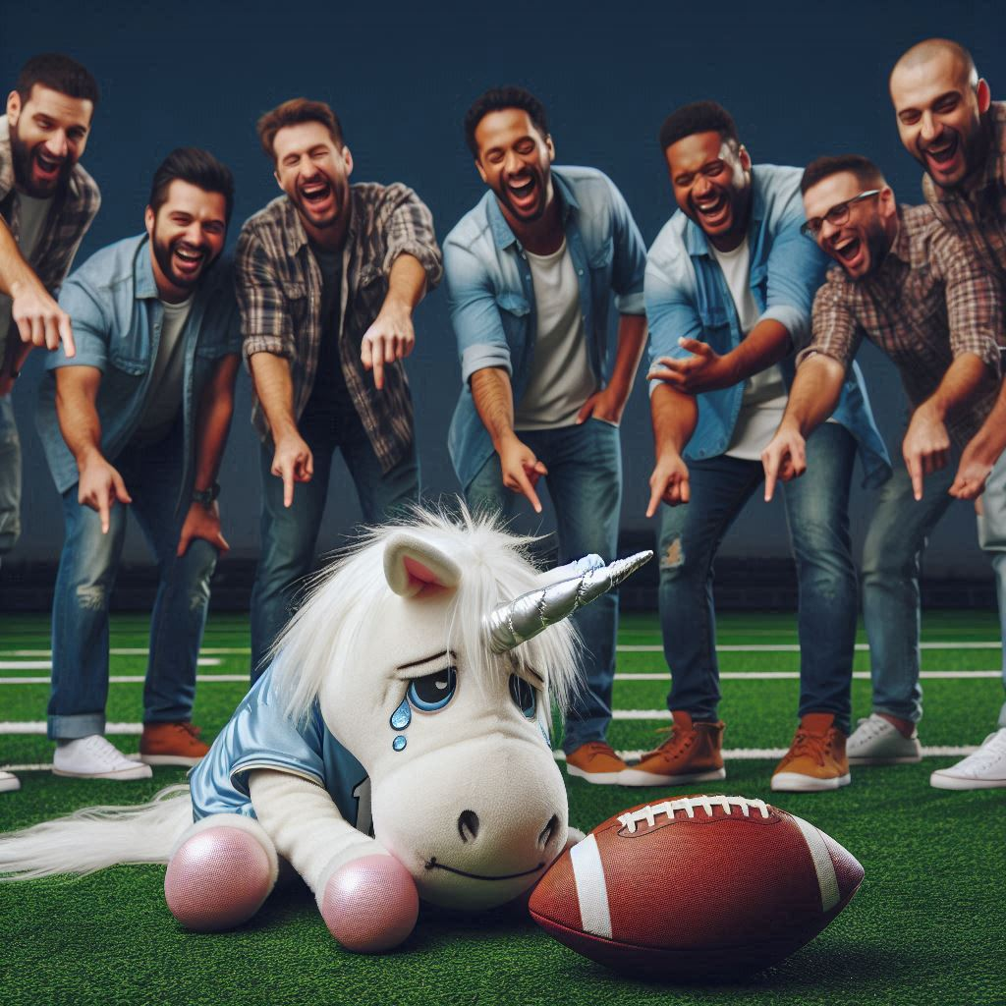
Eddiey’s
Team Name is…

Slide 6

Beat Cancer,
Lost to Bozos

Slide 7


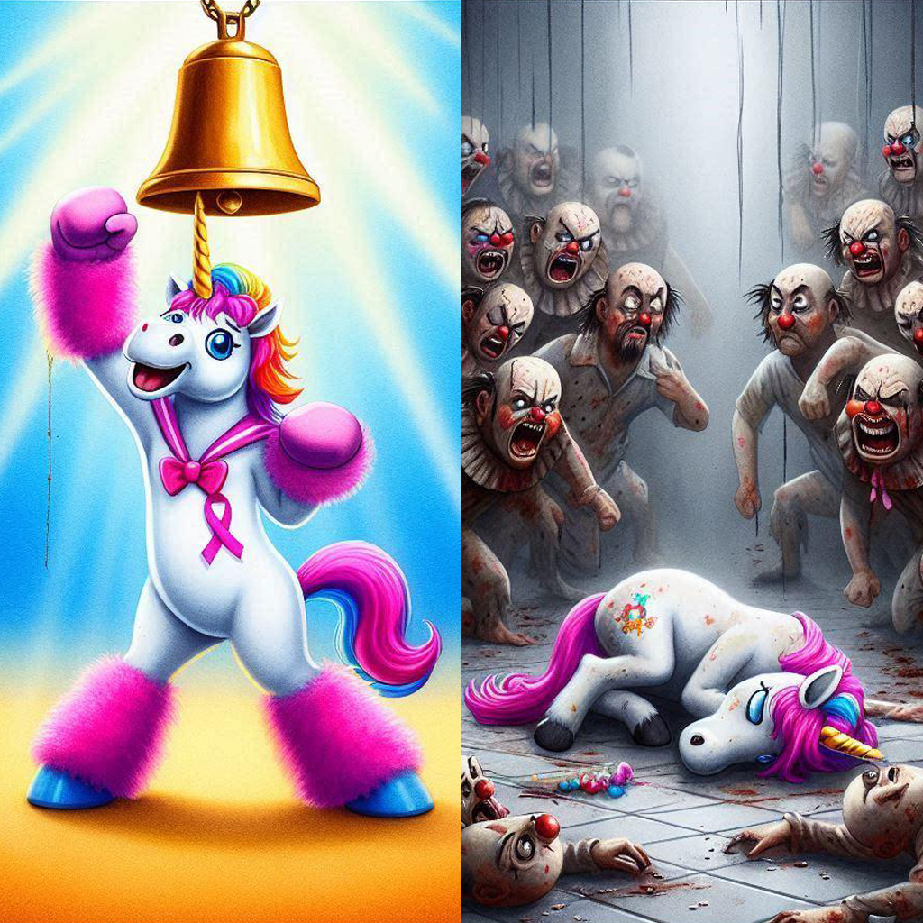

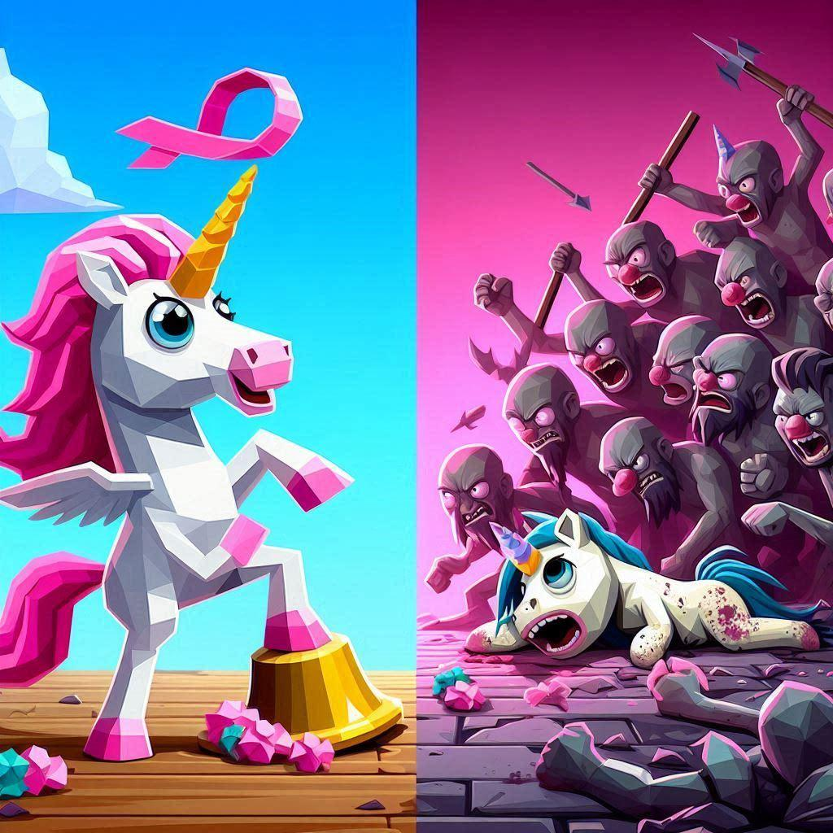
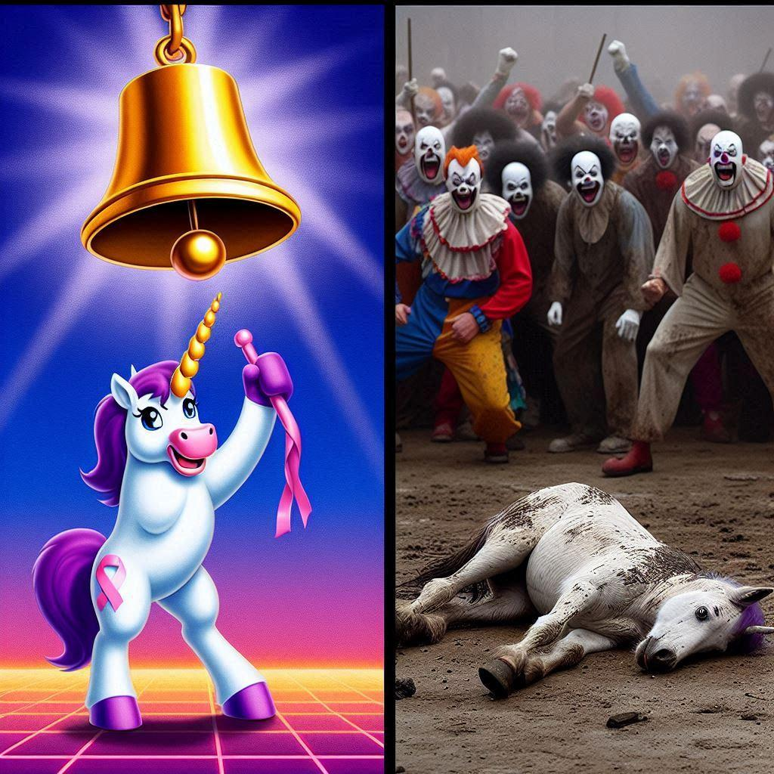


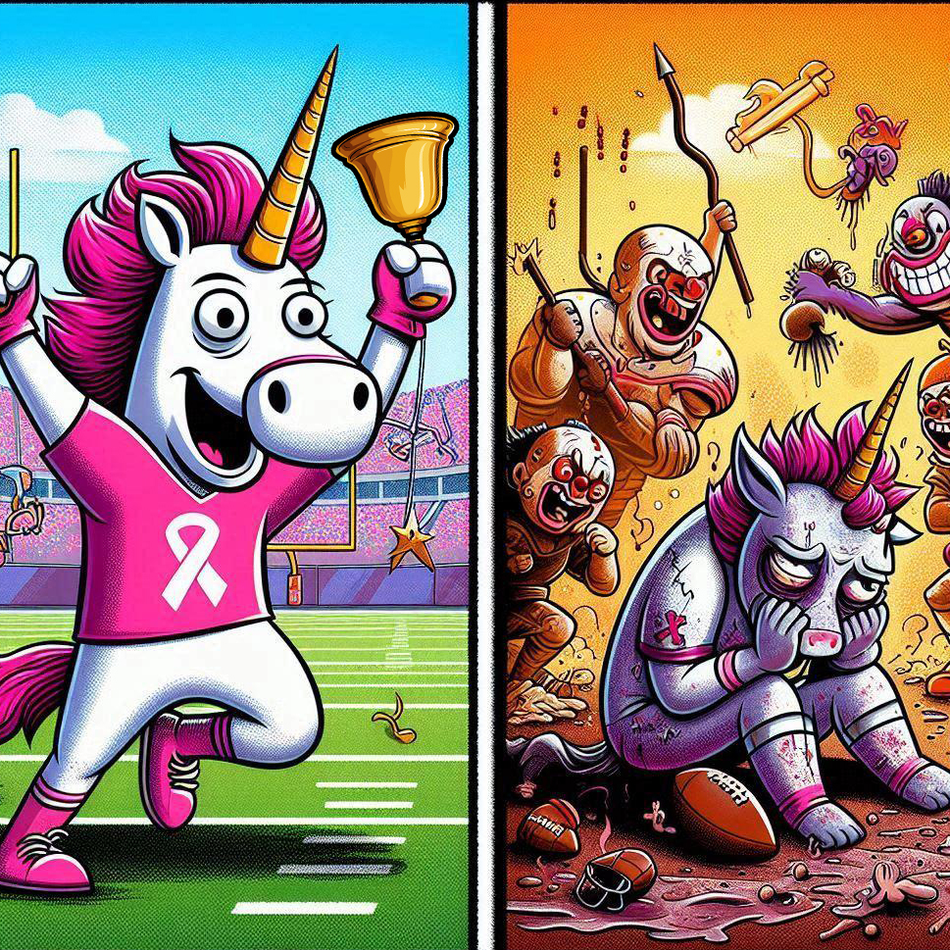
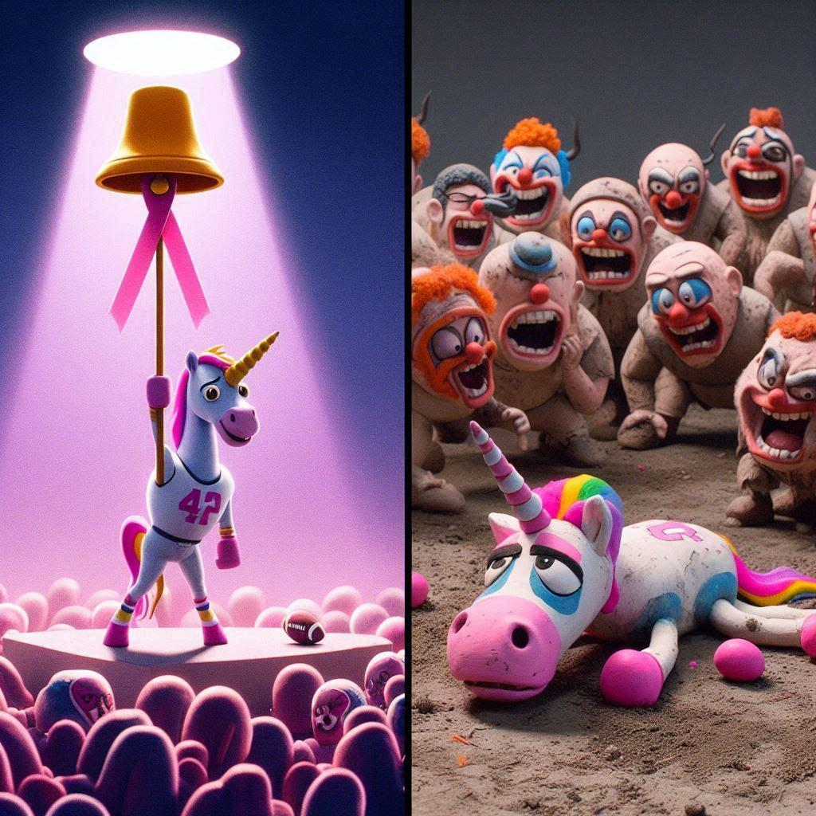
Some Runners Up
Ed
Fly Saquon, Fly
ChemoCorn
We ❤️ Eddie
Kerry Kramped My Style
EunuchCorn
Cancer Champ, Bozo Chump
Big Blue Bozo
Sx3 is Harder than Cancer
Got Lucky Year One
Gave up my 🥜 to be a 🦄

Slide 8
meanwhile…

Slide 9
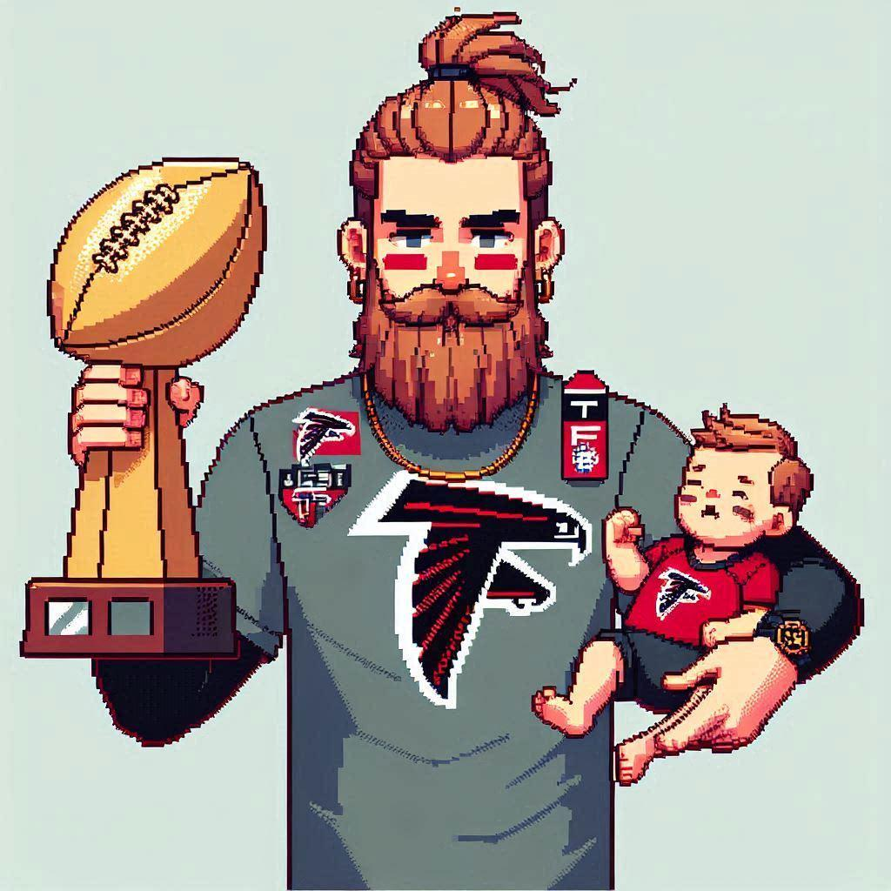
Bill Doesn’t Sux.

Slide 10
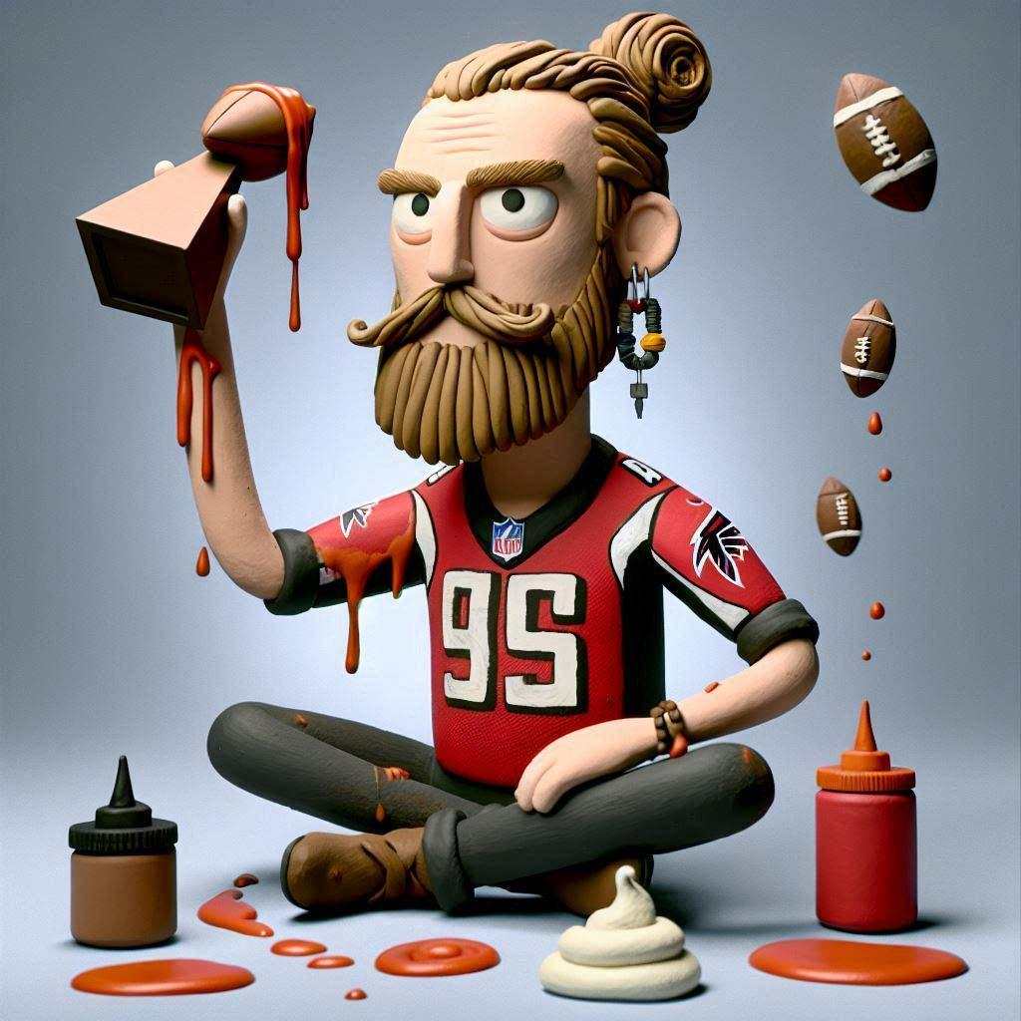
8-6 | Reg Ssn
1,913 | Pts (4th)
1-4 | Start
MOST | 2023 weekly points… in Championship
186 | Avg weekly pts in playoffs
64% | Made Playoffs (1st)
+ $875 | Lifetime Winnings (2nd)
Won Every | Mini game… TWICE
wk1 | L | 71 | 149 | Jake
wk2 | L | 126 | 156 | Darren
wk3 | L | 129 | 189 | Aaron
wk4 | W | 125 | 84 | Eddie
wk5 | L | 160 | 173 | Jim
wk6 | W | 115 | 129 | Darren
wk7 | W | 167 | 103 | Trevor
wk8 | W | 156 | 151 | Albert
wk9 | W | 166 | 126 | Andrew
wk10 | L | 123 | 118 | Jeff
wk11 | W | 121 | 109 | Gregg
wk12 | L | 133 | Rumble
wk13 | L | 115 | Rumble
Wk14 | W | 170 | Rumble
🏆15 | W | 132 | 126 | Jim
🏆16 | W | 208 | 125 | Albert
🏆17 | W | 217 | 143 | Aaron
Lamar
Breece
Kyren
Lamb
Amari
Pickens
D. London
Wicks
Downs
Pitts
Kraft
Muth

Slide 11
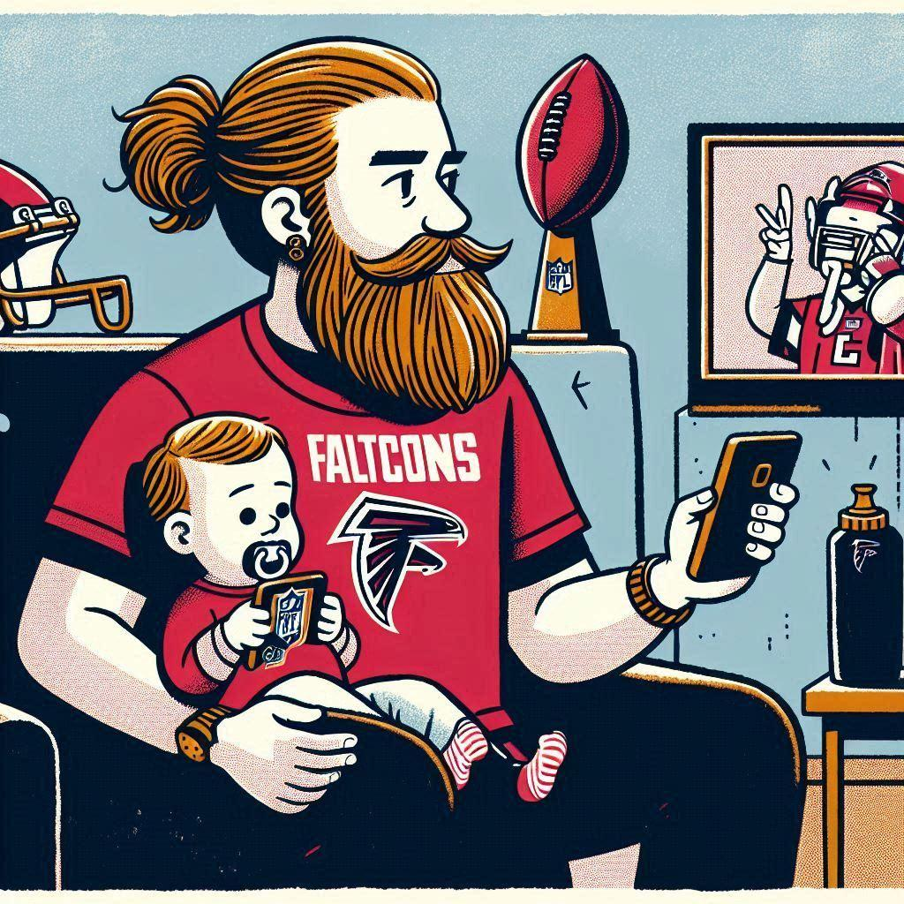
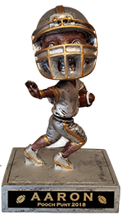
Congrats Bill!

Slide 12
Congrats Bill!

Slide 13
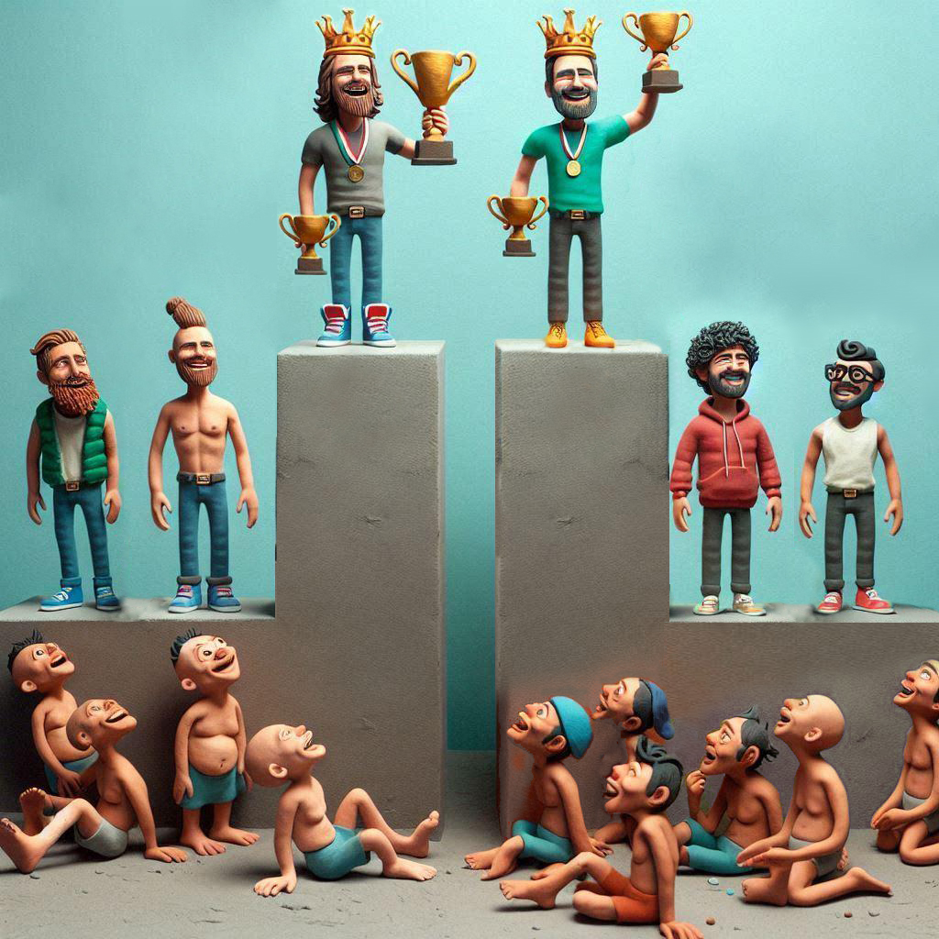

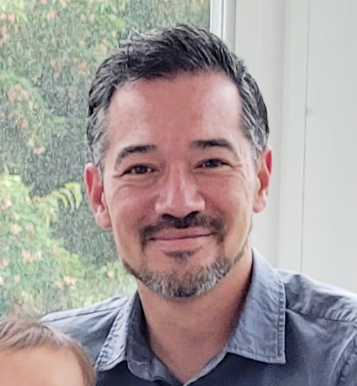

OG
OG

Slide 14
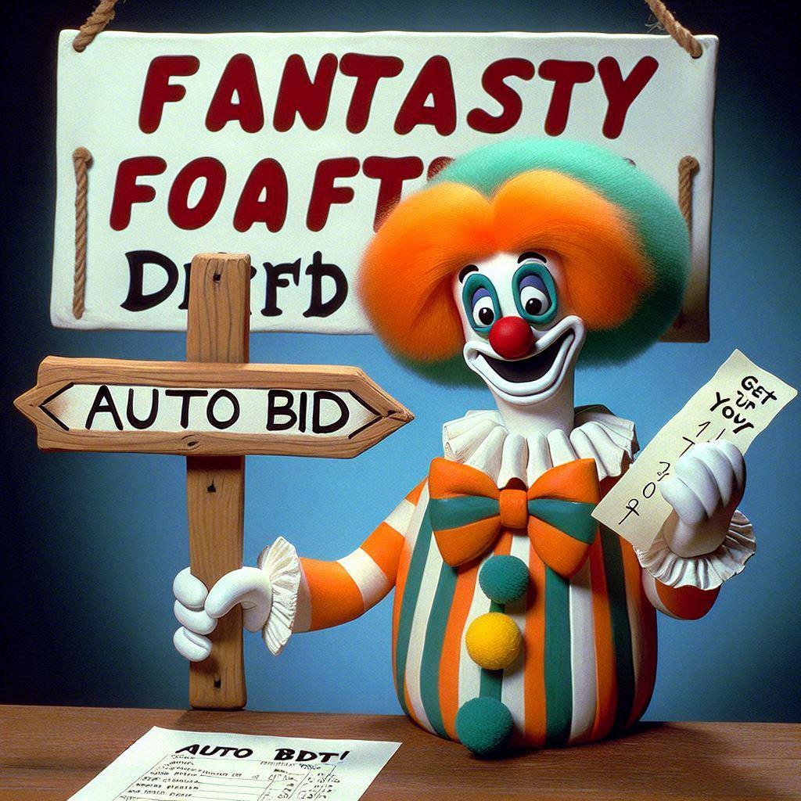
Best Draft
Mgr | Pts from Drafted Players
Jeff | 3,020
Bill | 2,991
Kurt | 2,907
Gregg | 2,881
Jake | 2,853
Albert | 2,761
Trevor | 2,697
Aaron | 2,623
Jim | 2,351
Andrew | 2,324
Eddie | 2,286
Darren | 2,234

Slide 15
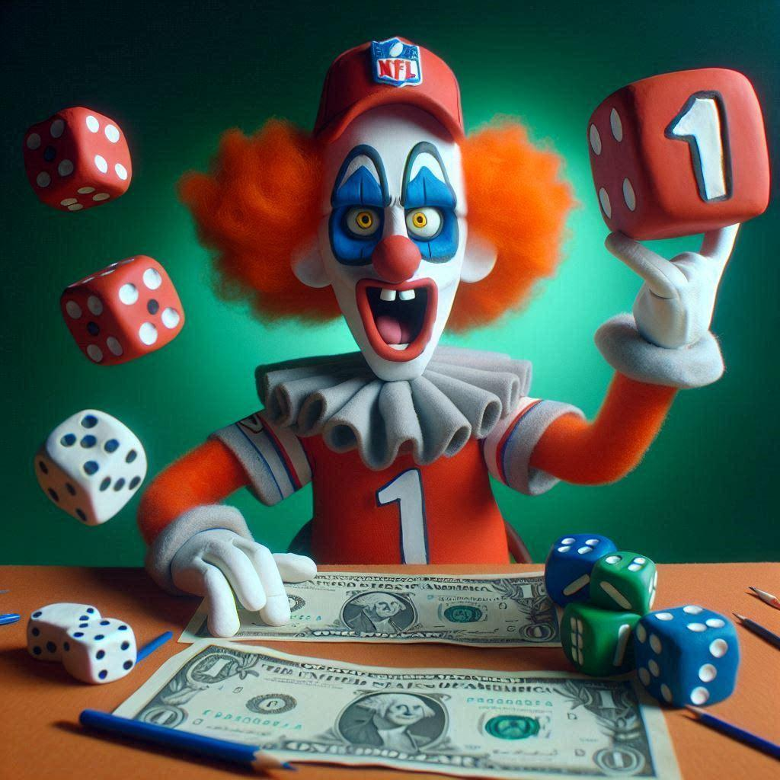
Draft Steals
Player | Draft $ | Points | Pt Per Draft Dollar | Drafted By
Nico Collins | $1 | 268 | 268 | Aaron
Jayden Reed | $1 | 222 | 222 | Eddie
Jacoby Meyers | $1 | 219 | 219 | Eddie
Rashee Rice | $1 | 215 | 215 | Jeff
Shaheed | $1 | 187 | 187 | Jeff
Gus Edwards | $1 | 187 | 187 | Andrew
Jake Ferguson | $1 | 177 | 177 | Kurt
Tank Dell | $1 | 175 | 175 | Bill
Singletary | $1 | 174 | 174 | Bill
Curtis Samuel | $1 | 158 | 158 | Jeff
Dalton Schultz | $1 | 152 | 152 | Albert
Kareem Hunt | $1 | 119 | 119 | Darren
Mostert | $2 | 270 | 135 | Jake
Thielen | $2 | 234 | 117 | Andrew
Devon Achane | $2 | 201 | 100.5 | Trevor
Sutton | $2 | 190 | 95 | Trevor
Cooks | $2 | 174 | 87 | Gregg

Slide 16
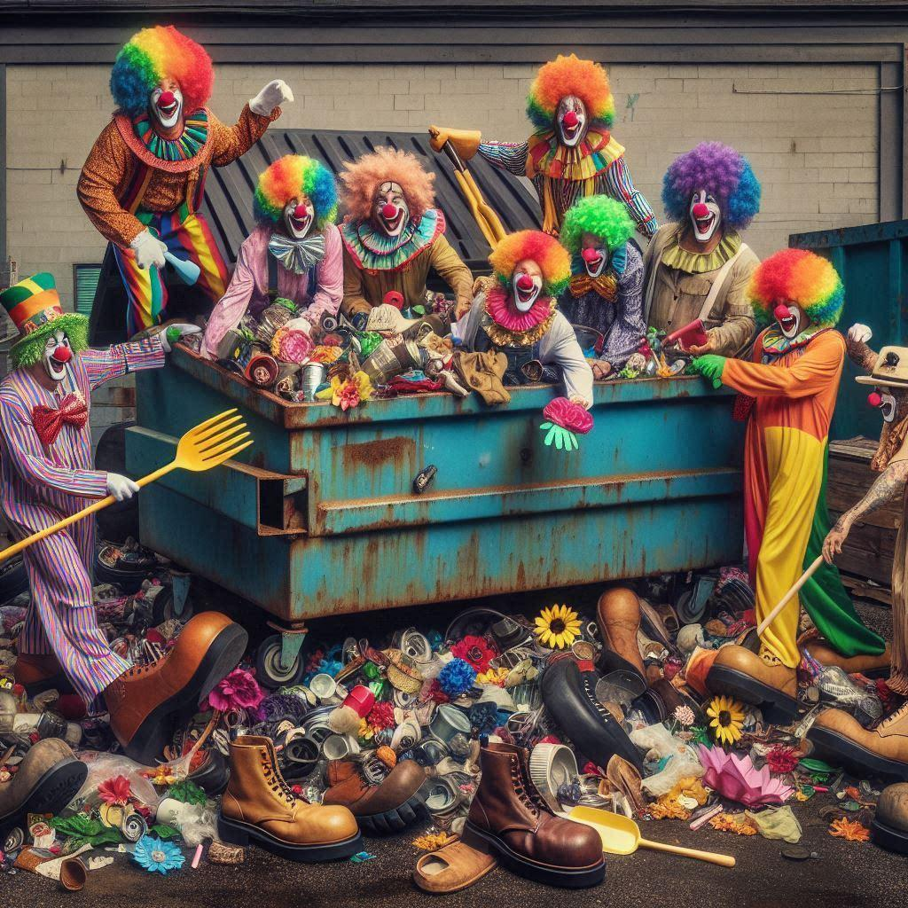
Waiver Wins
Player | Waiver $ | Points | Manager
Dak Prescott | $4 | 352 | Jake
Puka | $35 | 298 | Darren
CJ Stroud | $1 | 281 | Albert
Kyren Williams | $21 | 255 | Bill
Sam LaPorta | $0 | 240 | Aaron
Trey McBride | $0 | 182 | Aaron
Cole Kmet | $9 | 181 | Trevor
Jake Ferguson | $1 | 177 | Jake
Zeke | $3 | 174 | Jake
Zack Moss | $2 | 169 | Andrew
Devin Singletary | $0 | 167 | Jeff
Tank Dell | $12 | 165 | Bill
Taysom Hill | $1 | 143 | Andrew

Slide 17
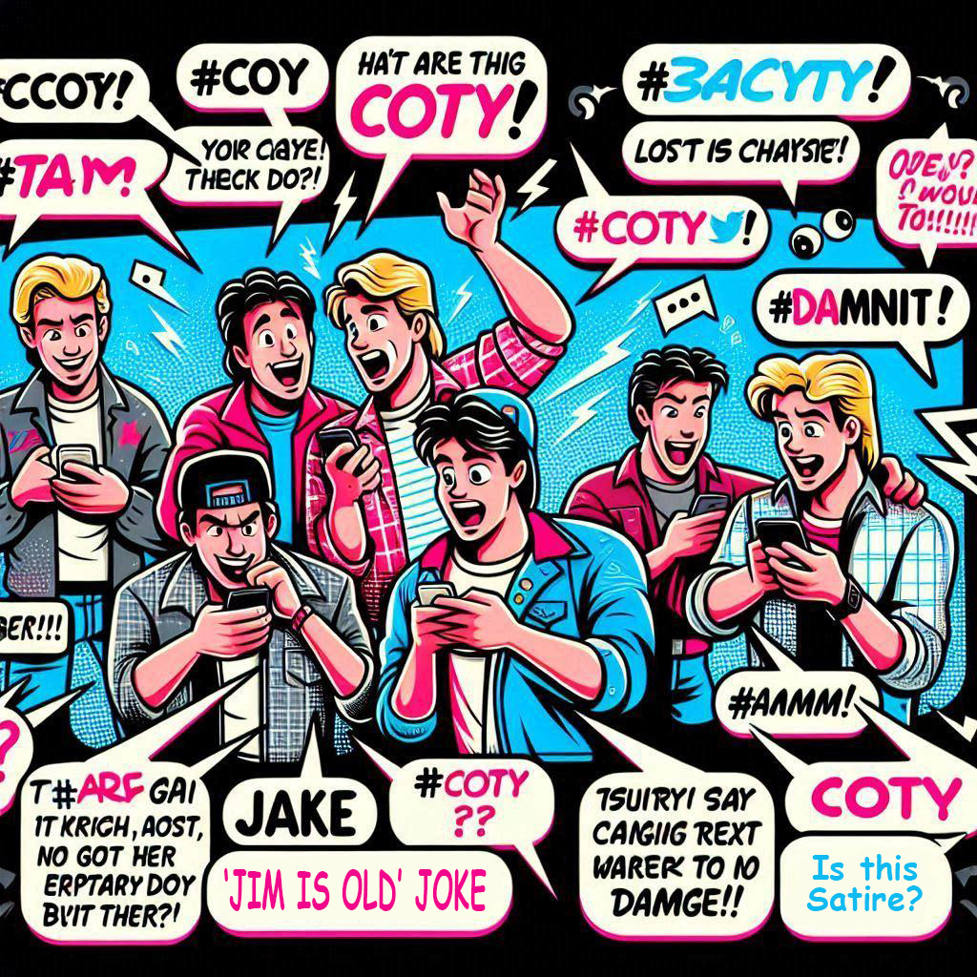
#COTY
and the 2023-2024
COTY goes to…

Slide 18
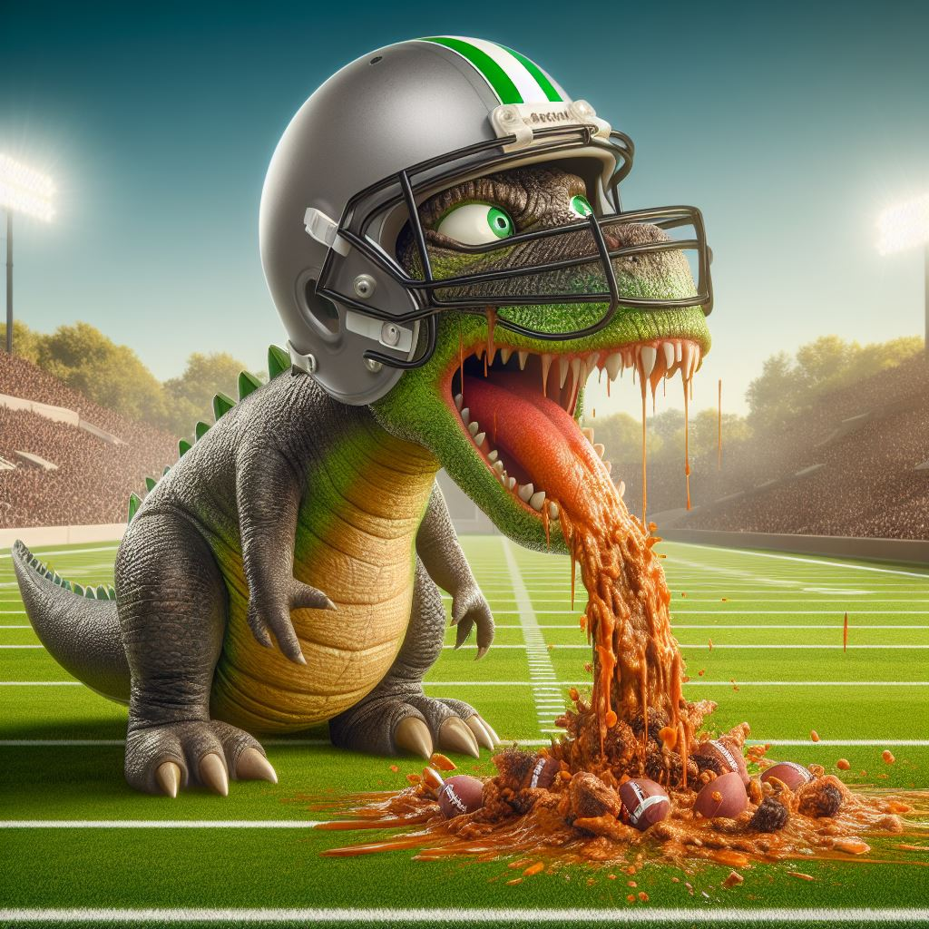
Jake!
Aaron & Kurt:
“Hey Jake, did you get anything together for COTY this year?”
Jake:
“No.”
🏅
🏅
🤯🏆🎉🧠💪

Slide 19
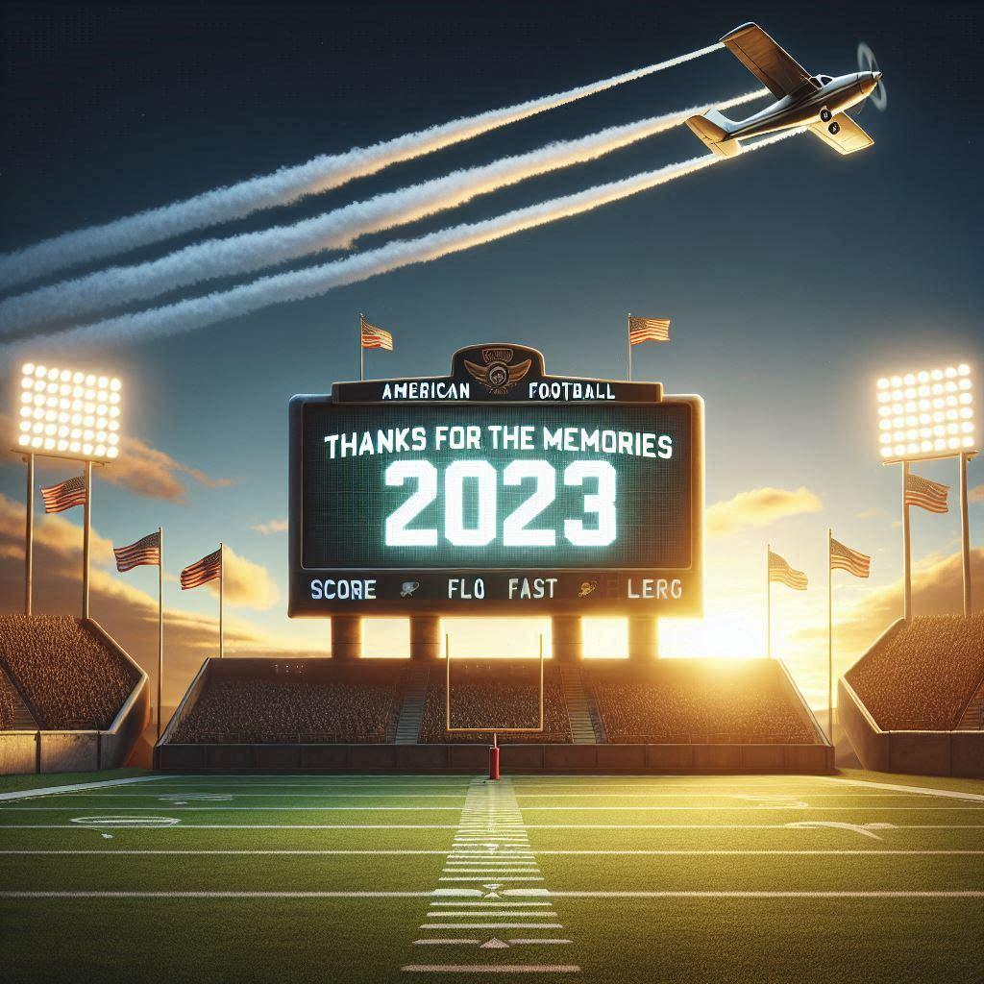
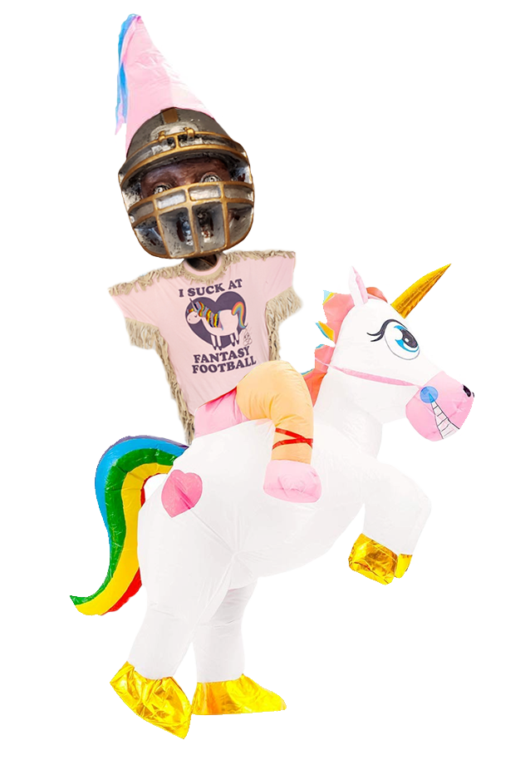


Final Results
Bill
Aaron
Jake
Eddie
Albert | 4th
Jeff | 5th
Jim | 6th
Darren | 7th
Gregg | 8th
Kurt | 9th
Trevor | 10th
Andrew | 11th
Mini Games
Pts Reg Ssn | Aaron | 2,107 (3rd all-time)
Pts Team Wk | Bill | 217 (wk 17, 4th all time)
Pts Player Wk | Bill | Amari – 56 (5th All-time)
Closest Defeat | Albert | Lost to Jim by 0.48

Slide 20
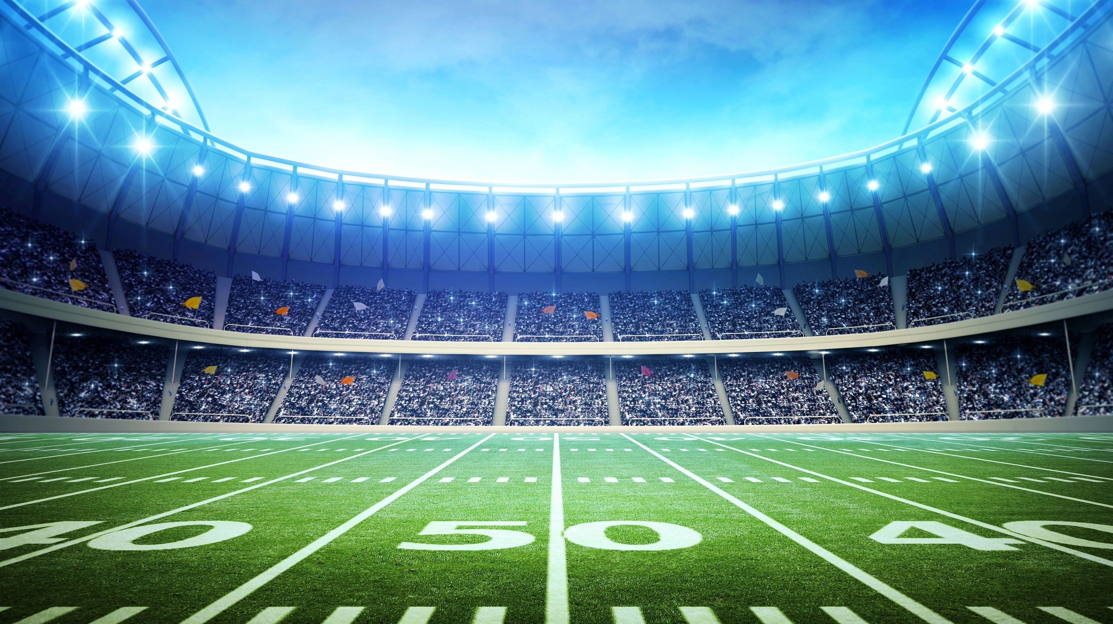
Sx3 Member History – 4 Year Run!
Mgr | 2024 | 2023 | 2022 | 2021 | 2020 | 2019 | 2018 | 2017 | 2016 | 2015 | 2014 | 2013
Aaron | OG | OG | OG | OG | OG | OG | OG | OG | OG | OG | OG | OG
Andrew | OG | OG | OG | OG | OG | OG | OG | OG | OG | OG | OG | OG
Jake | OG | OG | OG | OG | OG | OG | OG | OG | OG | OG | OG | OG
Bill | OG | OG | OG | OG | OG | OG | OG | OG | OG | OG | OG | OG
Trevor | OG | OG | OG | OG | OG | OG | OG | OG | OG | OG | OG | OG
Kurt | x | x | x | x | x | x | x | x | x | x | x
Albert | x | x | x | x | x | x | x | x | x | x
Jim | x | x | x | x | x | x | x | x | x | x
Jeff | x | x | x | x | x | x | x | x
Darren | x | x | x | x | x
Eddie | x | x | x | x | x
Gregg | x | x | x | x
Whitney |  |  |  |  |  |  | x | x | x | x | x | x
Clyde |  |  |  |  |  |  |  |  |  |  | x | x
Joey |  |  |  |  |  |  |  |  |  |  | x | x
Andy |  |  |  |  |  |  |  |  |  |  |  | x
Barrett |  |  |  |  |  |  |  |  |  |  |  | x
Bobby C |  |  |  |  |  |  |  |  |  |  |  | x
Stephanie |  |  |  |  |  |  |  |  |  |  |  | x
Sophie |  |  |  |  |  |  |  |  | x | x | x
Bear |  |  |  |  |  |  |  |  |  |  | x
Shawn |  |  |  |  |  |  |  |  |  |  | x
Bobby M |  |  |  |  |  |  | x | x | x | x
Sam |  |  |  |  |  |  | x | x | x | x
Caesar |  |  |  |  |  | boo
Ryan |  |  |  |  |  | x
Trentshall |  |  |  |  | x | x
4
3
2
1

Slide 21
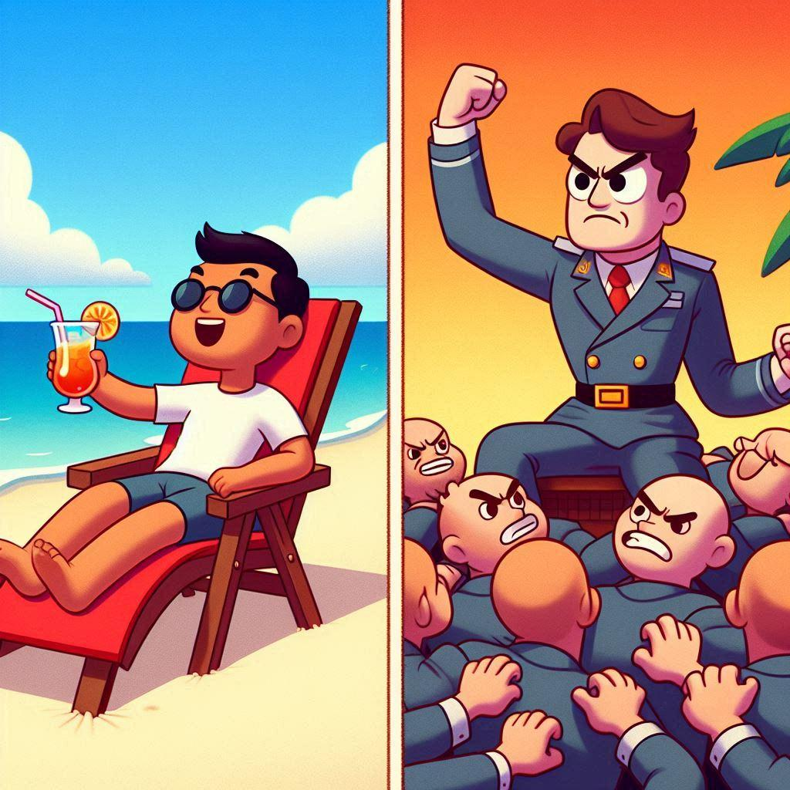
Dictator Sabbatical
Meet the new boss. Same as the old boss.

Slide 22
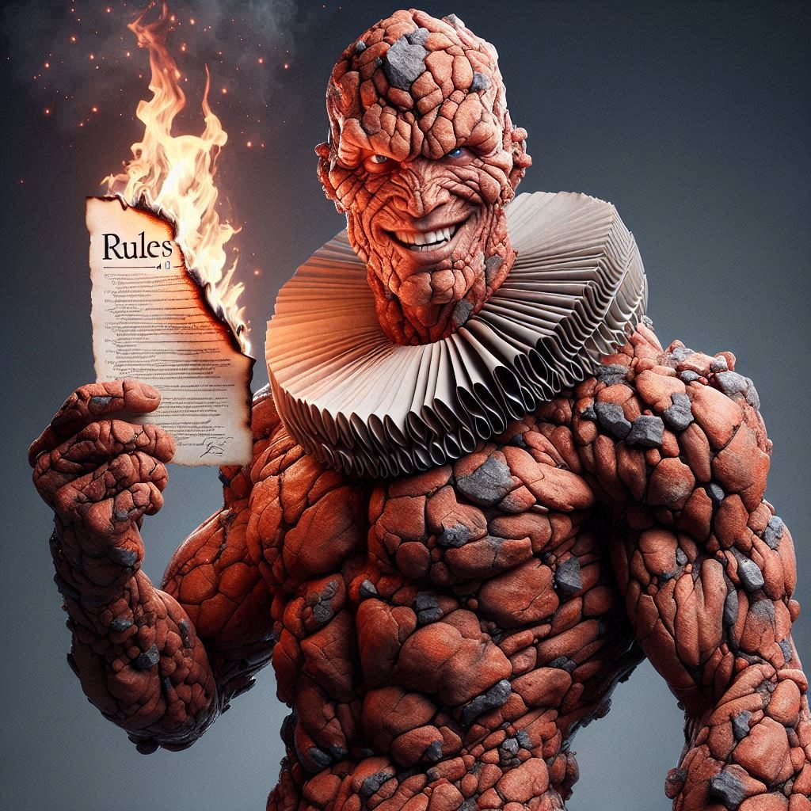
New $ Rules
Dues: $125
Prizes
1st | $500
2nd | $250
3rd | $150
7th | $300 (to charity) ★
Mini Games
Reg Ssn Pts | $60
Pts Week Team | $60
Pts Week Player | $60
Pts Wk 17 | $60 †
Closest Margin | $30
First Season-Ending Injury | $30 ✳
★ | Winner of Consolation Bracket. Choose any charity
† | All teams included last wk of year.
✳ | Must have spent >= $10 FAAB or Draft. Timing based on official declaration from team, not injury itself.

Slide 23
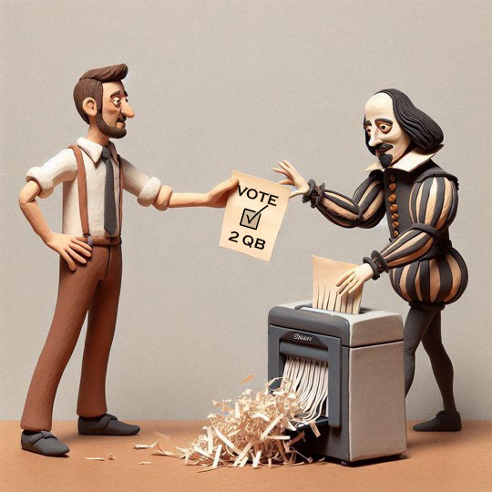
New Sleeper Feature:
Auto Subs
Designate subs for starters and if starter is inactive, sub is auto swapped
Bozo Vote
Option 1:
Sub must have same or later game time
Option 2:
Sub can have ANY game time within week
Example…
You can only set a sub for a SNF starter from SNF or MNF
Example…
set a TNF player as sub for a MNF starter. If MNF starter ends up inactive, you get TNF player’s pts
Just saves from scrambling or asking for commish help if mgr unavailable right b4 kickoff
default if vote tie
Saves from scramble / commish help PLUS enables mgr to not have to make tough, early calls related to injuries

Slide 24
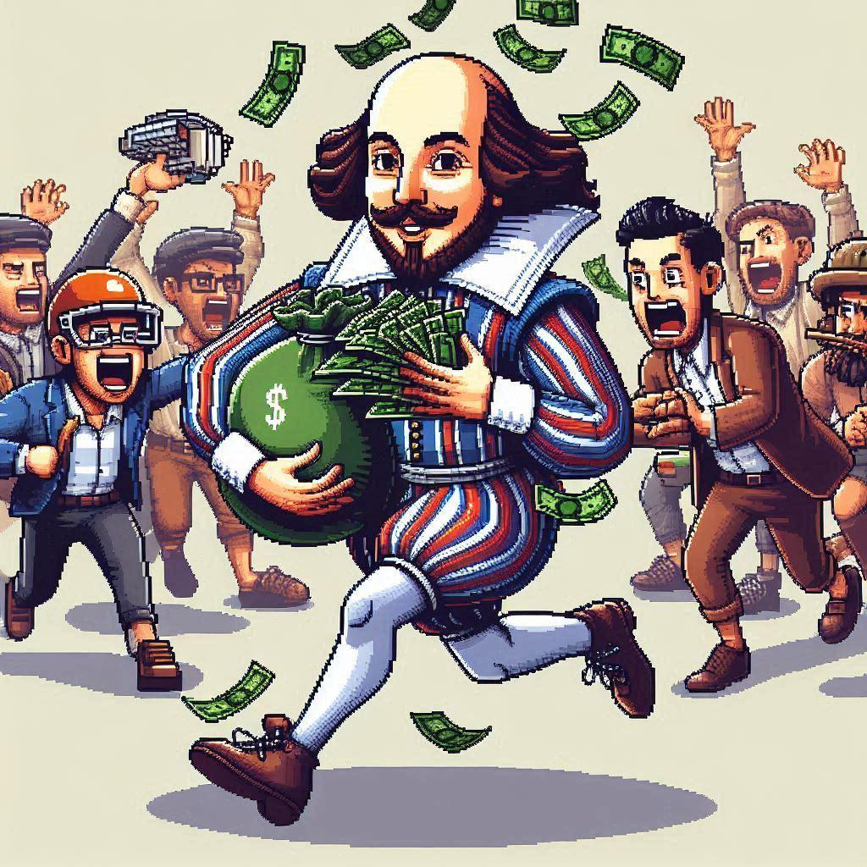
DISCLAIMER
All Sx3 prize monies are not available* until the end of the season.
To see your monies before then, check:
Oil tankers market
Bed, Bath & Beyond stock
Dogecoin
Beanie Babies on eBay
Albert’s kids’ clothes
*availability is subject to be “Kurdpt’d” and is not guaranteed

Slide 25
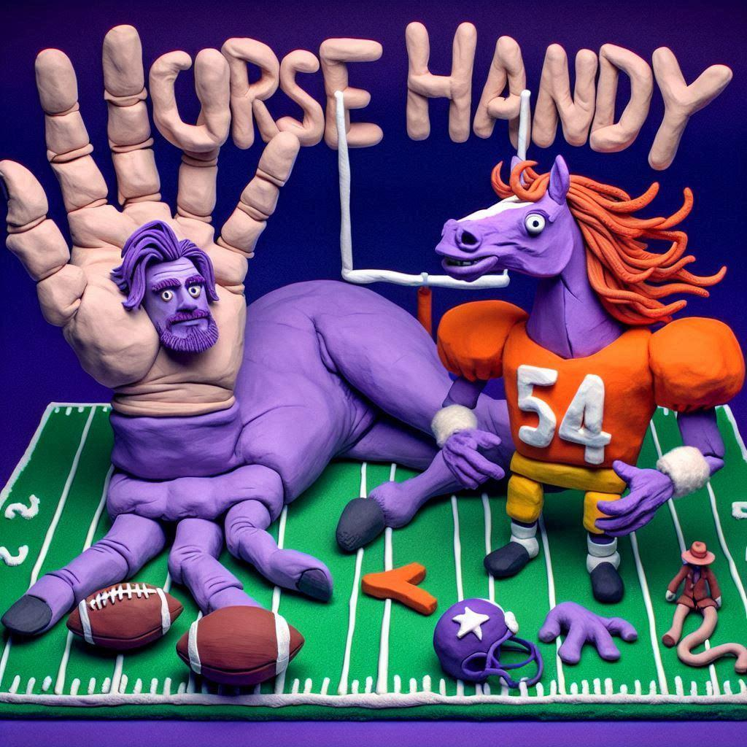
<pic>
New Website
Sx3ff.com
Sx3.fun became expensive 😠
Sx3.fun still active, points you to the new site

Slide 26
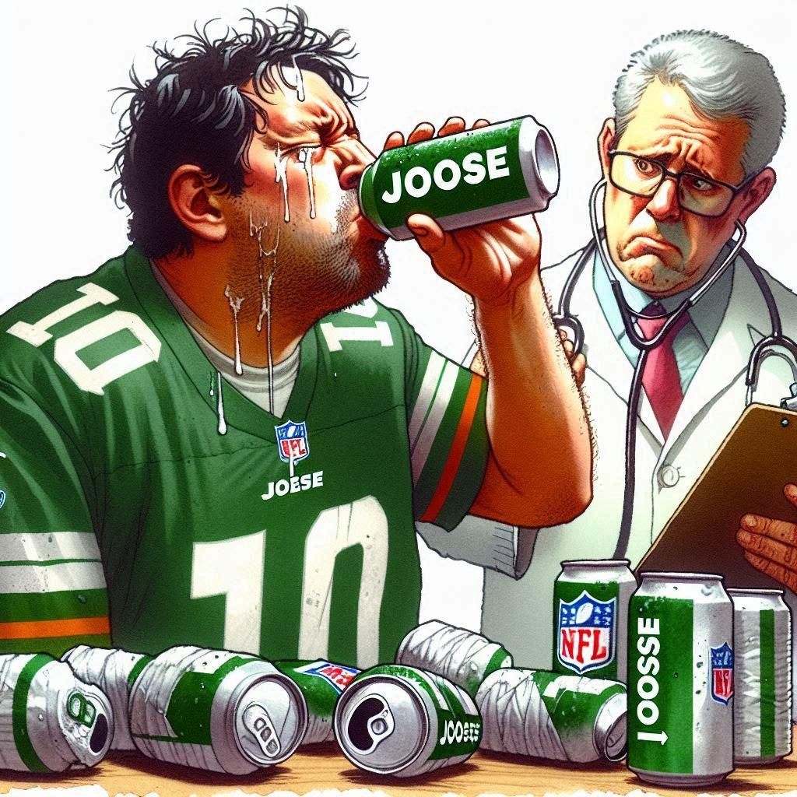
Draft Reminders
Nomination order has been randomly set
Nomination Time: 30 seconds (don’t take this long… at 15 secs everyone can harass you)
Bid Time: 10 seconds (resets to 10 secs w/ bids)
If you bid more than the next person, ALL of what you bid is deducted
Nominating a player = $1 bid
System forces you to have at least $1 for each roster spot … NO $0 players
EVERYONE be on the lookout for disconnects and shout so we can pause

Slide 27
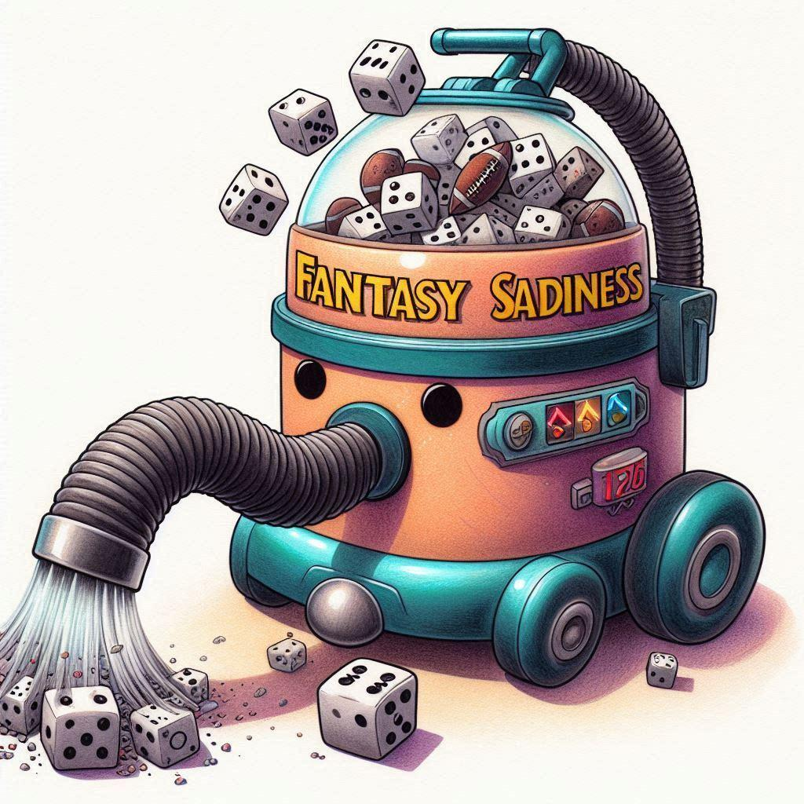
Good Luck.
You sux.

