Slide 1
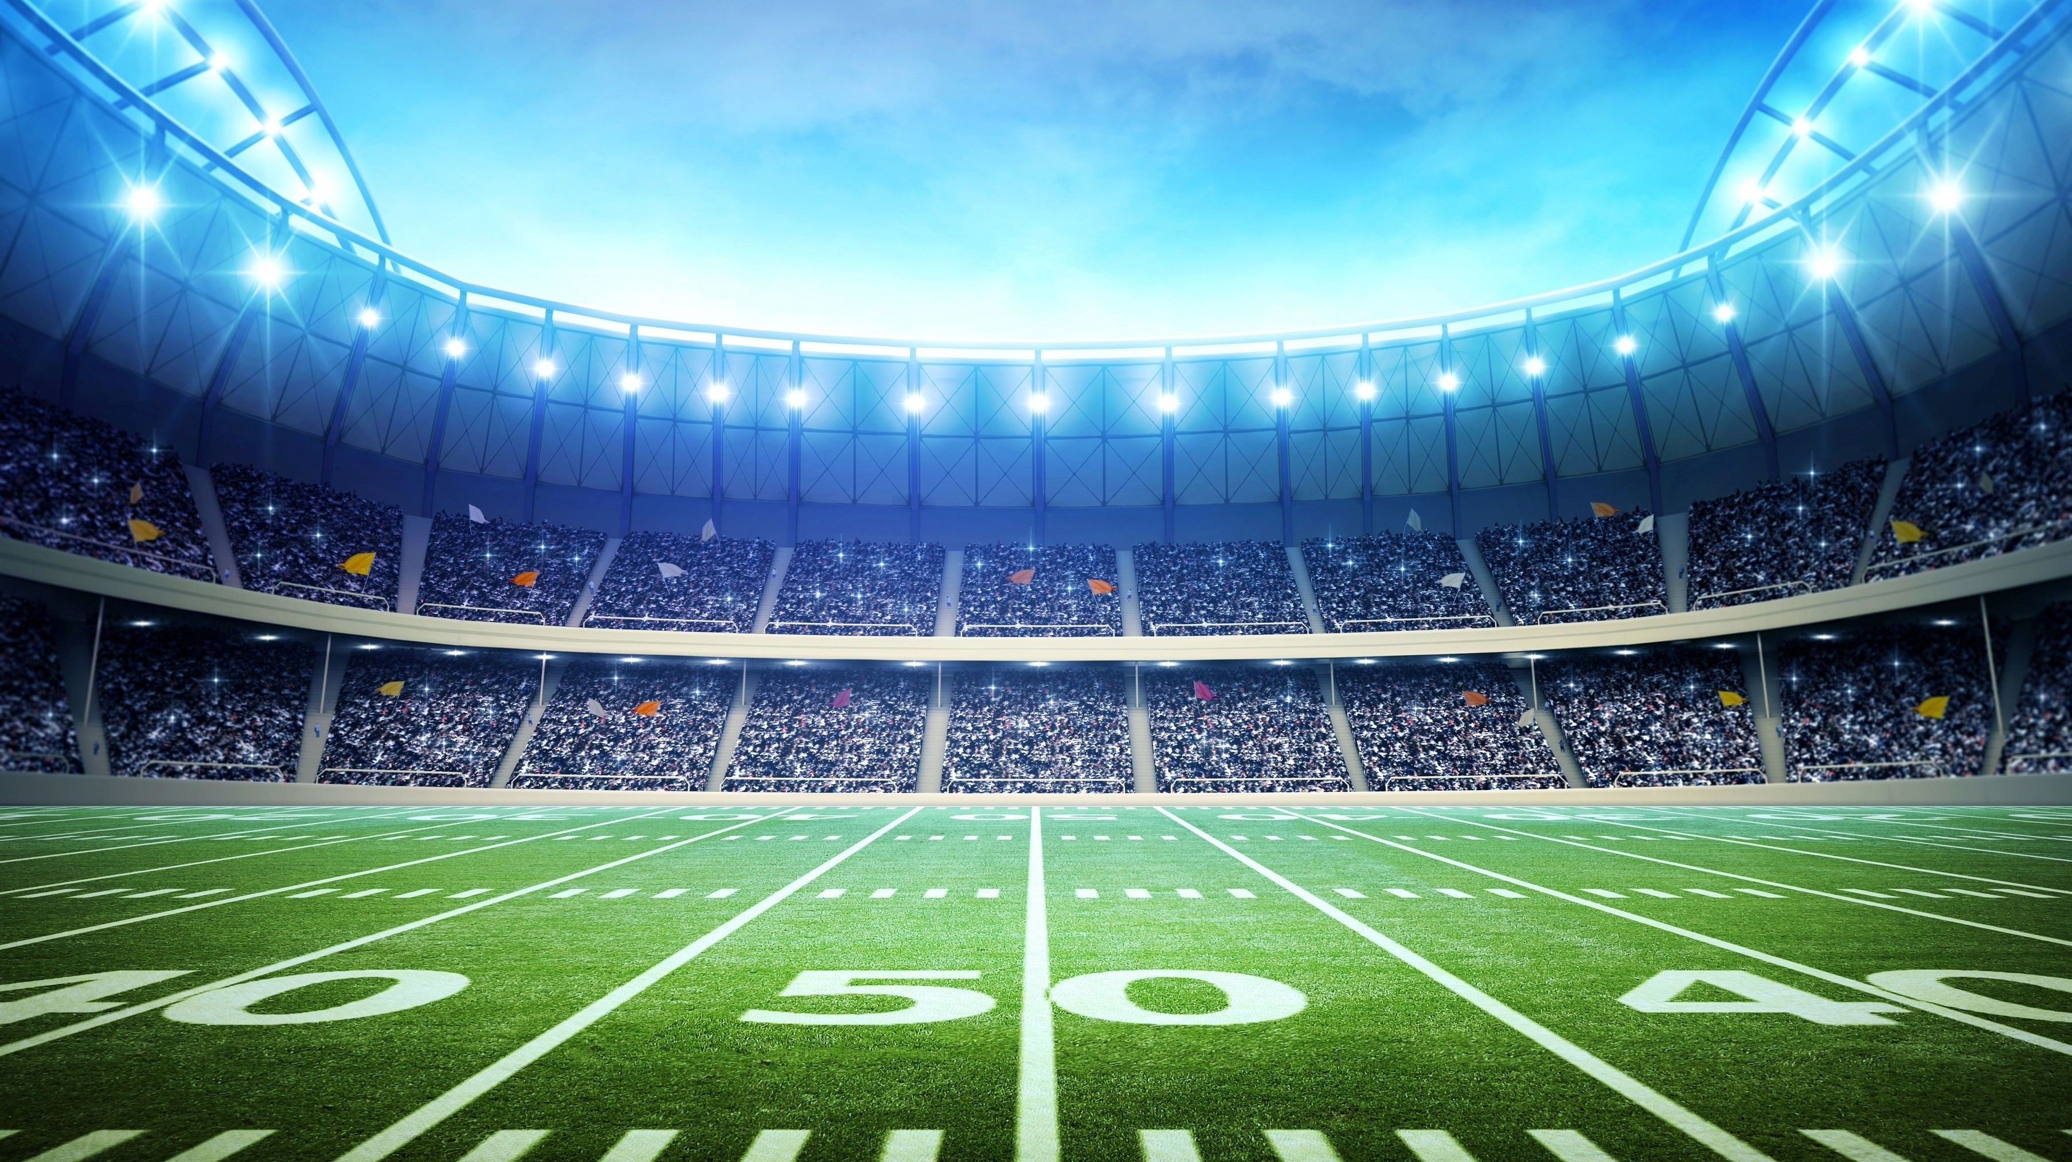


Welcome Back Bozos!

Slide 2



Andrew Sucks at
Fantasy Football
SHOW US THE UNICORN!
Russell | 💩
Cousins | 💩
D Henry
Jamal Williams
Edmonds | 💩
McKissic | 💩
Nyheim | 💩
AJ Brown
Pittman | 💩
DJ Moore | 💩
Allen Robinson | 💩
Doubs
Goedert | 💩
wk1 | W | 128 | 110 | Bill
wk2 | L | 102 | 120 | Eddie
wk3 | L | 104 | 154 | Jim
wk4 | W | 152 | 117 | Albert
wk5 | L | 106 | 158 | Jake
wk6 | W | 123 | 103 | Jeff
wk7 | W | 154 | 139 | Trevor
wk8 | L | 166 | 178 | Jake
wk9 | W | 165 | 138 | Darren
wk10 | L | 125 | 134 | Gregg
wk11 | W | 159 | 69 | Aaron
wk12 | L | 116 | Rumble | Rumble
wk13 | L | 125 | Rumble | Rumble
wk14 | L | 105 | Rumble | Rumble
🦄15 | L | 150 | 191 | Aaron
🦄16 | L | 102 | 172 | Jeff
6-8
Regular Season
1,836
Points For (8th)
1-1
2-2, 3-3, 4-4, 5-5, 6-6
$17
Leftover FAAB
-$300
Lifetime Earnings
0
Fantasy Skills

Slide 3
Andrew’s Team Name

Slide 4

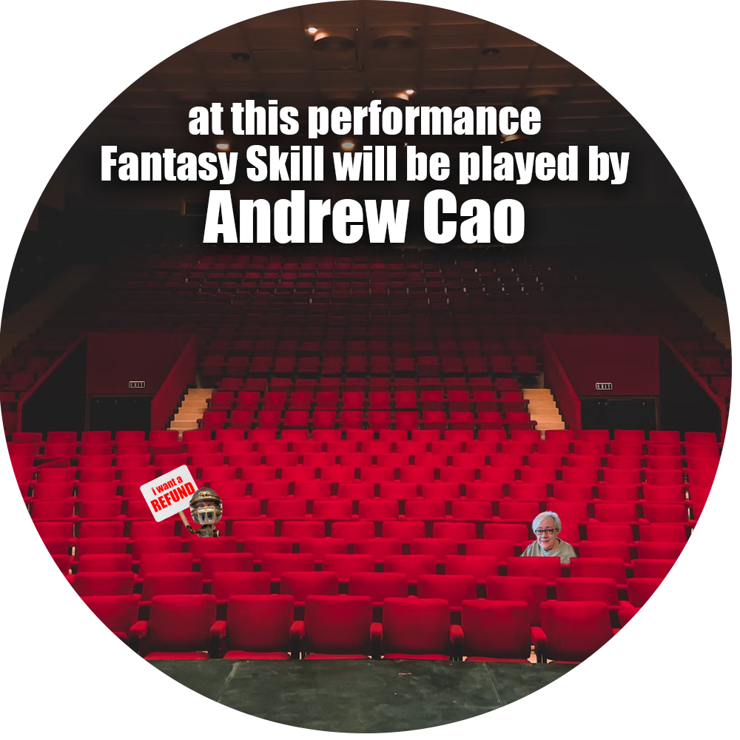

Andrew’s Team Name
AARON’S
UNDERSTUDY

Slide 5
Wk | Pts | WL
1 | 193.98 | W
2 | 89.96 | L
3 | 114.38 | L
4 | 152.88 | W
5 | 123.46 | L
6 | 112.68 | L
7 | 139.48 | L
8 | 100.54 | L
9 | 143.32 | L
10 | 140.04 | L
11 | 135.12 | L
12 | 111.12 | L
13 | 117.82 | L

Slide 6
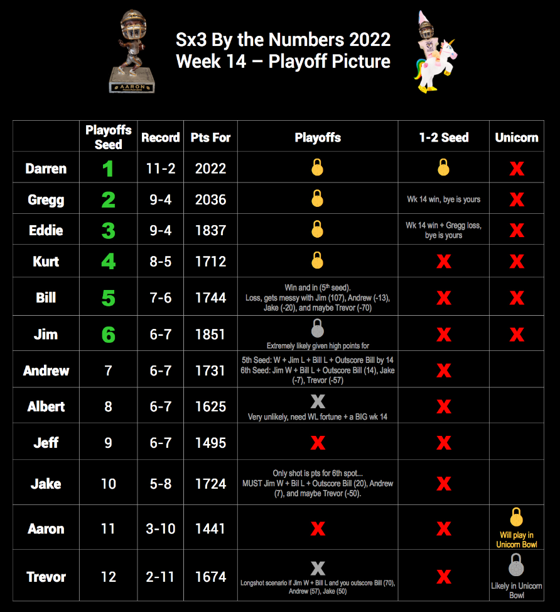
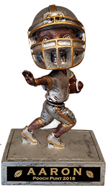


Slide 7
Wk 14 - Trevor
Mahomes | 22.28
McKinnon | 34.9
Najee | 13
Jefferson | 36.3
Jeudy | 33.0
Conklin | 7.8
Skowronek | 15.9
Chubba | 18.9
D Carlson | 13
NE DST | 23.16
218.54 | 135.12
Final Reg Ssn Standings
1 | Darren | 12-2 | 2,151
2 | Greg | 10-4 | 2,174
3 | Eddie | 9-5 | 1,958
4 | Kurt | 9-5 | 1,840
5 | Jim | 7-7 | 1,979
6 | Trevor | 3-11 | 1,893
7 | Bill | 7-7 | 1,855
8 | Albert | 7-7 | 1,753
9 | Andrew | 6-8 | 1,836
10 | Jeff | 6-8 | 1,621
11 | Jake | 5-9 | 1,810
12 | Aaron | 3-11 | 1,564

Slide 8

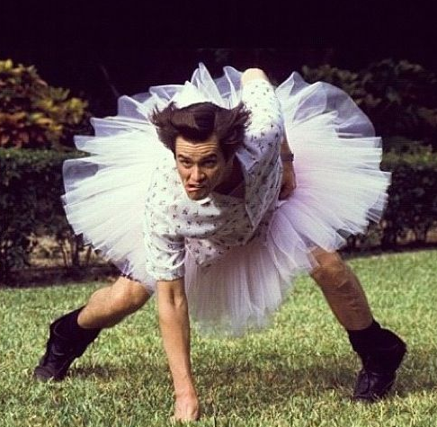
16
17
15
Trevor 161
Eddie 141
Trevor 149
Gregg 101
Trevor 125
Jim 109

Slide 9

OG
Congrats Trevor!
Only Kickers in the Building

Slide 10
OG
Congrats Trevor!
Only Kickers in the Building

Slide 12
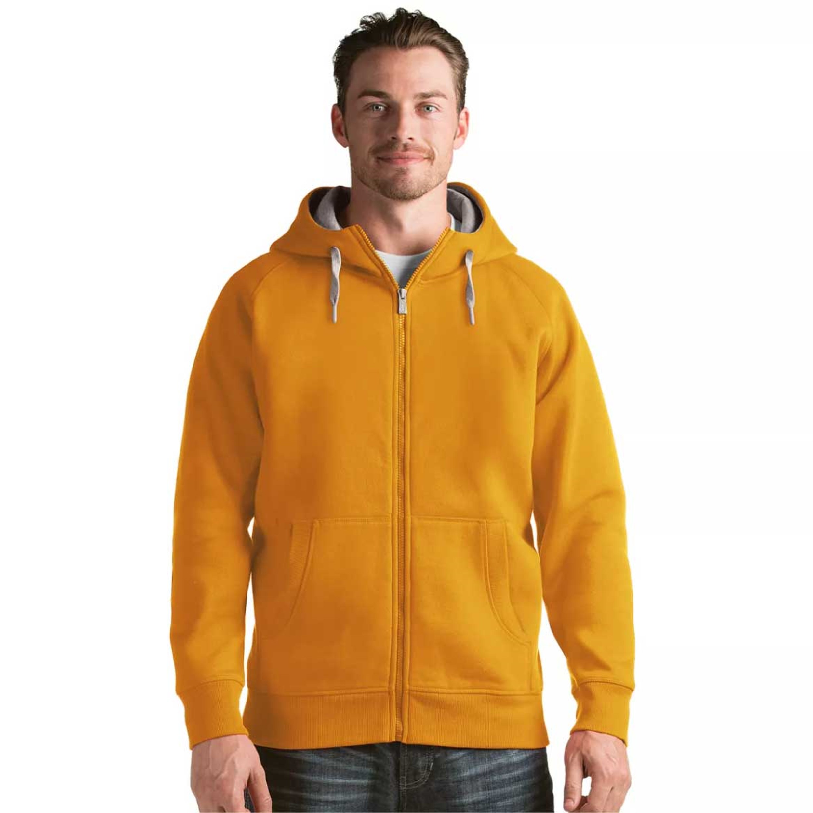

sx3
Gold
Hoodie

Slide 13


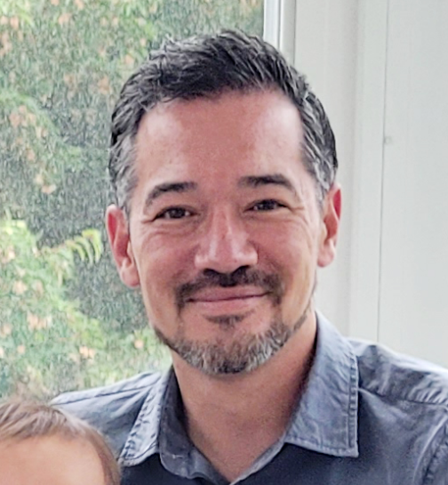
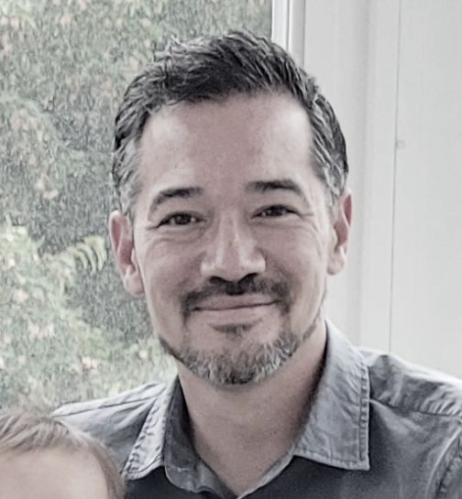
BET!
161
Loser of Aaron v Jake wk 17
… must recite an ode to the other’s greatness during next year’s draft
100

Slide 14
Oh, Jake
You boss, you beast, you baller
You're better than me
A fantasy gentleman and a scholar
It's hard to get beat
By anyone, you know
But the sting's even sharper
Cuz you gave up months ago
Each night I cry
As I lay down to bed
Cuddling with your picture
Wishing I were you instead
You play with such grace
Such skill, such promise
Despite your constant attempts
To trade me Michael Thomas
You master the COTY
Your own comments go viral
You look great with your shirt off
And throw one hell of a spiral
You make all the right moves
in Sx3
But note that many of them
Are after talking to me
You kicked my ass that week
It's sad. It's true.
But before I sign off
There's one thing I must do
Yes I'll end in the spirit
of keeping it real alive,
Remember Jake, I have 2 rings
And head-to-head I'm still 13-5
Oh, Jake
by Aaron Cao

Slide 15
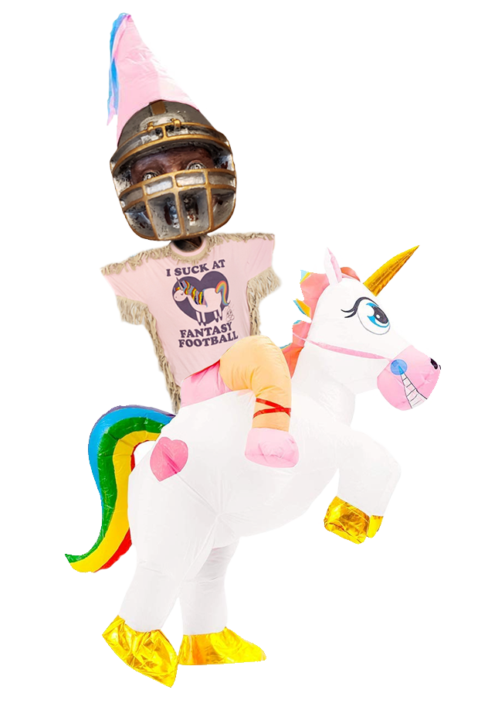


2022 - Results
Trevor
Jim
Darren
Andrew
Gregg | 4th
Eddie | 5th
Kurt | 6th
Jake | 7th
Aaron | 8th
Albert | 9th
Bill | 10th
Jeff | 11th
Andrew | 12th

Slide 16
Mini Games
Most Pts Reg Season
Most Pts Team Wk
Most Pts Started Player
Closest Margin Defeat
Gregg – 2174.3
155 pts/wk avg
Trevor – 218.5
21.8 pts/player avg
Eddie
Mixon – 56.1 (9)
153 rush yds, 4 TD
4 rec, 58 yds, 1 TD
3 TDs
Jim lost by 0.6
Week 1
Eddie: 144.12
Jim: 143.52
Wk 1 | 169.76
Wk 2 | 154.62
Wk 3 | 115.66
Wk 4 | 177.56
Wk 5 | 197.6
Wk 6 | 133.4
Wk 7 | 145.46
Wk 8 | 122.32
Wk 9 | 145.64
Wk 10 | 134.88
Wk 11 | 193.36
Wk 12 | 158.26
Wk 13 | 187.56
Wk 14 | 138.22
Mahomes | 22.28
McKinnon | 34.9
Najee | 13
Jefferson | 36.3
Jeudy | 33.0
Conklin | 7.8
Skowronek | 15.9
Chubba | 18.9
D Carlson | 13
NE DST | 23.16
Previous Winners
Tyreek ’20 | Aaron | 62.4
Ja’Marr ‘21 | Jim | 61.6
Rodgers ‘19 | Ryan | 57.3
Mixon ’22 | Eddie | 56.1
Henry ’18 | Jake | 54.8
Julio ’17 | Bill | 55.3
Lev ’16 | Bobby M | 54.8
AJ Green ’15 | Albert | 49.2
Glorious wk 14 Royal Rumble performance to defy the odds and make the playoffs
Man, that’d suck to happen week 1!
NEW 1st all-time highest
Jake last year now 2nd

Slide 17
2022-2023 Sx3 COTY
“I don’t know if it’s worth the effort putting this shit together.” - Jake

Slide 18
What is the COTY? (This is for Jim)
Each year, you twats fill our Sx3 message thread with non-stop mindless drivel. It’s typically banal, rife with spelling errors and occasionally offensive. (Cut to Albert. (Or I guess his proxy?))
But. Every once in a while. Someone says something marginally funny.
For these rare moments. We (I) created. The COTY. (Comment of the year.)

Slide 19
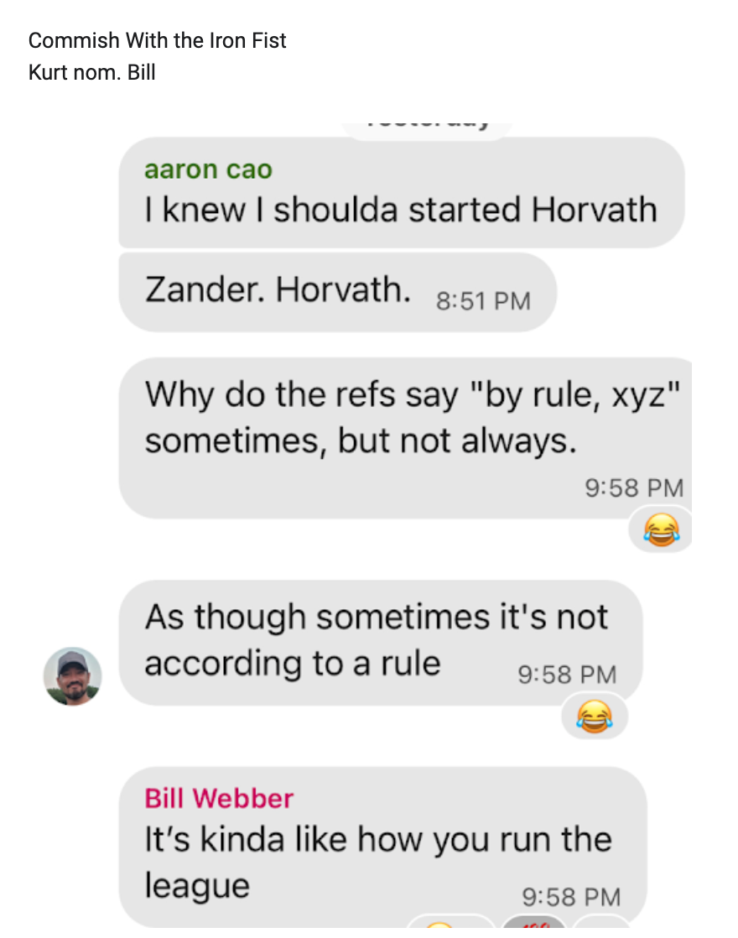
Ok here are the top 3 finishers…
Sx3’s 2022-2023
THIRD PLACE COTY goes to:
BILL WEBBER for
“Commish with the Iron Fist”

Slide 20
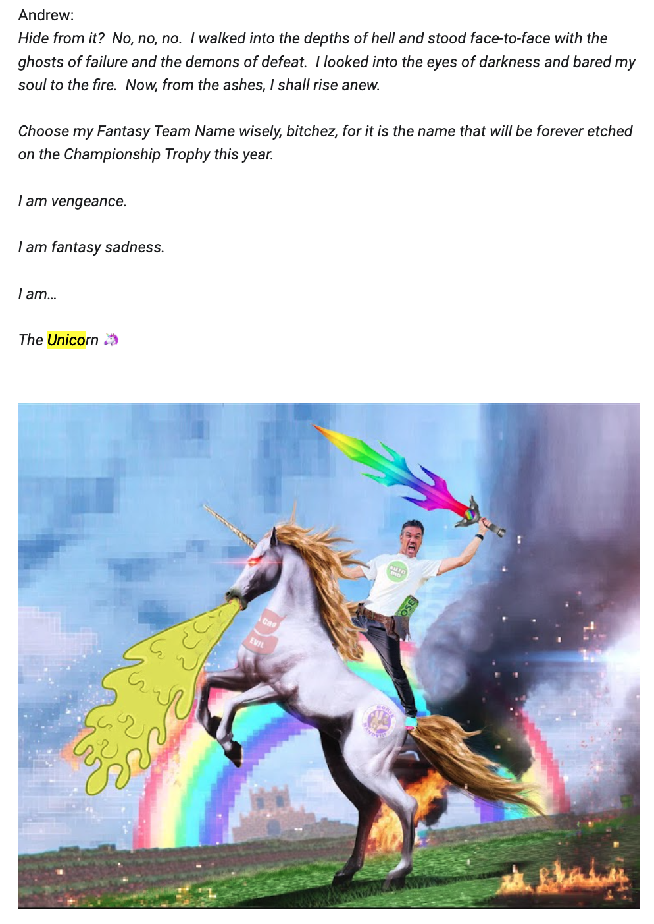
Sx3’s 2022-2023
OTHER THIRD PLACE COTY goes to:
ANDREW CAO for
“I am vengeance. I am The Unicorn.”

Slide 21
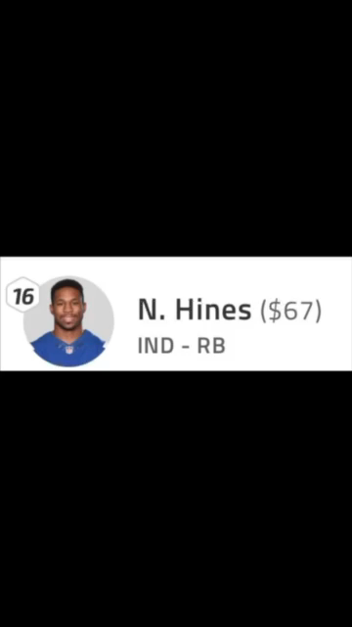
Sx3’s 2022-2023
SECOND PLACE COTY goes to:
EDDIEYE MCKENNA for
“On Brand. Early and often.”

Slide 22
And finally….
Sx3’s 2022-2023
OFFICIAL COTY WINNER:

Slide 23
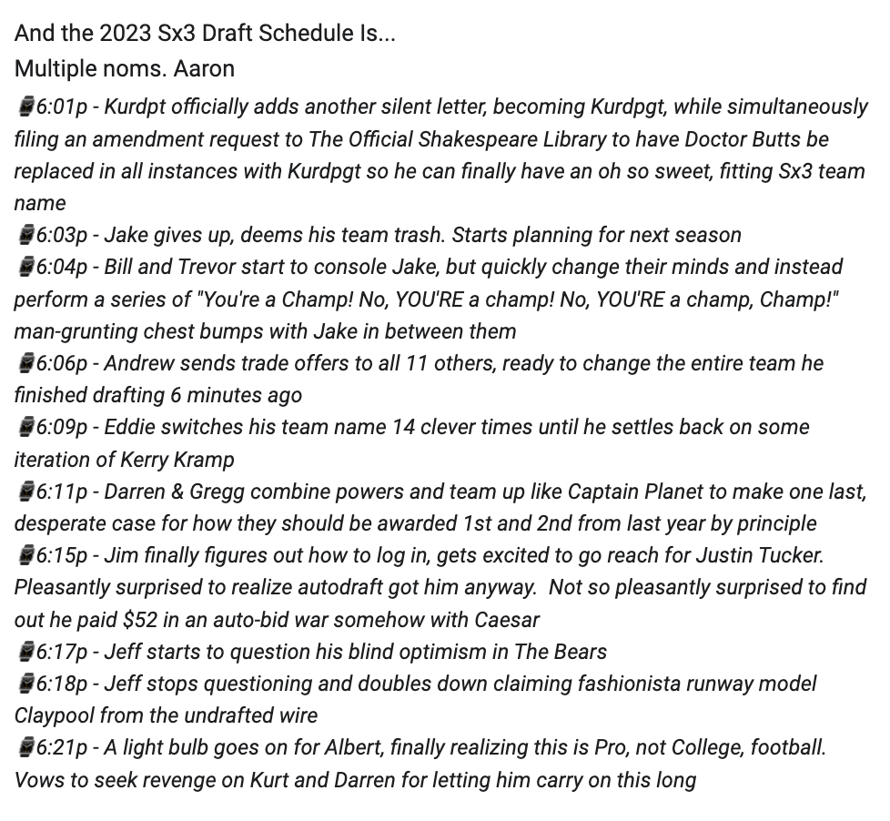
2022 Sx3 COTY
THE NATION’S WORST
FANTASY FOOTBALL
COMMISSIONER WHO
ONLY WON HIS LAST CHIP
BECAUSE SOMEONE GAVE
HIM JOE BURROW…
AARON CAO for
“And the schedule is…”
Congrats or whatever…

Slide 24
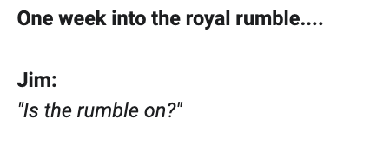
Lastly.
The COTY-LORD’S honorable mention goes to:
JIM BOROWSKI / BORONSKI for:
“Asking a question.”

Slide 25
Thank you
Keep the #COTYs comin’

Slide 26
Sx3 Member History
Mgr | 2023 | 2022 | 2021 | 2020 | 2019 | 2018 | 2017 | 2016 | 2015 | 2014 | 2013
Aaron | OG | OG | OG | OG | OG | OG | OG | OG | OG | OG | OG
Andrew | OG | OG | OG | OG | OG | OG | OG | OG | OG | OG | OG
Jake | OG | OG | OG | OG | OG | OG | OG | OG | OG | OG | OG
Bill | OG | OG | OG | OG | OG | OG | OG | OG | OG | OG | OG
Trevor | OG | OG | OG | OG | OG | OG | OG | OG | OG | OG | OG
Kurt | x | x | x | x | x | x | x | x | x | x
Albert | x | x | x | x | x | x | x | x | x
Jim | x | x | x | x | x | x | x | x | x
Jeff | x | x | x | x | x | x | x
Darren | x | x | x | x
Eddie | x | x | x | x
Gregg | x | x | x
Whitney |  |  |  |  |  | x | x | x | x | x | x
Clyde |  |  |  |  |  |  |  |  |  | x | x
Joey |  |  |  |  |  |  |  |  |  | x | x
Andy |  |  |  |  |  |  |  |  |  |  | x
Barrett |  |  |  |  |  |  |  |  |  |  | x
Bobby C |  |  |  |  |  |  |  |  |  |  | x
Stephanie |  |  |  |  |  |  |  |  |  |  | x
Sophie |  |  |  |  |  |  |  | x | x | x
Bear |  |  |  |  |  |  |  |  |  | x
Shawn |  |  |  |  |  |  |  |  |  | x
Bobby M |  |  |  |  |  | x | x | x | x
Sam |  |  |  |  |  | x | x | x | x
Caesar |  |  |  |  | boo
Ryan |  |  |  |  | x
Trentshall |  |  |  | x | x
3
2
1

Slide 27
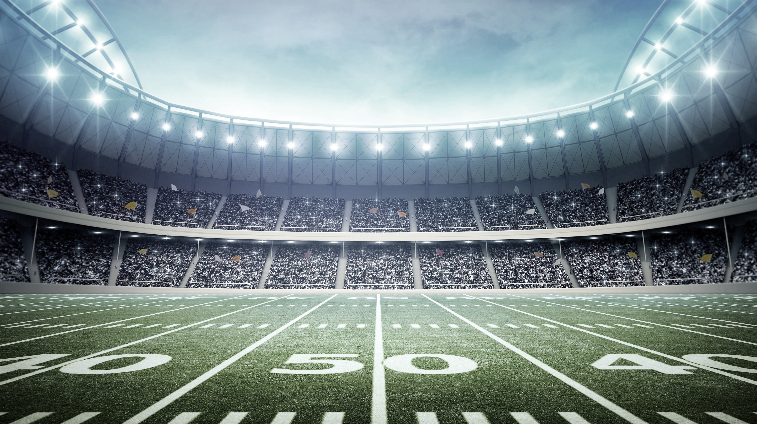
Sx3.fun
New Stuff
Gimme Stuff

Slide 28
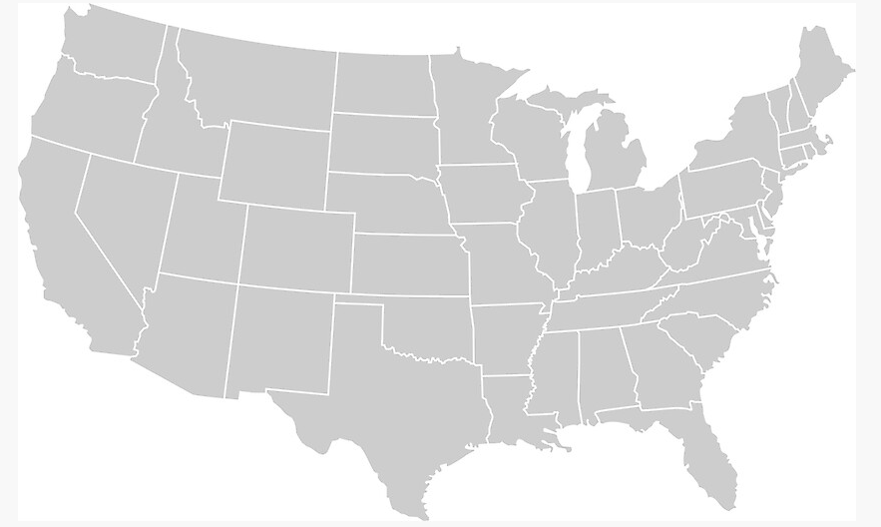
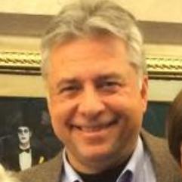
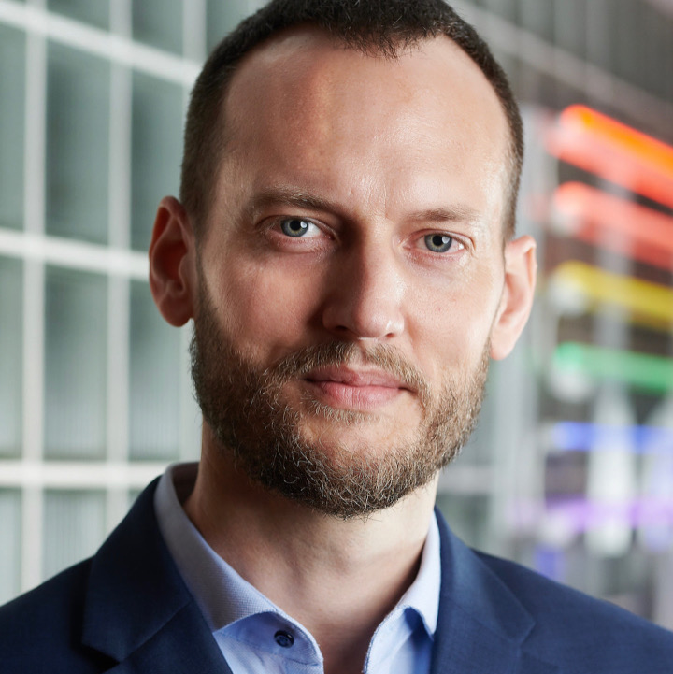
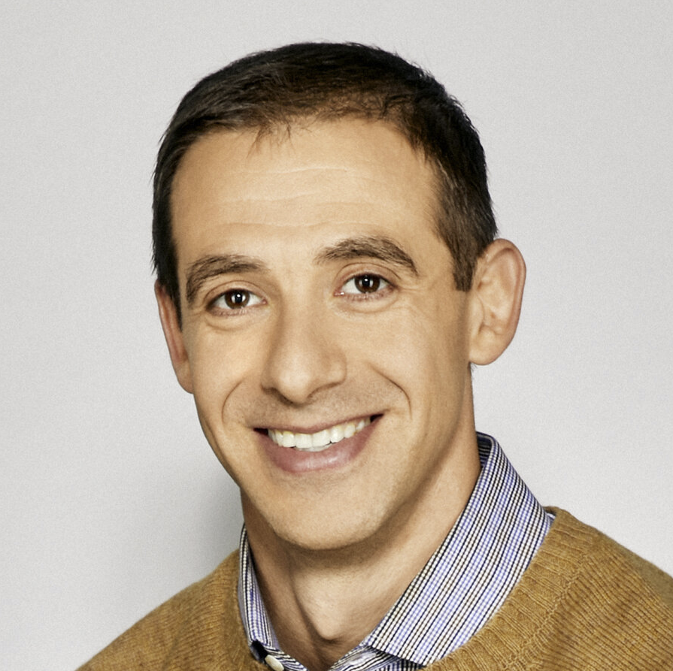
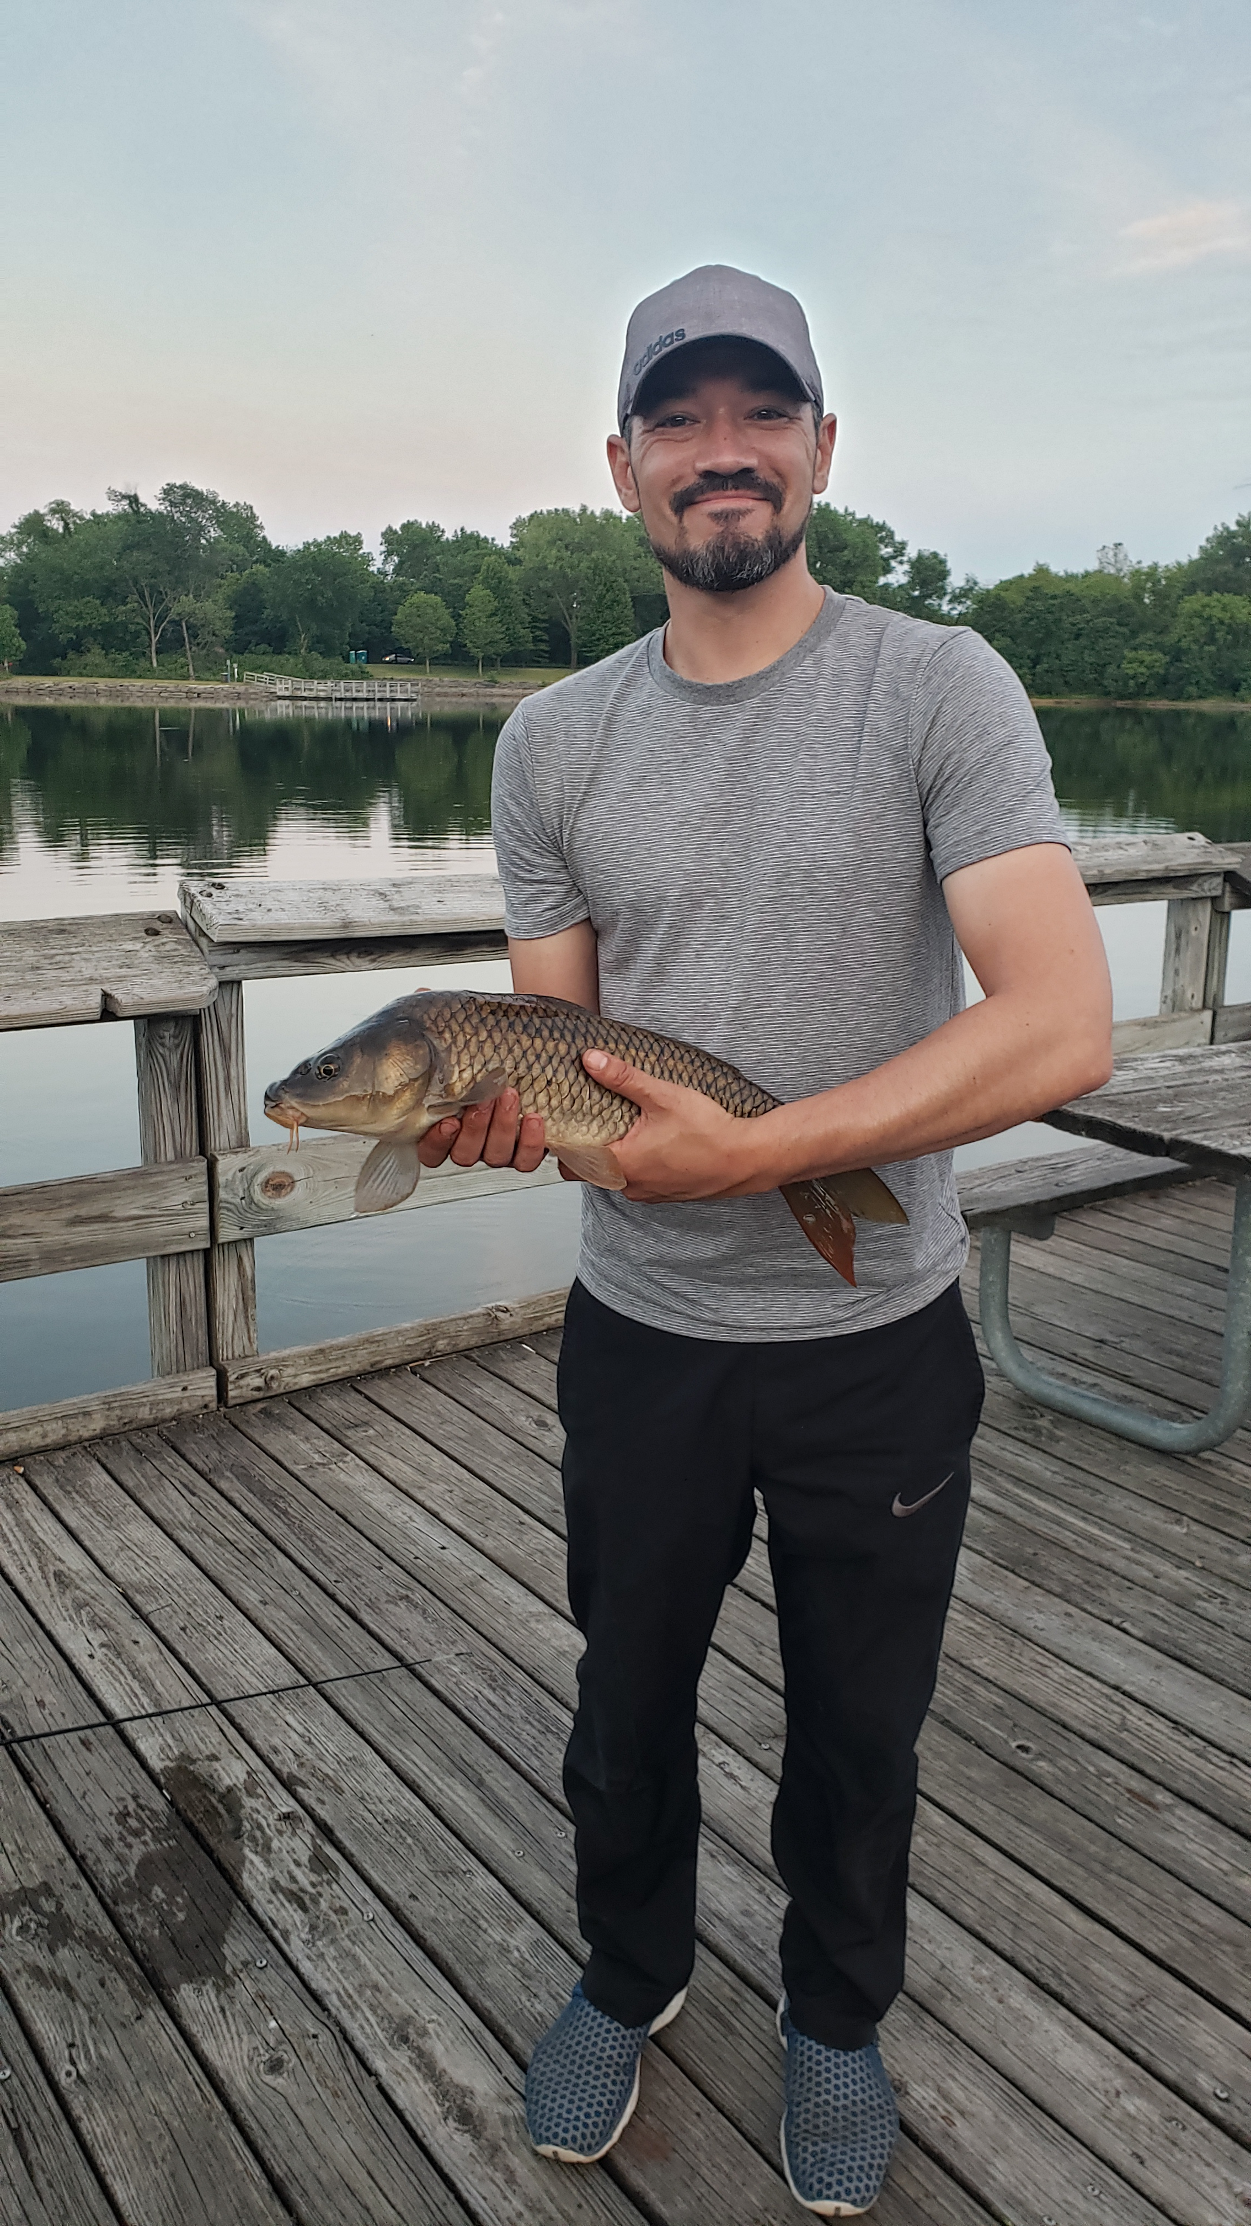
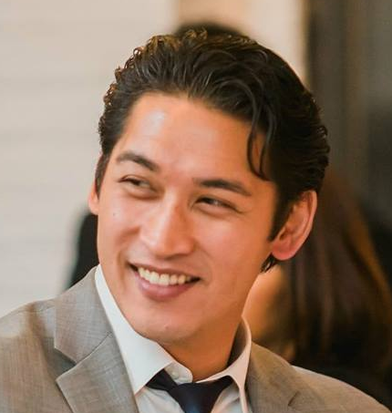
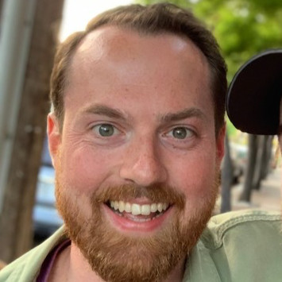
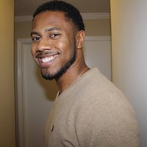
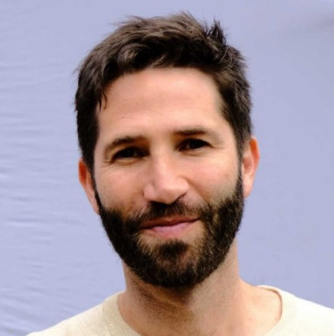
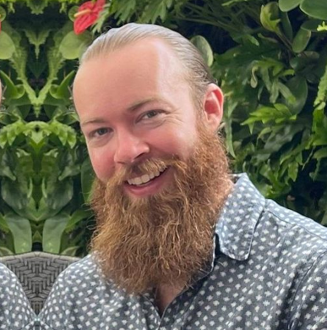
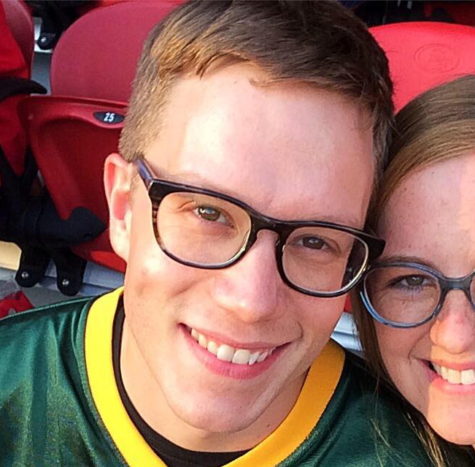

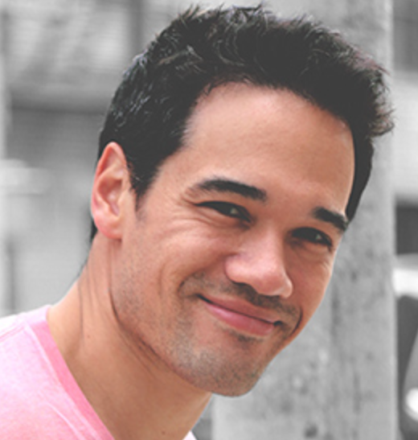

Slide 29
Prizes & Payouts
Champion | $625
2nd Place | $300
3rd Place | $100
Most Pts Reg Season | $50
Most Team Pts in a Week | $50
Most Player Pts in a week | $50
Closest Margin of Defeat | $25 (to the loser)

Slide 30
Pay Up!
Paid Up: Jim, Darren (previoius winnings)
Owes $100: Errbody Else
Don’t say Football or Fantasy in memo
Cash
Venmo (@aaroncao, or caoac@yahoo.com)
PayPal (caoac@yahoo.com)
Cash App ($aaroncao) cash.app/app.BKNKFVN promo code ($5)
Google Pay (aaronccao@gmail.com) g.co/payinvite/cx8rg64 promo code ($5)
Chase Quick Pay / Zelle (caoac@yahoo.com)
BTC, LTC, ETH (ask me for details. If Coinbase send to caoac@yahoo.com)

Slide 31
Gimme a Break
NEXT year, I’m taking a break from Commish duties.
Who wants to take the reins?
Basic Commish duties, not Aaron excessive OCD-ness.
(I’ll do some some of that stuff regardless)
Please consider it ☺

Slide 32
Draft Details
Nomination Order has already been randomly set
Nomination Time: 30 seconds (don’t take this long… at 15 secs everyone can harass you)
Offer/Bid Time: 10 seconds (resets to 10 secs w/ bids)
If you bid more than the next person, ALL of what you bid is deducted
Nominating a player = $1 bid
System forces you to have at least $1 for each roster spot … NO $0 players
EVERYONE be on the lookout for disconnects and shout so we can pause

Slide 33
Good Luck!
May you all fail miserably

