Slide 1

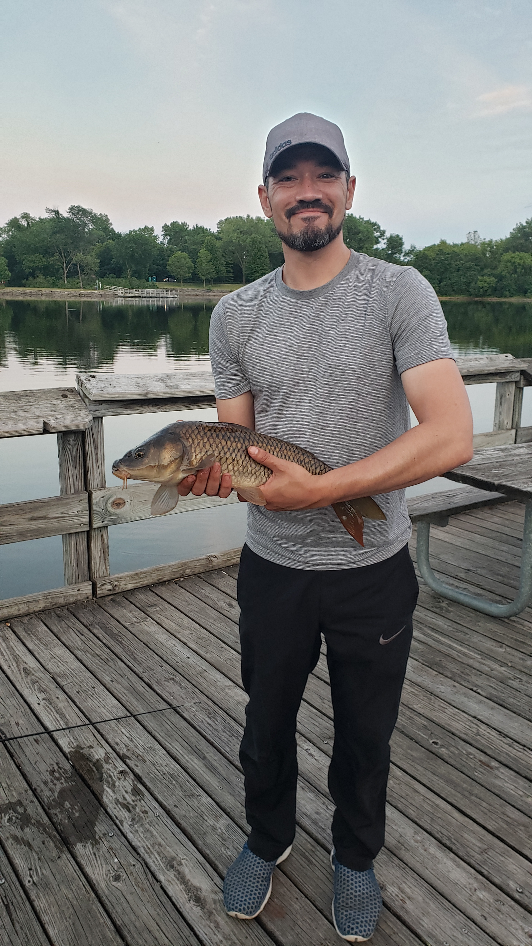


Week 17 Battle
Jeff & Aaron went head-to-head in wk 17 in a battle for 7th place.
We made a bet.
Jeff, a die-hard Bears fan, would have to wear a Cheesehead for the draft if he lost.
Aaron, who bleeds Green & Gold, would wear Bears garb if he lost.

Slide 2
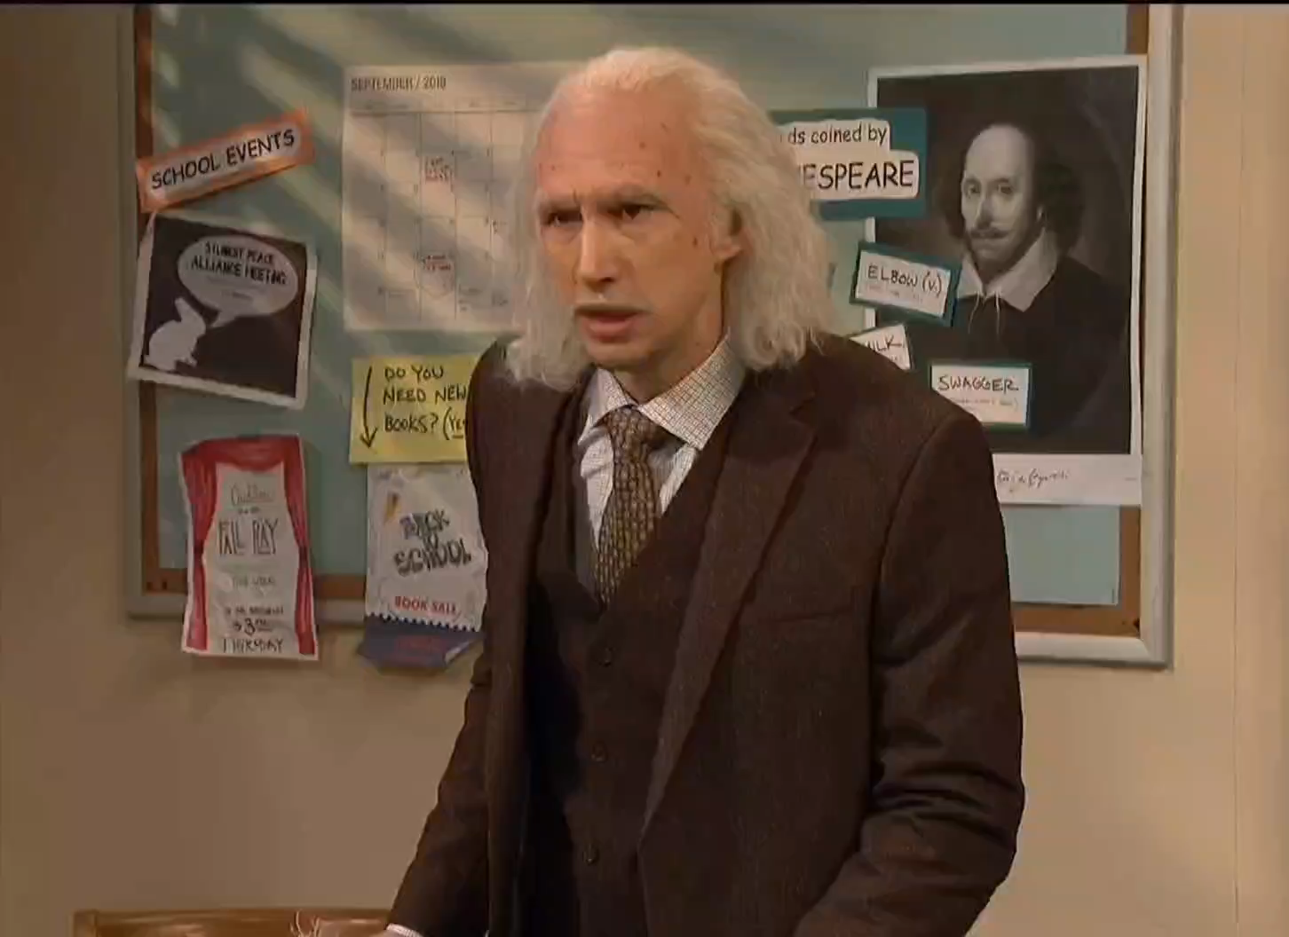
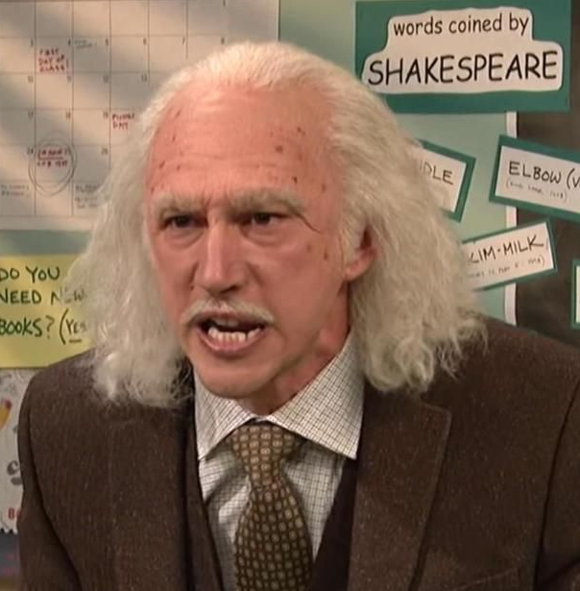
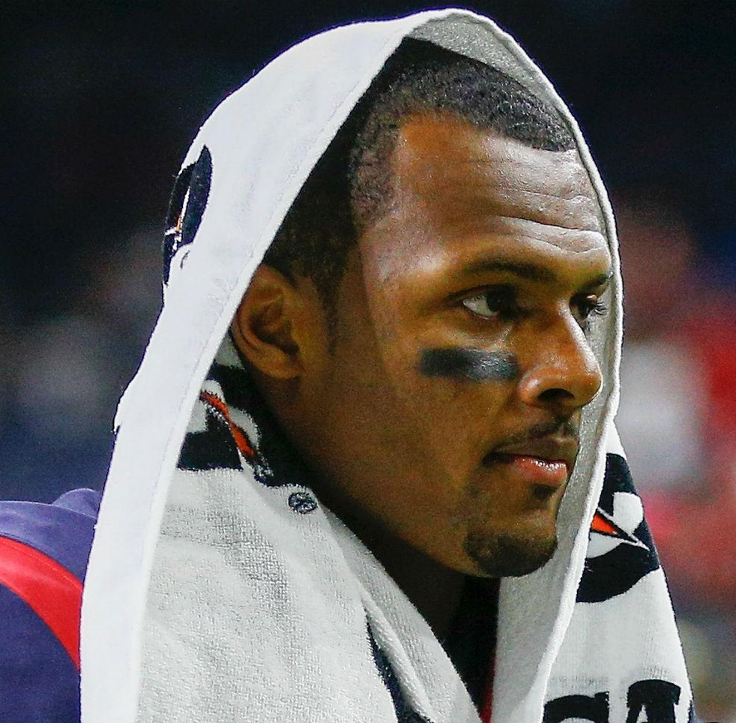
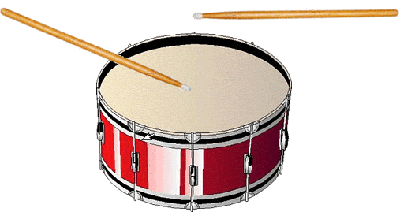

Week 17 Battle
Crush Your Enemies
Watson Watsoff
Rodgers | 25.14
David Johnson | 29.9
Chubb | 17.6
Tyreek | 10.5
Higgins | 21.9
Gronk | 19.8
MVS | 0
Tyron Johnson | 5.6
Butker | 8
CLE | 11.68
Watson | 27.76
Melvin | 7.9
Darryl | 6.2
Cooks | 28.1
Kupp | 14.64
Waller | 17.2
T.Y. | 9
Curtis Saumel | 21.8
Crosby | 4
CHI | 8.88
vs
150.12
145.48

Slide 3

Let’s See That Cheesehead!!!

Slide 5


2021
9th Anniversary!

Slide 6
Sx3.fun
Website with news, rules, stats & other various share-ables
This presentation is available there as a PDF

Slide 7



Jim’s 2020 Team Is…
Staying Positive
with Jake Paque
Two-nicorn

Slide 8
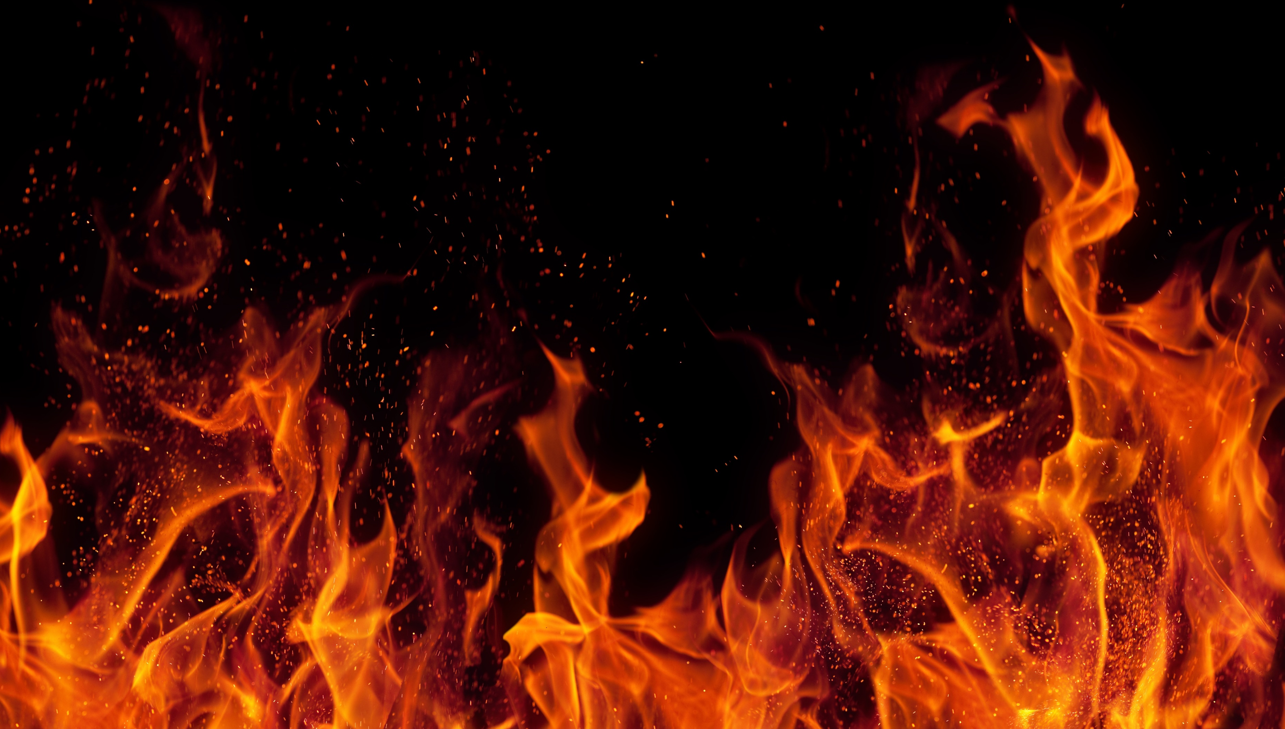
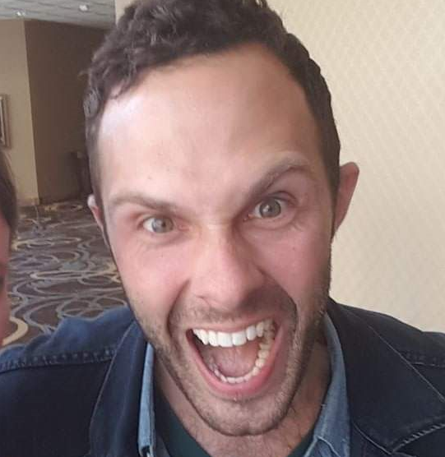
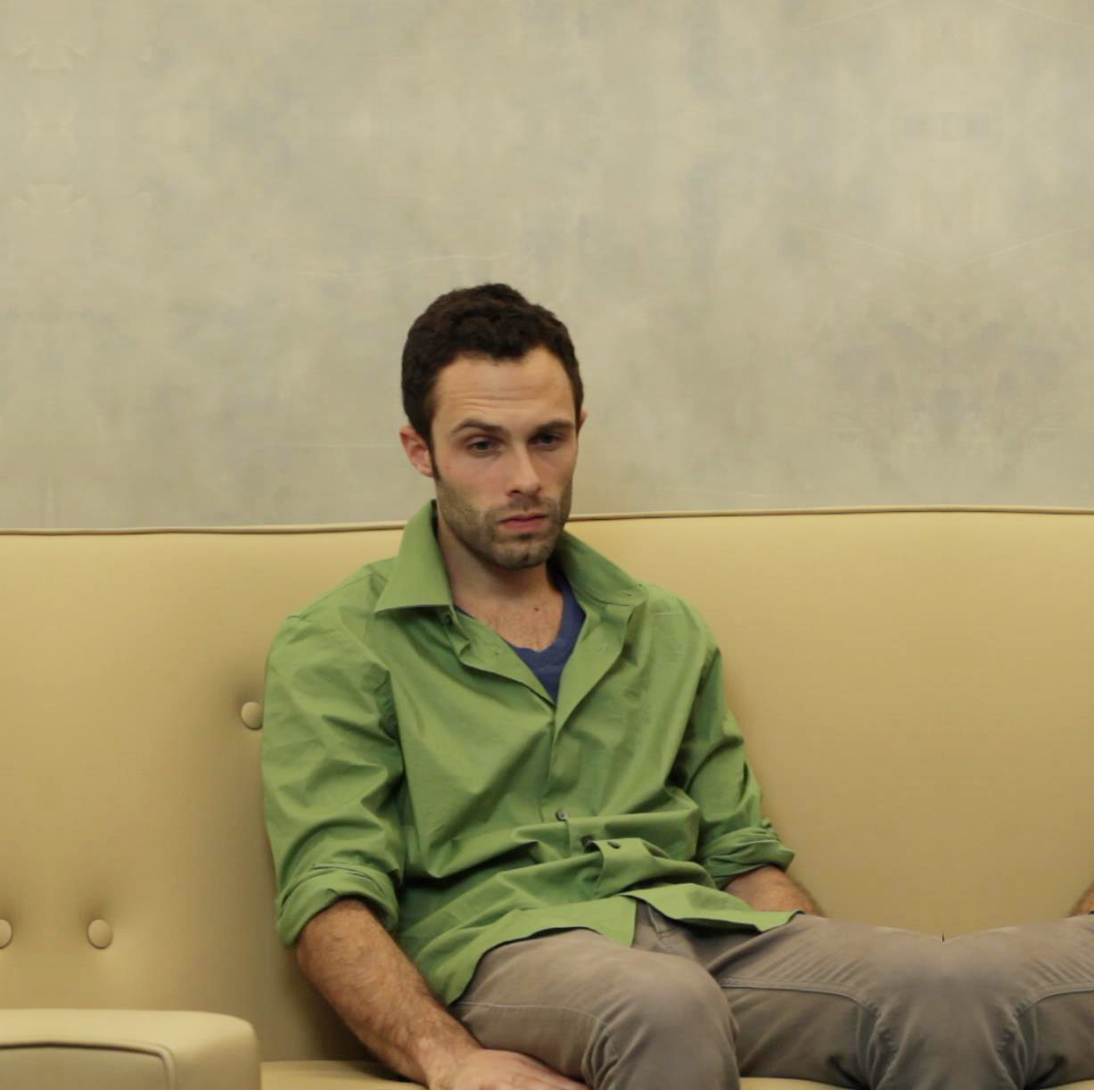

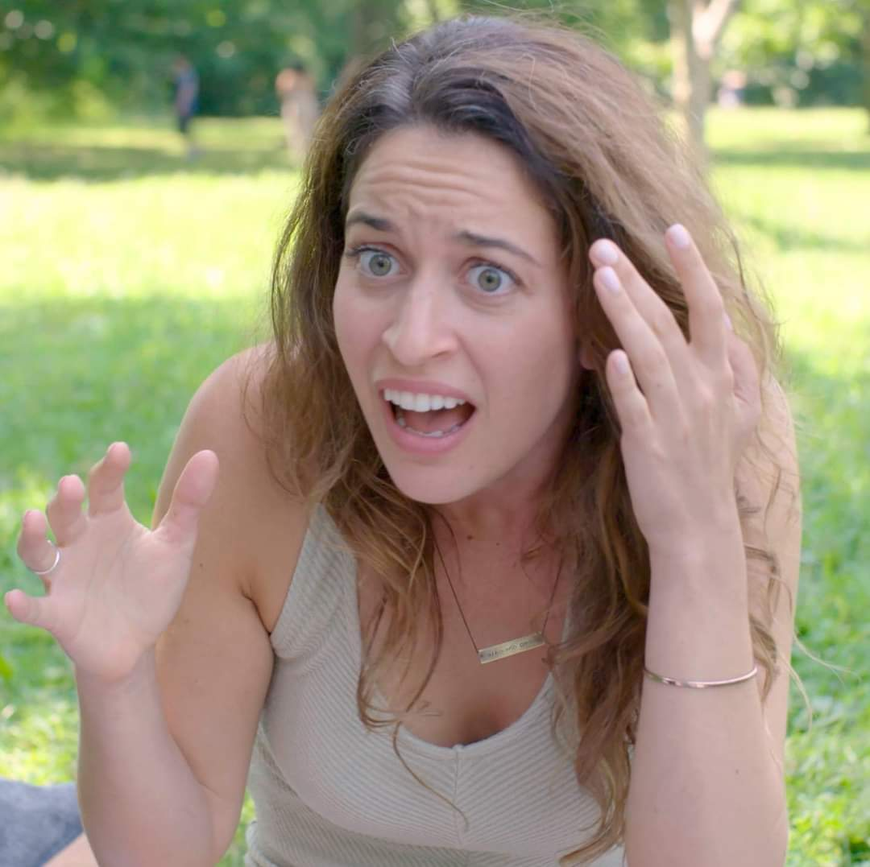
actually
Staying Positive
with Jake Paque
What is happening? Who are you!?
“I have nothing but confidence. And I will scream in every one of your fucking ears as I crush your pathetic, unvaccinated, injury-riddled teams.
“VenMo me half your buy-in and save yourself the embarrassment of getting mutilated by me and my squad”
“Daddy’s gonna clean house this season and wipe up all your spills.”

Slide 9

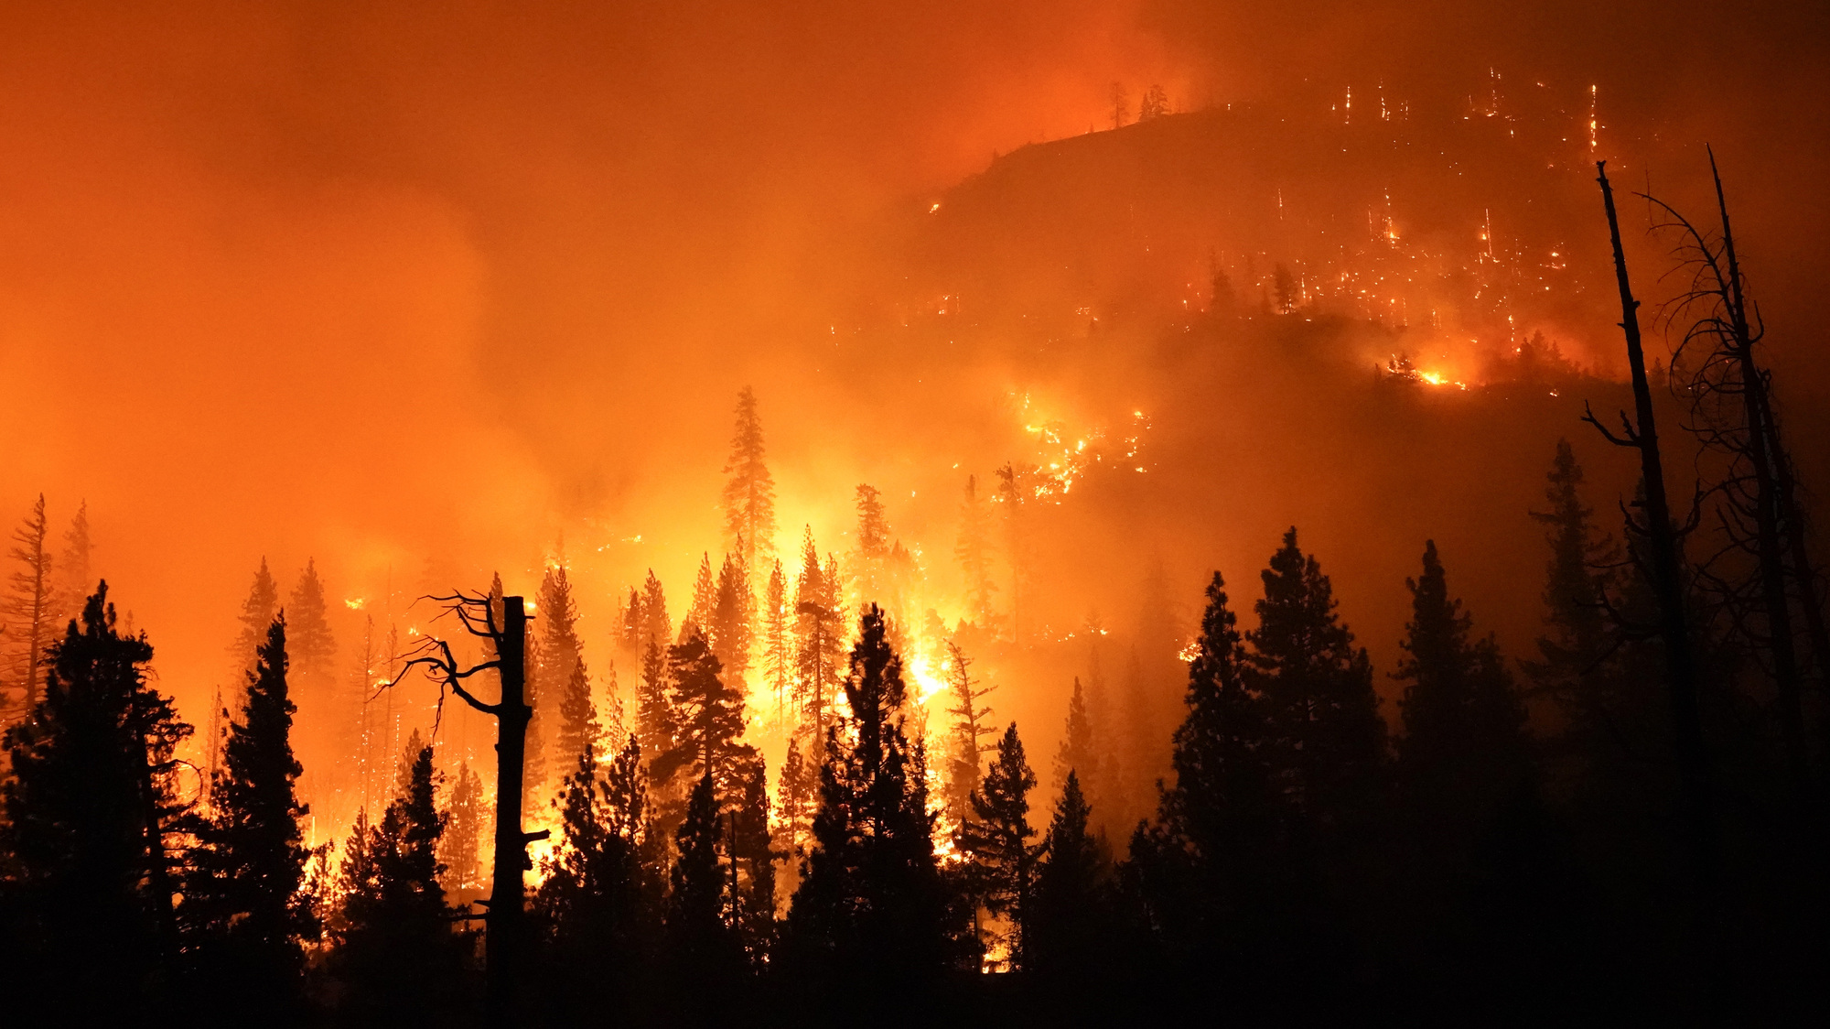
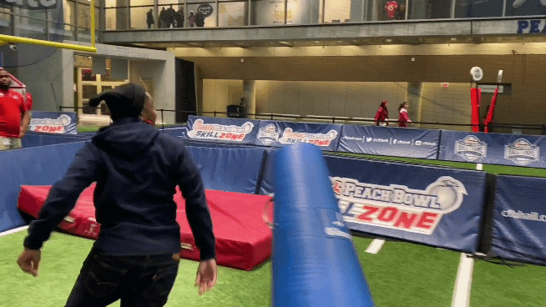



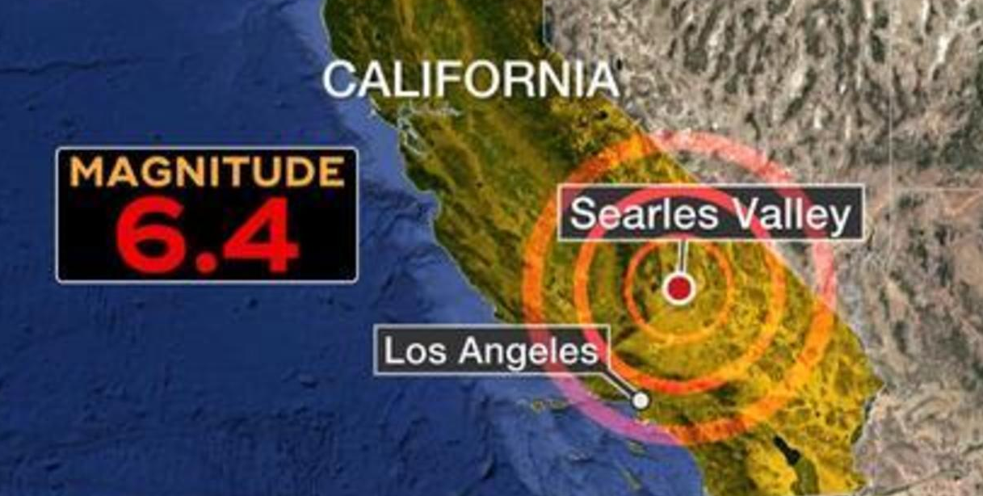
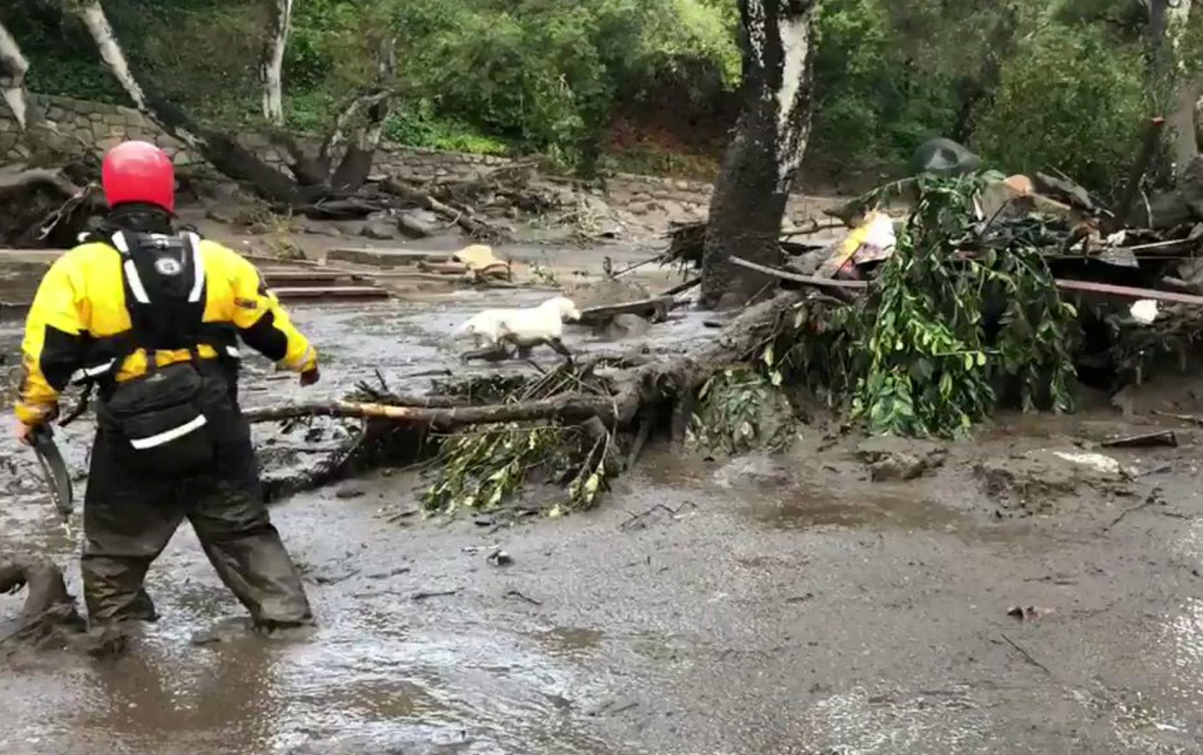
Welcome Gregg!
Software Engineer
at Apple
Friends w/ Eddieyy
Giants
fan
Lives in San Jose CA
Hands Made of Bricks

Slide 10



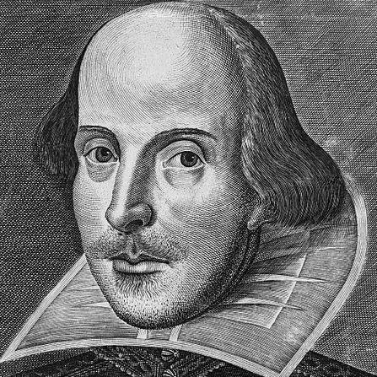





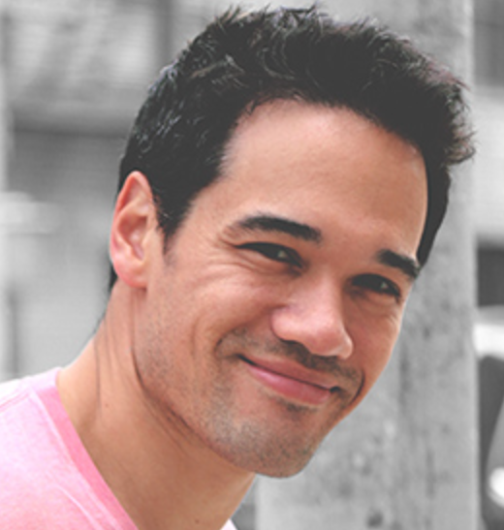









NYC
Has No Friends
Kurt
Columbus Circle Men’s Room
CockWorld 2014
Albert
NYC
Andrew
Home
Town
Jake
Gainesville, FL
Founding Fathers
Atlanta
Darren
womb
Home
Town
LA
1st & 2nd in National
Horse Handy Competition
2021 Buns & Beards Calendar
Andrew
Aaron
Chicago
Has no friends
Trevor
Bill
NYC Friend
Colorado
Atlanta
Asians All Know Each Other
Julia
Dad
Conservative Needlework Association
Jim
Marquette, MI
OnlyFans
Gregg
Jeff
Eddie
San Jose, CA
Chicago
San Jose, CA

Slide 11


Sx3 Graveyard
RIP
RIP
RIP
RIP
Trent & Marshall
19, 20
Too Chatty
Ryan Hopson
19
Rage Quit
Sophie
14, 15, 16
Domestic Disputes
Bobby Maher
15, 16, 17, 18
Poor Priorities
Jake
Andrew
RIP
RIP
RIP
Bobby C
13
Gamblers Anonymous
Joey
13, 14
Didn’t Believe in Fun
Clyde
13, 14
Joined a Cult
Andrew
RIP
RIP
RIP
Can’t keep friends
Caesar
5 mins ‘19
Wanted to be a Lifelong Sx3 Meme
Sam K
15, 16, 17, 18
Tired of Losing and Bukkake
Whitney
13, 14, 15,
16, 17, 18
Booted
RIP
RIP
RIP
Andy
13
Denied Permission from Wife
Steph
13
Couldn’t Stand Andrew
Barrett
13
Misunderstood ‘Fantasy’
Aaron
RIP
RIP
Shawn
14
No Idea Who this Guy is
Bear
14
Animals Not Allowed

Slide 12
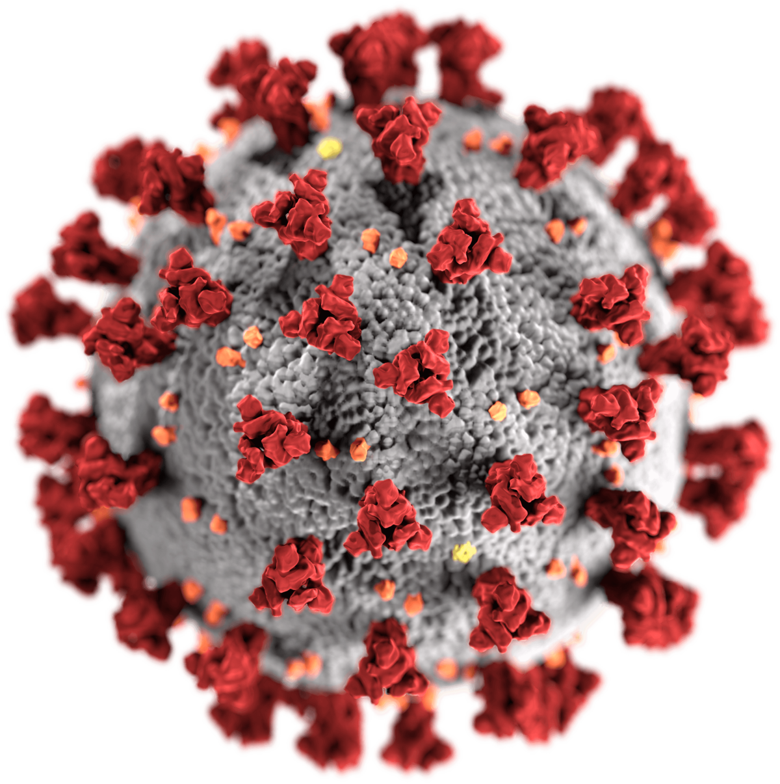
2020
Looking Back…

Slide 13
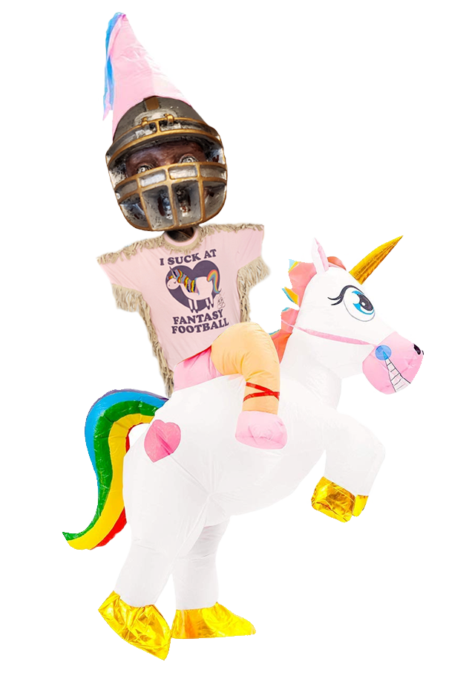
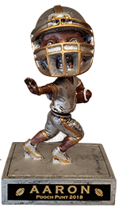


2020 - Results
Eddie
Bill
Andrew
Albert
Trevor | 4th
Kurt | 5th
Jim | 6th
Aaron | 7th
Jeff | 8th
Darren | 9th
Trent/Marshall | 10th
Jake | 11th
Albert | 12th
Regular Season
Trevor | 10 | 3 | 1,841
Andrew | 9 | 4 | 1,939
Jim | 8 | 5 | 1,929
Bill | 7 | 6 | 1,795
Kurt | 7 | 6 | 1,726
Eddie | 5 | 8 | 1,799
Darren | 6 | 7 | 1,718
TrentShall | 6 | 7 | 1,656
Albert | 6 | 7 | 1,635
Jeff | 5 | 8 | 1,665
Jake | 5 | 8 | 1,604
Aaron | 4 | 9 | 1,789

Slide 14

Eddieyiey Former Sizzler CEO Kerry Kramp
REG SEASON
5-8 (9th)
138.43 pts/wk
PLAYOFFS
6 seed
164.3 pts/wk
CHAMPIONSHIP ROSTER
THE CHAMP
Tannehill | QB 7 | Wk 12 FA $0
Jalen Hurts | QB 31 | Wk 14 FA $0
Dak (IR) | QB 32 | $22 Draft
Jonathan Taylor | RB 6 | Wk 9 Trade
James Robinson | RB 7 | Wk 1 FA $0
Kareem Hunt | RB 10 | $15 Draft
Miles Sanders | RB 24 | $35 Draft
Jeff Wilson | RB 33 | Wk 15 FA
Sony Michel | RB 55 | Wk 15 FA
Saquon (IR) | RB 120 | $62 Draft
Allen Robinson | WR 9 | $23 Draft
Marvin Jones | WR 17 | Wk 8 FA $0
Aiyuk | WR 33 | $1 Draft
Hockenson | TE 5 | $3 Draft
Jordan Atkins | TE 25 | Wk 16 FA
Wk | Pts
1 | 110.22
2 | 154.16
3 | 174.20
4 | 192.08
5 | 112.54
6 | 123.2
7 | 179.86
8 | 121.04
9 | 110.4
10 | 109.22
11 | 105.98
12 | 126.78
13 | 179.96
Wk | Pts
14 | 182.72
15 | 163.44
16 | 146.8
5-8 reg ssn finish, squeaked into
playoffs with 6th seed points-for
9.9 points total season pts away
from not making playoffs
Spent $67 FAAB on Nyheim Hines wk 2
Out of FAAB by wk 7
Trades Made: 3

Slide 15

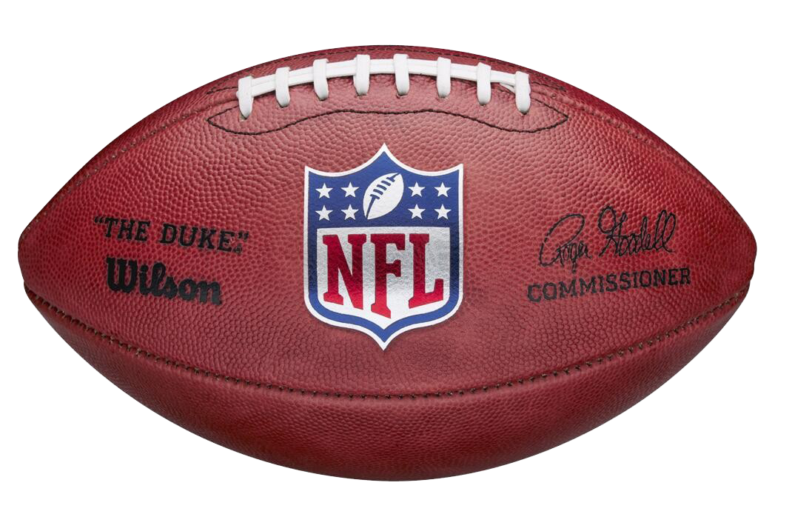
Stats!

Slide 16

Sx3 Trash Talk
with JeffBot
“Thanks for the birthday wishes!”

Slide 17

2020: The Ones
QB
Player | Pts | Draft $ | By
Josh Allen | 407 | $6 | Jim
Rodgers | 394 | $4 | Aaron
Mahomes | 388 | $32 | Trevor
Kyler | 388 | $16 | Jeff
Watson | 383 | $18 | Jeff
Russell | 367 | $18 | Trent
Tannehill | 351 | $1 | Andrew
Herbert | 346 | undrafted
Brady | 344 | $4 | Jake
Lamar | 336 | $29 | Jim
Cousins | 315 | undrafted
M Ryan | 289 | $3 | Andrew
RB
Player | Pts | Draft $ | By
Kamara | 383 | $42 | Darren
Henry | 353 | $37 | Andrew
Dalvin | 351 | $52 | Trent
Monty | 269 | $10 | Trevor
A Jones | 265 | $31 | Jim
J Taylor | 259 | $23 | Jim
Robinson | 254 | undrafted
J Jacobs | 233 | $45 | Trevor
Zeke | 225 | $46 | Darren
Kareem | 219 | $16 | Eddie
Chubb | 213 | $35 | Aaron
Nyheim | 208 | undrafted
WR
Player | Pts | Draft $ | By
Adams | 366 | $44 | Andrew
Diggs | 337 | $16 | Jake
Tyreek | 336 | $41 | Aaron
Hopkins | 294 | $34 | Bill
Ridley | 289 | $17 | Andrew
Jefferson | 282 | $5 | Bill
DK | 277 | $19 | Jim
Lockett | 269 | $19 | Trevor
Robinson | 266 | $23 | Eddie
Thielen | 257 | $28 | Trent
AJ Brown | 256 | $23 | Kurt
Evans | 252 | $26 | Jake
TE
Player | Pts | Draft $ | By
Kelce | 318 | $33 | Darren
Waller | 285 | $15 | Jeff
Logan | 177 | undrafted
Tonyan | 176 | undrafted
Hock | 175 | $3 | Eddie
Andrews | 170 | $17 | Albert
Gesicki | 160 | $2 | Aaron
Gronk | 150 | $3 | Trent
Fant | 149 | $5 | Kurt
Hurst | 149 | $8 | Kurt
Schultz | 146 | undrafted
Graham | 143 | undrafted

Slide 18
2020 Draft: QB, RB, WR, TE 1s … RB, WR 2s
CMC | $69 | Albert
Saquon | $62 | Eddie
Dalvin | $52 | Trent
MT | $50 | Darren
Zeke | $46 | Darren
Jacobs | $45 | Trevor
Davante | $44 | Andrew
Kamara | $42 | Darren
Tyreek | $41 | Aaron
CEH | $40 | Bill
Mixon | $39 | Kurt
Ekeler | $39 | Jake
Henry | $37 | Andrew
Drake | $36 | Jake
Chubb | $35 | Aaron
Miles | $35 | Eddie
Kittle | $34 | Trevor
Hopkins | $34 | Bill
Godwin | $34 | Albert
Kelce | $33 | Darren
Mahomes | $32 | Trevor
A Jones | $31 | Jim
Golladay | $30 | Andrew
Julio | $30 | Bill
Lamar | $29 | Jim
Thielen | $28 | Trent
Conner | $27 | Kurt
OBJ | $26 | Aaron
Carson | $26 | Bill
Evans | $26 | Jake
M Brown | $24 | Jake
AJ Brown | $23 | Kurt
A Rob | $23 | Eddie
Le'V | $23 | Albert
J Taylor | $23 | Jim
Melvin | $23 | Jeff
Gurley | $22 | Kurt
Dak | $22 | Eddie
McLaurin | $22 | Eddie
Keenan | $21 | Aaron
Amari | $21 | Jim
Lockett | $19 | Trevor
Moore | $19 | Andrew
Ingram | $19 | Trent
DK | $19 | Jim
Akers | $19 | Jeff
Sutton | $18 | Trevor
Mostert | $18 | Andrew
Dv Johnsn | $18 | Aaron
Russell | $18 | Trent
Watson | $18 | Jeff
Ridley | $17 | Andrew
JuJu | $17 | Kurt
Chark | $17 | Aaron
Gallup | $17 | Bill
M Andrews | $17 | Albert
Fournette | $17 | Albert
T.Y. | $17 | Jeff
Diggs | $16 | Jake
Fuller | $16 | Jim
Kyler | $16 | Jeff
Kupp | $16 | Jeff
Gibson | $15 | Trevor
Kareem | $15 | Eddie
Julian | $15 | Jim
Waller | $15 | Jeff
AJ Green | $15 | Jeff
Boyd | $14 | Andrew
DeVante P | $14 | Aaron
CeeDee | $14 | Trent
Jeudy | $14 | Albert
Woods | $13 | Kurt
Dobbins | $13 | Trent
Ertz | $13 | Jake
J Howard | $12 | Jim
Marvin | $11 | Bill
Engram | $11 | Trent
Singletary | $11 | Jeff
Kerryon | $10 | Trevor
Monty | $10 | Trevor
Crowder | $10 | Trent
Cooks | $10 | Jeff
A Miller | $10 | Jeff
Shepard | $10 | Jeff
Swift | $9 | Kurt
Deebo | $9 | Kurt
Moss | $9 | Eddie
J White | $9 | Jim
Hurst | $8 | Kurt
Diontae | $8 | Bill
Lindsay | $8 | Trent
M Mack | $8 | Jake
Kirk | $8 | Jeff
Tarik | $7 | Aaron
E Sanders | $7 | Trent
D Harris | $7 | Darren
Slayton | $7 | Albert
J Brown | $7 | Jim
Latavius | $6 | Aaron
Claypool | $6 | Bill
Pollard | $6 | Bill
RoJo | $6 | Jake
J Allen | $6 | Jim
Breida | $6 | Jeff
Fant | $5 | Kurt
J Jefferson | $5 | Bill
Cam | $5 | Trent
Ruggs | $5 | Darren
Landry | $5 | Jake
Goldent | $5 | Albert
Burrow | $4 | Kurt
Rodgers | $4 | Aaron
Brady | $4 | Jake
M Ryan | $3 | Andrew
Hock | $3 | Eddie
Gronk | $3 | Trent
Jimmy G | $2 | Trevor
Gesicki | $2 | Aaron
Robby | $1 | Trevor
Tannehill | $1 | Andrew
Undrafted
Herbert
Cousins
J Robinson
Nyheim
Mike Davis
McKissic
Claypool
Logan
Tonyan
Schultz
Graham

Slide 19
2020 Draft: Stonks – Fire Sale!
 | Player | Draft Cost | EOS Rank | EOS Pts
QB | Rodgers | $4 | QB 2 | 394
WR1 | Jefferson | $5 | WR 6 | 282
WR2 | Diontae | $8 | WR 21 | 227
RB1 | J Robinson | $0 | RB 7 | 254
RB2 | Monty | $10 | RB 4 | 269
TE | Logan | $0 | TE 3 | 177
Flex | Robby | $1 | WR 20 | 228
Flex | Nyheim | $0 | RB 12 | 208
K | J Sanders | $0 | K1 | 180
DST | IND | $0 | D1 | 225
 |  | $28 |  | 2,444 153/wk
 | Player | Draft Cost | EOS Rank | EOS Pts
QB | Herbert | $0 | QB 8 | 346
WR1 | Claypool | $0 | WR 23 | 218
WR2 | Beasles | $0 | WR 26 | 212
RB1 | J Robinson | $0 | RB 7 | 254
RB2 | Nyheim | $0 | RB 12 | 208
TE | Logan | $0 | TE 3 | 177
Flex | M Davis | $0 | RB 13 | 206
Flex | McKissic | $0 | RB 18 | 191
K | J Sanders | $0 | K1 | 180
DST | IND | $0 | D1 | 225
 |  | $0 |  | 2,217 139/wk
EOS Points For
$28 Team | 2,444
Andrew | 2,363
Eddie | 2,292
Jim | 2,283
Trevor | 2,253
Aaron | 2,237
Bill | 2,224
$0 Team | 2,217
Kurt | 2,166
Jeff | 2,120
Darren | 2,119
Jake | 2,019
Albert | 2,005
Trent | 2,004

Slide 20
2020 Draft: The Draft Fail Team
 | Player | Draft Cost | EOS Rank | EOS Pts
QB1 | Dak | $22 | QB 31 | 141
WR1 | MT | $50 | WR 90 | 85
WR2 | Golladay | $30 | WR 100 | 67
RB1 | CMC | $69 | RB 47 | 90
RB2 | Saquon | $62 | RB 120 | 19
TE | Kittle | $34 | TE 18 | 127
Flex | Mixon | $39 | RB 49 | 99
Flex | Odell | $26 | WR 91 | 90
K | Jake Elliott | $1 | K 29 | 77
DST | SF | $3 | D 20 | 88
 |  | $336 |  | 883 55/wk
EOS Points For
Andrew | 2,363
Eddie | 2,292
Jim | 2,283
Trevor | 2,253
Aaron | 2,237
Bill | 2,224
Kurt | 2,166
Jeff | 2,120
Darren | 2,119
Jake | 2,019
Albert | 2,005
Trent | 2,004
$336 Team | 883

Slide 21



Money Management
$
$
with Trevor
FAAB Spends
2016 - $35
2017 - $34
2018 - $55
2019 - $31
2020 - $44
$301 left
on the table
$60/yr
Sx3 Winnings
2013 - $0
2014 - $0
2015 - $0
2016 - $0
2017 - $0
2018 - $0
2019 - $0
2020 - $0
-$700
Quit wasting my money. Get it together, ass hole.

Slide 22
Start / Sit Fails
20+ Point Players Left on Bench:
Less than 2 pts Scored from Starter:
Owner | # Times | Pts
Jim | 10 | 276
Kurt | 9 | 220
Trevor | 9 | 221
Jeff | 8 | 212
Eddie | 7 | 169
Aaron | 6 | 156
Albert | 6 | 146
Bill | 5 | 123
Darren | 5 | 130
Jake | 5 | 132
Andrew | 3 | 73
Player | Points | Week | Owner | W/L
Josh Allen | 36.5 | 2 | Jim | W
Lamar | 35.92 | 14 | Jim | L
Cam | 35.58 | 2 | Trent | W
Carr | 32.74 | 13 | Kurt | W
Miles | 32.6 | 14 | Eddie | W
Watson | 32.36 | 11 | Jeff | W
Josh Allen | 32.24 | 3 | Jim | W
Drake | 31.4 | 6 | Jake | W
Keenan | 31.2 | 3 | Aaron | L
Cooks | 31.1 | 5 | Jeff | L
Gallup | 31.1 | 16 | Jeff | L
Baker | 31.02 | 14 | Jake | L
Mike Williams | 30.4 | 5 | Darren | W
Tannehill | 30 | 5 | Andrew | W
Chark | 29.5 | 4 | Aaron | L
Landry | 29.3 | 12 | Jake | W
Josh Allen | 29.18 | 1 | Jim | W
Kareem | 29 | 14 | Eddie | W
Agholor | 29 | 16 | Trevor | L
Josh Allen | 25.42 | 4 | Jim | W
Owner | # of Times
Darren | 11
Albert | 11
Trent | 11
Bill | 9
Aaron | 8
Andrew | 8
Trevor | 8
Jake | 8
Jim | 6
Jeff | 5
Eddie | 5
Player | Points | Week | Owner | W/L
McKinnon | -0.1 | 7 | Aaron | L
Corey Davis | 0 | 16 | Trent | L
Zeke | 0 | 15 | Darren | L
Da Johnson | 0 | 15 | Darren | L
Boyd | 0 | 15 | Andrew | L
Fant | 0 | 14 | Kurt | L
Rudolph | 0 | 13 | Andrew | L
CEH | 0 | 13 | Bill | L
J Cook | 0 | 12 | Trevor | L
Marquise Brown | 0 | 11 | Jake | L
Hurst | 0 | 11 | Kurt | L
Corey Davis | 0 | 9 | Trent | L
Aiyuk | 0 | 9 | Eddie | L
J Jackson | 0 | 9 | Jake | L
Golladay | 0 | 8 | Andrew | L
Odell | 0 | 7 | Aaron | L
Fells | 0 | 7 | Jake | L
Gesicki | 0 | 6 | Aaron | L
John Brown | 0 | 6 | Darren | L
Jim
Left 276 points on the bench from 10 bad starts
Didn’t start Josh Allen,
THE QB 1, until week 7

Slide 23
Player | $ | Wk | Finish Position Rank | Finish Pts | To
James Robinson | $0 | 2 | RB 7 | 254 | Eddie
Logan Thomas | $2 | 14 | TE 3 | 177 | Andrew
Tonyan | $0 | 4 | TE 4 | 176 | Jim
Herbert | $0 | 3 | QB 8 | 346 | Bill
McKissic | $0 | 3 | RB 18 | 191 | Trevor
Tannehill | $0 | 12 | QB 7 | 351 | Eddie
Tee Higgins | $2 | 2 | WR 25 | 196 | Aaron
Gaskin | $5 | 2 | RB 27 | 165 | Jake
Justin Jefferson | $32 | 4 | WR 6 | 282 | Bill
Mike Davis | $51 | 3 | RB 13 | 206 | Albert
Nyheim | $67 | 2 | RB 12 | 208 | Eddie
FAABulous … Best Waiver Buys

Slide 24
Not So FAABulous … Worst Waiver Buys
Player | $ | Week | Finish Position Rank | Finish Pts | To
Burkhead | $75 | 4 | RB 44 | 90.4 | Jim
Nyheim | $67 | 2 | RB 12 | 208 | Eddie
Justin Jackson | $36 | 5 | RB 62 | 65.3 | Jake
Pittman | $35 | 10 | WR 79 | 99 | Trevor
Dalton | $32 | 6 | QB 28 | 140.9 | Kurt
Gore | $26 | 12 | RB 47 | 87.9 | Aaron
D’Ernest Johnson | $20 | 5 | RB 76 | 35.6 | Andrew
Scotty Miller | $19 | 4 | WR 73 | 103 | Jeff
Albert | $15 | 3 | RB 54 | 76.3 | Albert

Slide 25
Owner | Lineup Changes | # Per Week
Edward | 629 | 39
Aaron | 295 | 18
Kurt | 267 | 17
Jake | 248 | 16
Jeff | 242 | 15
Darren | 240 | 15
Andrew | 204 | 13
Albert | 196 | 12
Jim | 183 | 11
Trevor | 167 | 10
Bill | 143 | 9
Tinker Tinker!
… Most Lineup Changes
Eddieyy
Way too much tinkering.
Get a life, man.
* Typical start/sit move is 2 changes

Slide 26
Player | # Times Added
Tony PollardRB - DAL | 11
Malcolm BrownRB - LA | 6
Kansas City ChiefsDEF | 6
Brian HillRB - ATL | 6
Mike GesickiTE - MIA | 6
Chris BoswellK - PIT | 6
Logan ThomasTE - WAS | 6
Stephen GostkowskiK - TEN | 5
New Orleans SaintsDEF | 5
Tennessee TitansDEF | 5
Devontae BookerRB - LV | 5
San Francisco 49ersDEF | 5
Washington Football TeamDEF | 5
Teddy BridgewaterQB - CARQ | 5
Green Bay PackersDEF | 5
Carlos HydeRB - SEA | 5
Los Angeles ChargersDEF | 5
Los Angeles RamsDEF | 5
This Time it’s Different
… Most added players

Slide 27


If You Ain’t Trading, You Ain’t Trying
Did somebody say TRADE!?!?
F%@! you and your f@$%ing trades

Slide 28
Big Weeks & Weak Weeks
Weak Weeks
Big Weeks
Points | Week | Owner | W/L
62.42 | 6 | Aaron | L
65.8 | 10 | Trent | L
73.38 | 6 | Albert | L
82.1 | 9 | Jake | L
87.4 | 8 | Jeff | L
90.14 | 10 | Albert | L
93.92 | 12 | Trent | L
95.06 | 7 | Albert | L
97.4 | 8 | Jake | L
97.54 | 7 | Darren | L
97.9 | 12 | Jeff | L
99.6 | 2 | Albert | L
62.42 | 6 | Aaron | L
65.8 | 10 | Trent | L
73.38 | 6 | Albert | L
Aaron Wk 6
Player | Pts
Rogers | 3.8
McKinnon | 4.8
Da Johnson | 13.9
Odell | 4.5
Chark | 11.5
Gesicki | 0
D Parker | 6.5
Tyreek | 5.5
Z Gonzalez | 8
LAR dst | 3.92
 | 62.42
Points | Week | Owner | W/L
206.92 | 12 | Aaron | W
204.98 | 2 | Jim | W
196.22 | 7 | Andrew | W
192.08 | 4 | Eddie | W
190.26 | 4 | Jim | W
183.36 | 16 | Darren | W
182.72 | 14 | Eddie | W
181.88 | 6 | Andrew | W
181.32 | 1 | Andrew | W
181.2 | 12 | Jim | W
180.6 | 5 | Albert | W
Aaron Wk 12
Player | Stats | Pts
Rodgers | 211 pass yds 4 pass TDs | 25.64
Gore | 74 rush yds 12 rec yds | 11.6
Chubb | 144 rush yds, 1 TD 32 Rec Yds | 27.6
Keenan | 40 rec yds, 1 TD 1 2pt | 16
D Parker | 119 Rec Yds | 20.9
Gronk | 106 Rec Yds | 17.6
Tyreek | 269 rec yds, 3 TDs | 62.4
Lazard | 23 rec yds, 1 TD | 12.3
Butker | 3 PAT, 2 FG | 9
CLE dst | 25 pts | 3.88
 |  | 206.92
All-Time
Pts | Year | Wk | Mgr
51.5 | 16 | 1 | Albert
58.02 | 13 | 3 | Aaron
58.5 | 18 | 14 | Sam
59.2 | 13 | 8 | Whitney
62.16 | 17 | 10 | Sam
62.42 | 20 | 6 | Aaron

Slide 29
Mini Games
Most Pts Reg Season
Most Pts Team Wk
Most Pts Started Player
Closest Margin Defeat
Andrew – 1,939.08
149 pts/wk avg
Aaron – 206.92
20.7 pts/player avg
Aaron – Tyreek – 62.4
13 rec
269 yds
3 TDs
Jim lost by 0.12
Week 12
Trevor: 125.56
Jim: 125.44
Wk 1 | 181.32
Wk 2 | 178.88
Wk 3 | 122.44
Wk 4 | 106.12
Wk 5 | 133.7
Wk 6 | 181.88
Wk 7 | 196.22
Wk 8 | 120.3
Wk 9 | 167.24
Wk 10 | 129.64
Wk 11 | 148.22
Wk 12 | 148.56
Wk 13 | 124.56
Rodgers | 25.64
Gore | 11.6
Chubb | 27.6
Keenan | 16
D Parker | 20.9
Gronk | 17.6
Tyreek | 62.4
Lazard | 12.3
Butker | 9
CLE dst | 3.88

Slide 30
Sx3 History
Owner | Avg Finish | # Playoffs | % Years Playoffs | earnings/ losses | 2020 | 2019 | 2018 | 2017 | 2016 | 2015 | 2014 | 2013
Aaron | 5.00 | 4 | 50.0% | +$325 | 7 | 4 | 🏆 | 7 | 4 | 2 | 7 | 8
Albert | 7.17 | 2 | 33.3% | +$275 | 🦄 | 7 | 3 | 10 | 10 | 🏆
Andrew | 5.25 | 5 | 62.5% | -$100 | 3 | 2 | 7 | 9 | 3 | 4 | 3 | 11
Bill | 5.00 | 6 | 75.0% | +$400 | 2 | 5 | 9 | 🏆 | 9 | 5 | 5 | 4
Darren | 9.00 | 0 | 0.0% | -$100 | 9
Eddie | 1.00 | 1 | 100% | +$525 | 🏆
Jake | 6.63 | 5 | 62.5% | -$450 | 11 | 10 | 4 | 11 | 5 | 6 | 4 | 2
Jeff | 6.75 | 1 | 25.0% | +$225 | 8 | 🏆 | 10 | 8
Jim | 8.17 | 2 | 33.3% | -$225 | 6 | 🦄 | 8 | 2 | 🦄 | 10
Kurt | 5.57 | 5 | 71.4% | -$350 | 5 | 6 | 6 | 3 | 8 | 9 | 2
Trevor | 6.25 | 5 | 62.5% | -$700 | 4 | 8 | 🦄 | 4 | 6 | 7 | 6 | 3
 | 2020 | 2019 | 2018 | 2017 | 2016 | 2015 | 2014 | 2013
Champ | Eddie | Jeff | Aaron | Bill | Bobby | Albert | Whitney | Joey
2nd | Bill | Andrew | Whitney | Jim | Whitney | Aaron | Kurt | Jake
3rd | Andrew | Ryan | Albert | Kurt | Andrew | Sophie | Andrew | Trevor
Unicorn | Albert | Jim | Trevor | Sam | Jim | Sam | Bear | Bobby C

Slide 31
Sx3 Trash Talk
with JeffBot
“Good luck this week!”

Slide 32
2021
The Year Ahead…

Slide 33
New (ish) Rules
Full list of rules at sx3.fun
IR Spot
COVID Contingencies
1 spot
IR, NON, SUS, PUP, EXE, COV or OPT
24 hours to move from Reserve spot once activated
Past 24 hours and Aaron will move that player for you, dropping your lowest YTD scorer
Any attempt to game the COVID adjustments system will result in your forfeiture of points for the position(s) in question for that week
Games played on or before Wednesday of the current week will still count for that week
Declarations & Fill-in Players:
The net is... just be clear to Aaron or the Sx3 Signal thread (preferred) what you'd do with your roster had you known about the COVID impact at the start of the week.
Your declaration can come in any format (list, rankings, couple sentences, etc).

Slide 34
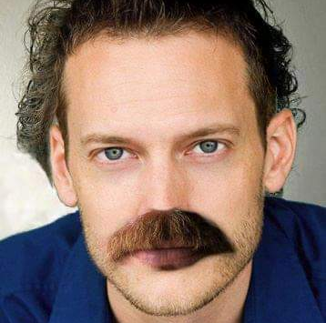

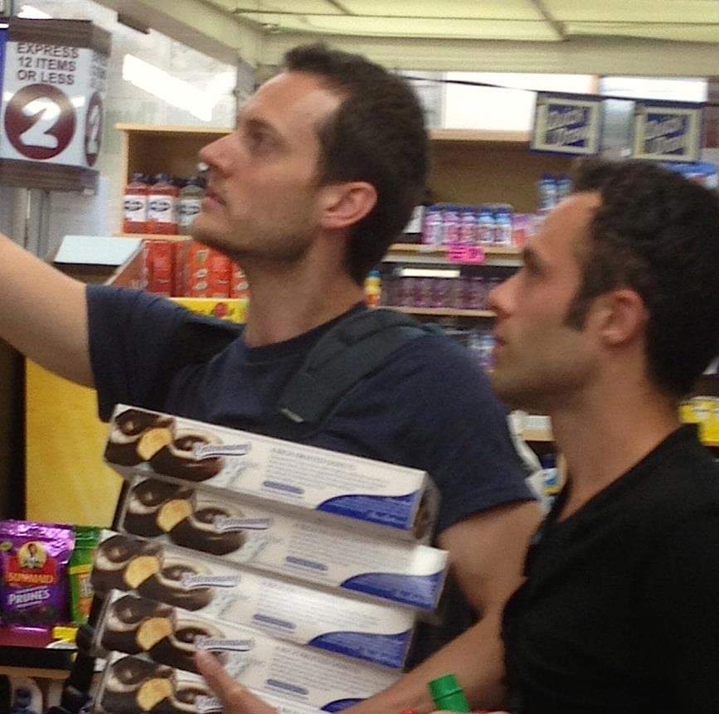
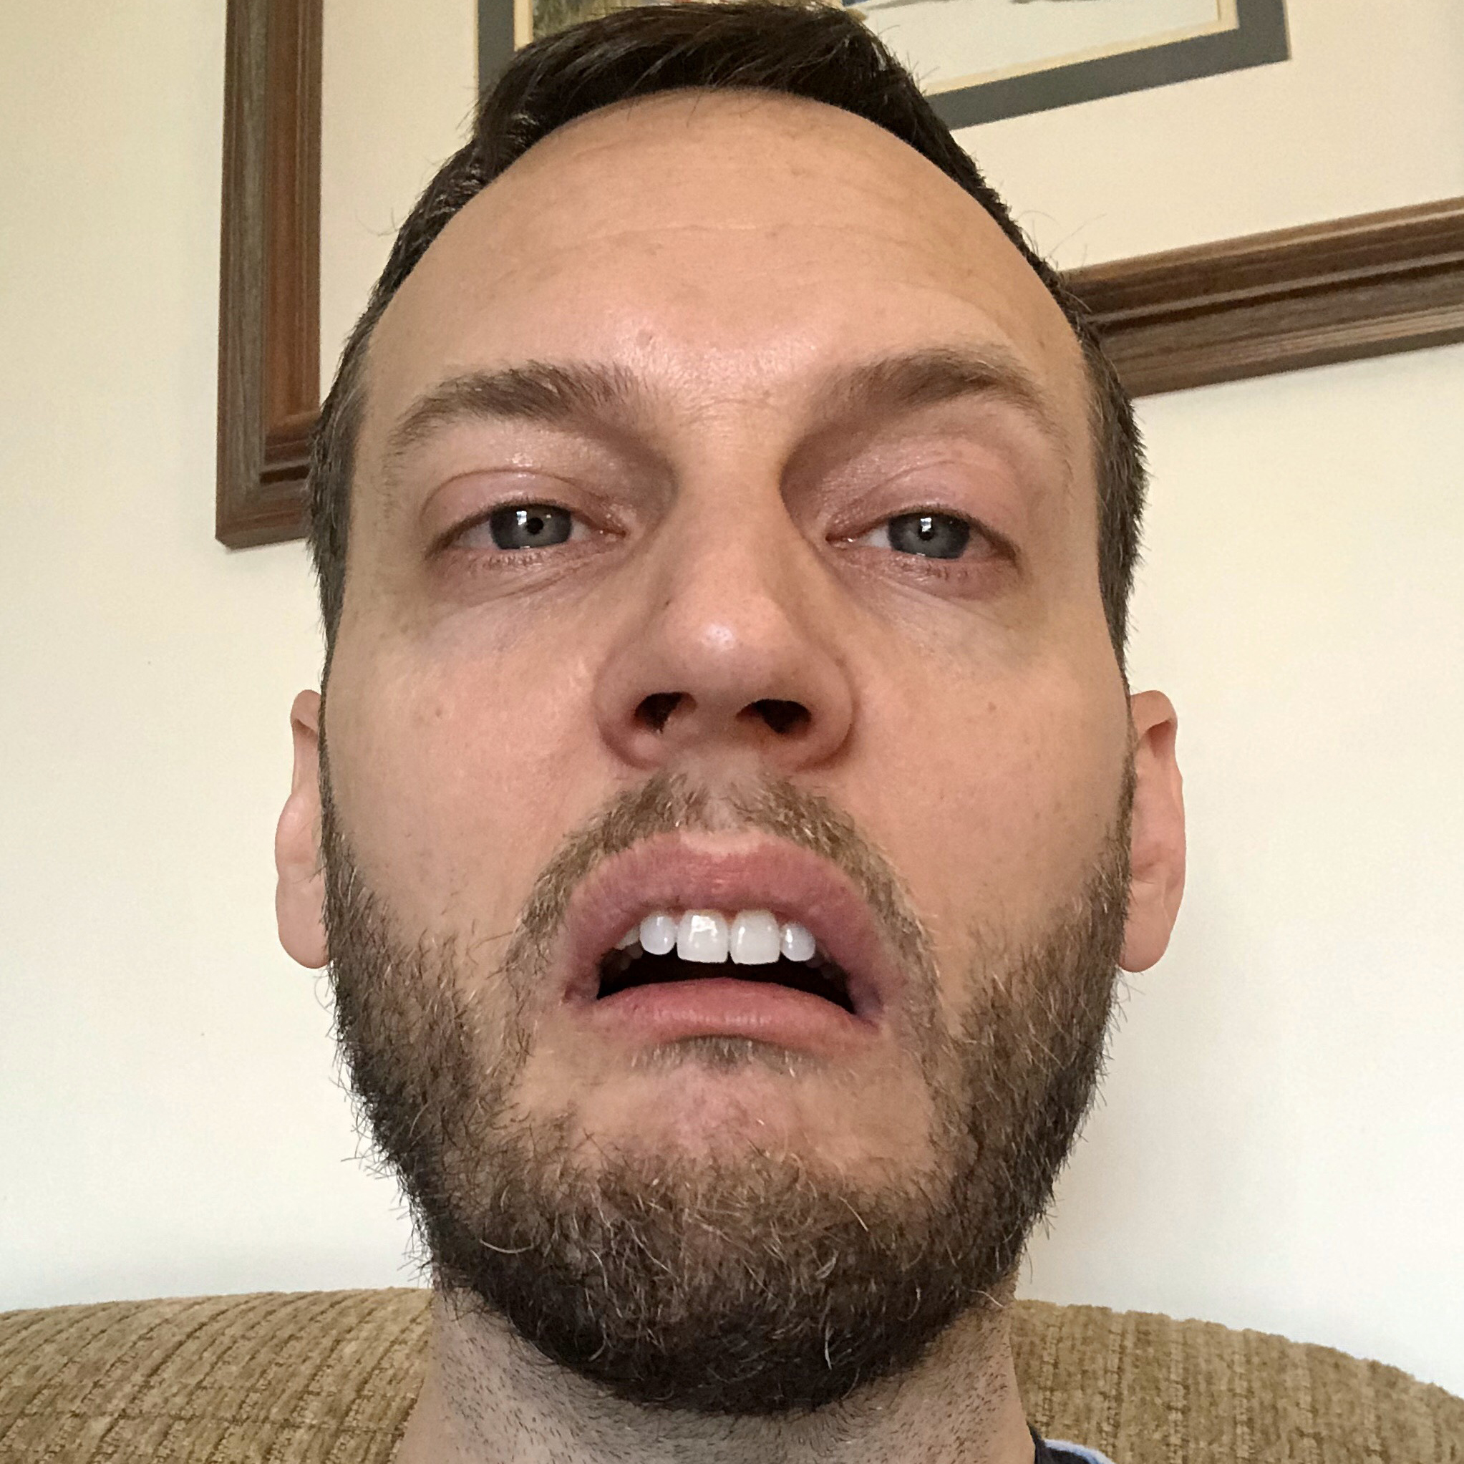

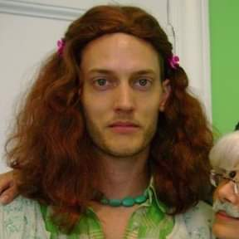
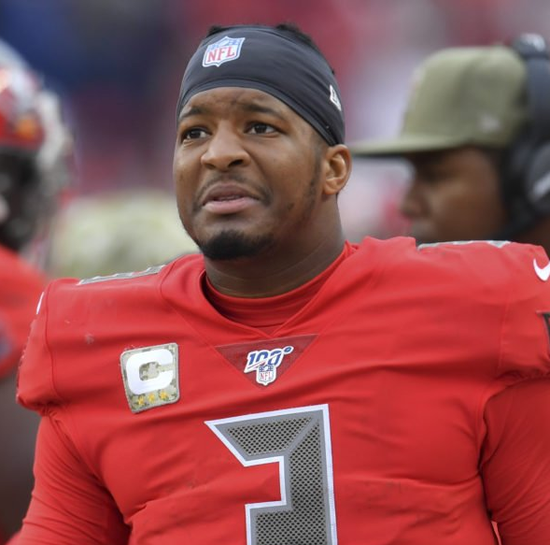

Chatty Chat
Kurp Contribution
Retiring Google Hangouts less the vid share here today
Put your name and a photo in
Mute Notifications
→ Sx3 Thread
→ dots upper right
→ Mute Notifications
You don’t have to catch up on everything.
Just jump in where the conversation is!
astute fantasy analysis and commentary in our chat
“Wait last year you said that photo was from when you and the boys unloaded your haul early, spent the rest of the Wed afternoon at the Bent Elbow, and John Cougar Mellencamp showed up and started jamming and you ended up needing your stomach pumped.”

Slide 35
Schedule Randomizer

Slide 36
Prizes & Payouts
Champion | $625
2nd Place | $300
3rd Place | $100
Most Pts Reg Season | $50
Most Team Pts in a Week | $50
Most Player Pts in a week | $50
Closest Margin of Defeat | $25 (to the loser)

Slide 37
Pay Up!
Owes $100: Kurt, Jeff
Owes $75: Jim
Paid/Complete: Errbody Else
Cash
Venmo (@aaroncao, or caoac@yahoo.com)
Cash App ($aaroncao) cash.app/app.BKNKFVN promo code ($5)
Google Pay (aaronccao@gmail.com) g.co/payinvite/cx8rg64 promo code ($5)
Chase Quick Pay / Zelle (caoac@yahoo.com)
BTC, LTC, ETH (ask me for details. If Coinbase send to caoac@yahoo.com)

Slide 38
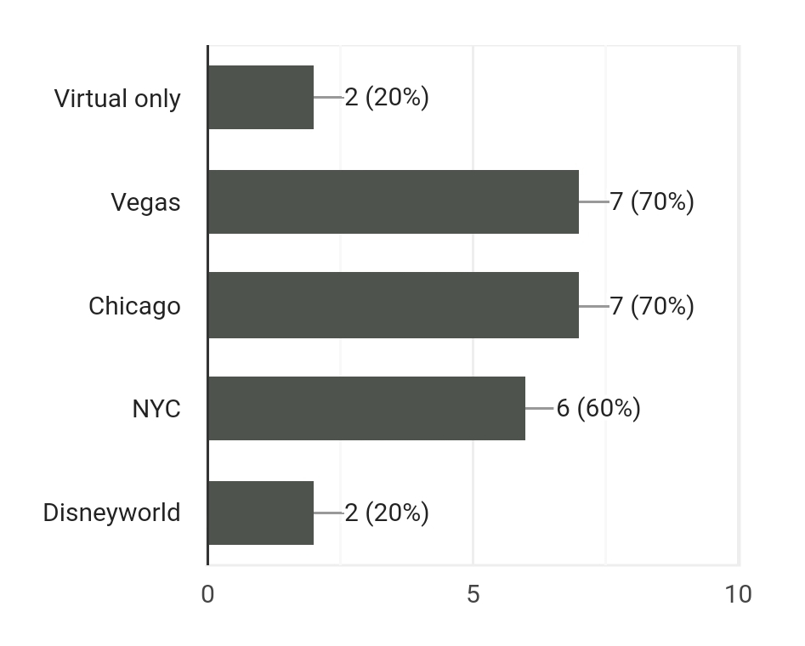
Next Year’s Draft
Continue Labor Day Weeknd tradition
In person for 10th Anniversary?

Slide 39
Draft Details
You can join the draft 30 mins before the start: at 530p CST
Draft Order is randomly set 30 minutes before the start
Nomination Time: 20 seconds
Offer/Bid Time: 15 seconds (resets to 10 secs w/ bids)
If you bid more than the next person, ALL of what you bid is deducted
Nominating a player = $1 bid
System forces you to have at least $1 for each roster spot … NO $0 players
No exceptions or changes will be made if you disconnect/autodraft.
EVERYONE be on the lookout for disconnections and shout so we can pause.

Slide 40
Good Luck!
May you all fail miserably

Slide 42


I SUCK AT
FANTASY FOOTBALL
DRAFT
What Went Wrong?
YOU SUCK ALBERT!
Show Us The 🦄
Big Ben | $2
Teddy B | $2
CMC | $69
Le’Veon | $23
Fournette | $17
Godwin | $34
Jeudy | $14
Slayton | $7
Renfrow | $1
Golden Tate | $5
Alshon | $1
M Andrews | $17
Goedert | $1
A Hooper | $1
CMC Injury – 3 Games Played
Le’Veon – Jets. 4 Inactive Games. Stuck behind CEH in KC.
Godwin – Drafted as WR 1, ended WR 30 (4 inactive games)
Alshon – 8 Inactive weeks, 13 ssn tgts, 6 recs. Held till Week 11.
Drafted WR Core – Avg WR 68
🦄 Bowl Round 1
Started Kirk Cousins
4 Started WRs totaled 25.24 pts
🦄 Bowl Finals
Brees Stinker (9 pts)
Started Watkins (1.4 pts)
Kazoozie Steamroll (Evans 41 pts)

Slide 44
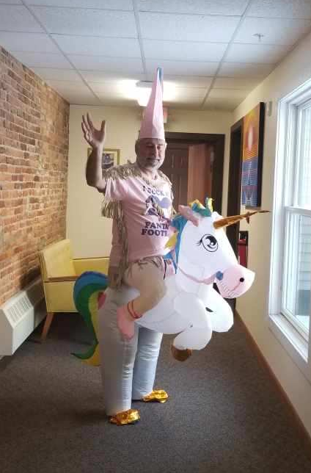
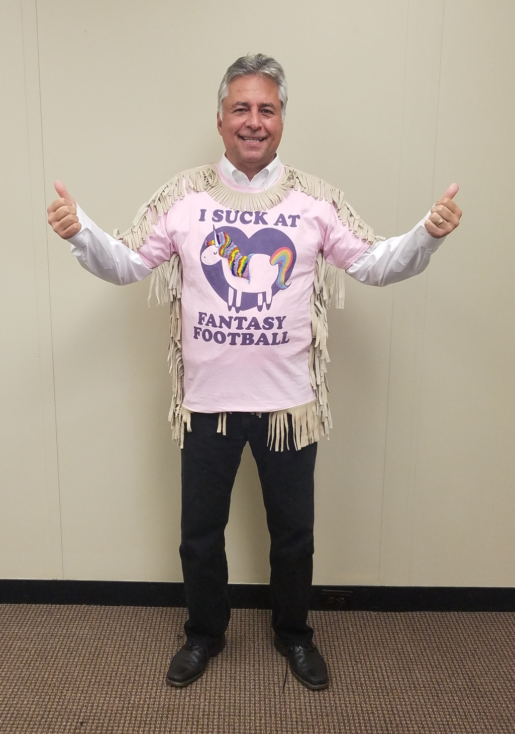
ALBERT SUCKS AT
FANTASY FOOTBALL
The man who brought the frills to the 🦄 strikes again
Two Cheers for Two-Nicorn!

Slide 45
ALBERT SUCKS AT
FANTASY FOOTBALL
YOUR TEAM NAME IS…
But first, some of the runners up…

Slide 46
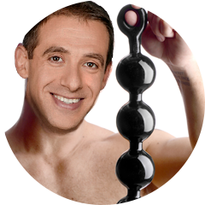
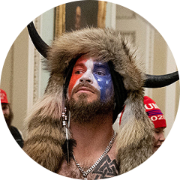

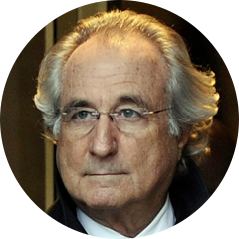

ALBERT SUCKS AT
FANTASY FOOTBALL
Albert Loves Anal Beads
Q Sent Me
Other, Lesser Kurt
or
That Guy Kurt Knows
or
Kurt’s Cousin or Something
Madoff 2.0
(sound investment advice to friends during Pandemic)
Albert Wears a Merkin

Slide 47
ALBERT’S TEAM
NAME IS…

Slide 48
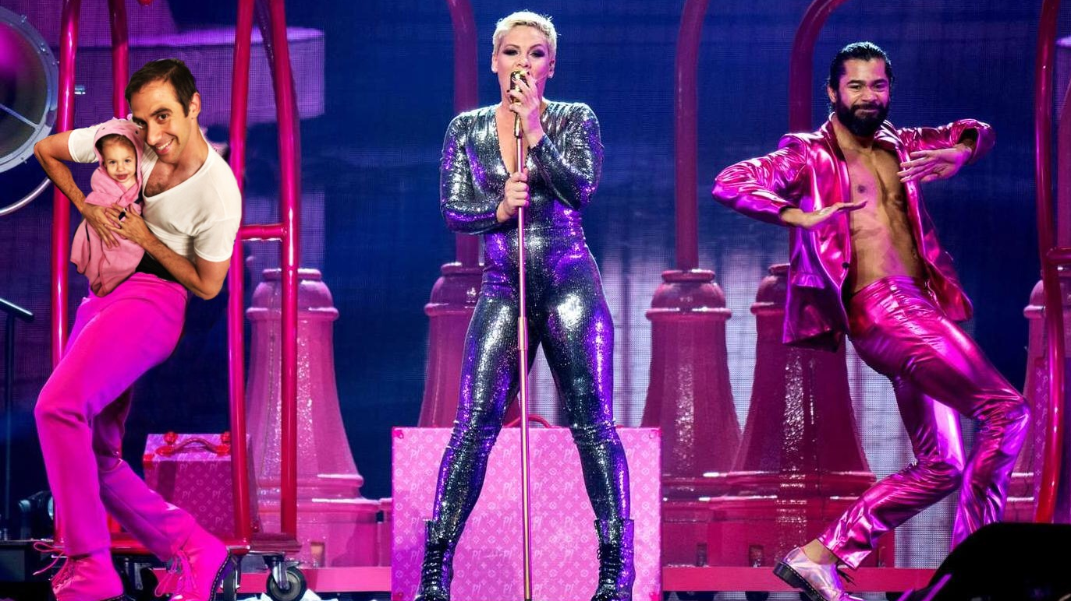

P!nk is a Good Musical Artist

