Slide 1
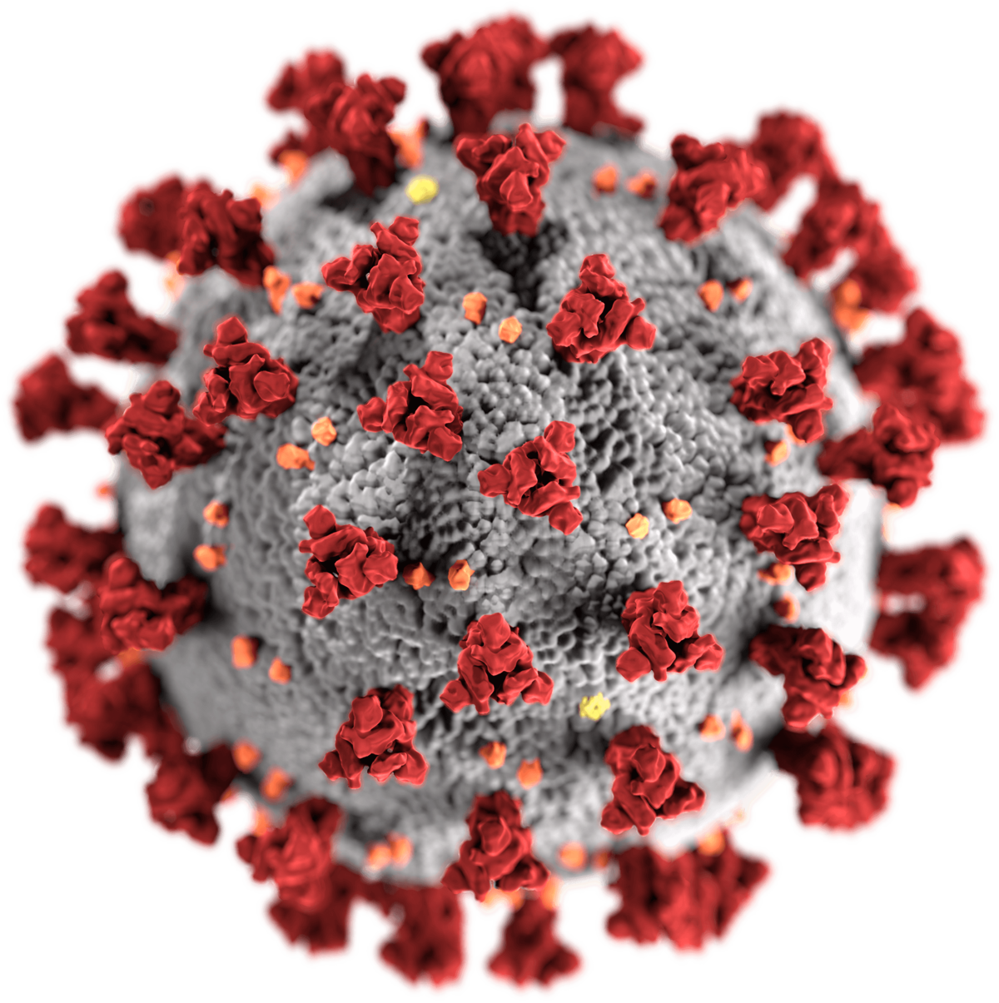
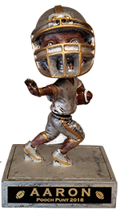
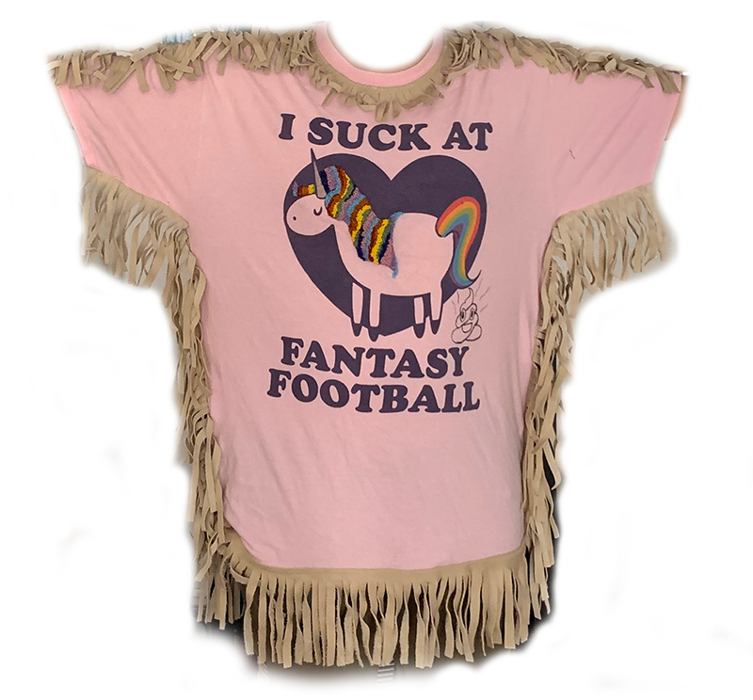

Sx3
2020
8th Anniversary!

Slide 2
Sx3.fun
Website with news, rules, stats & other various share-ables
This presentation is available there as a PDF

Slide 3
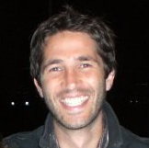



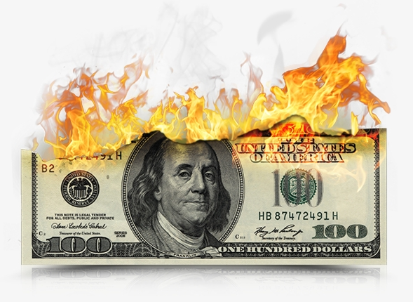
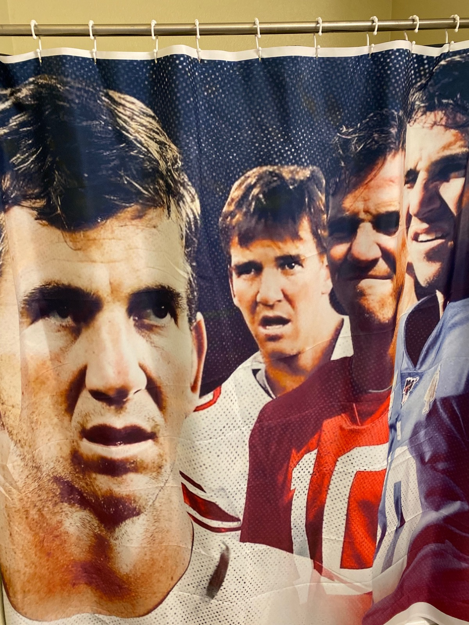

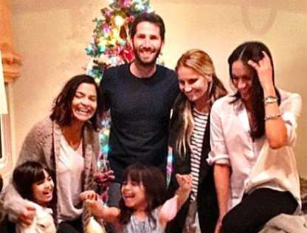
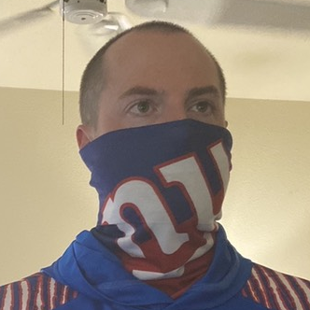
Welcome
New Guys!
Darren Litt
Eddie McKenna
LA
San Jose, CA
His mom has a thing with Albert
Certified Pyro Technician
Married his boss
Daughters’ godmother is
Megan Markle
Wore masks before it was cool (he’s COVID patient zero)
This is actually in his bathroom

Slide 4

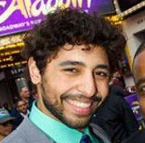

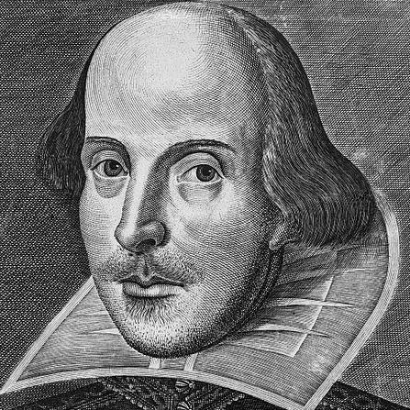



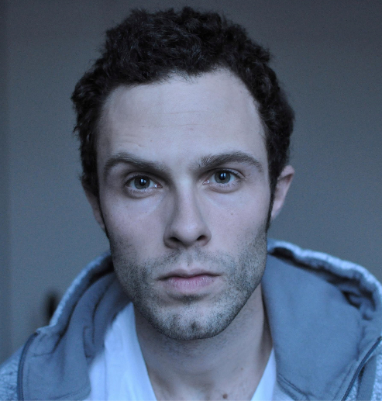


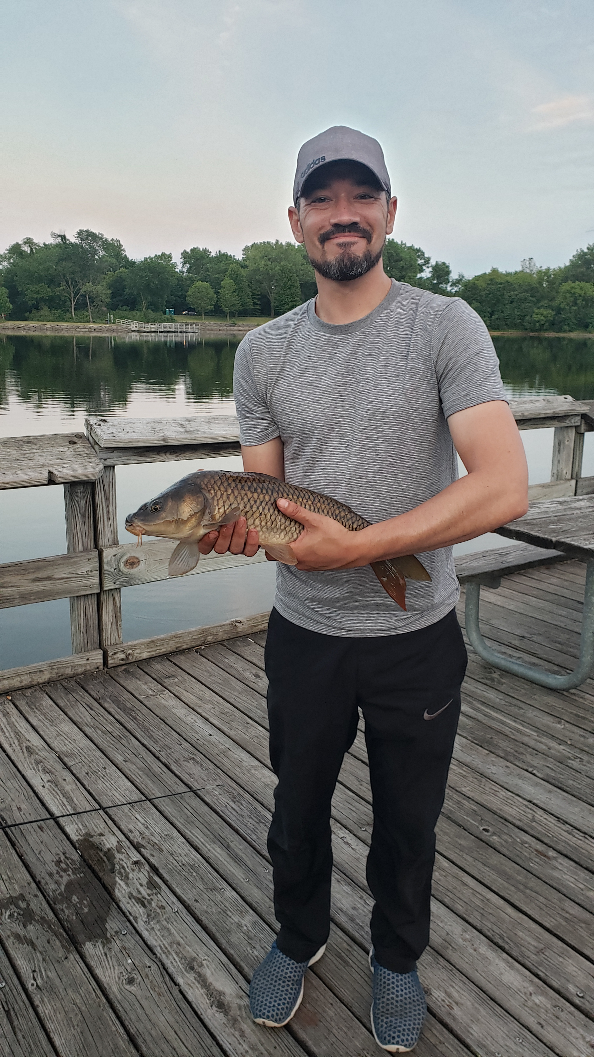
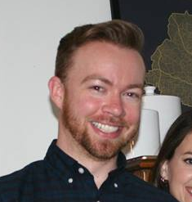


NYC
CockWorld ‘14
Trent
Marshall
Kurt
NYC
NYC
Albert
Work/Aladdin
Drugs
NYC
Sonic Drive-In
Atlanta
Jake
Home
Town
Darren
Andrew
Founding Fathers
LA
Gainesville, FL
womb
Pandemic-Driven Domestic Partnership
Home
Town
Julia
Dad
NYC
NYC Friend
Jim
1st & 2nd in National
Horse Handy Competition
Marquette, MI
Aaron
Chicago
Bill
Asians All Know Each Other
Atlanta
Work/Apple
Jeff
Trevor
Chicago
Eddie
Colorado
San Jose, CA

Slide 5

Chatty Chat
Retiring Google Hangouts less the vid share here today
Put your name and a photo in
Mute Notifications
→ Sx3 Thread
→ dots upper right
→ Mute Notifications
You don’t have to catch up on everything.
Just jump in where the conversation is!

Slide 6
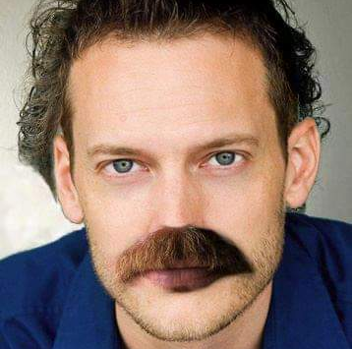

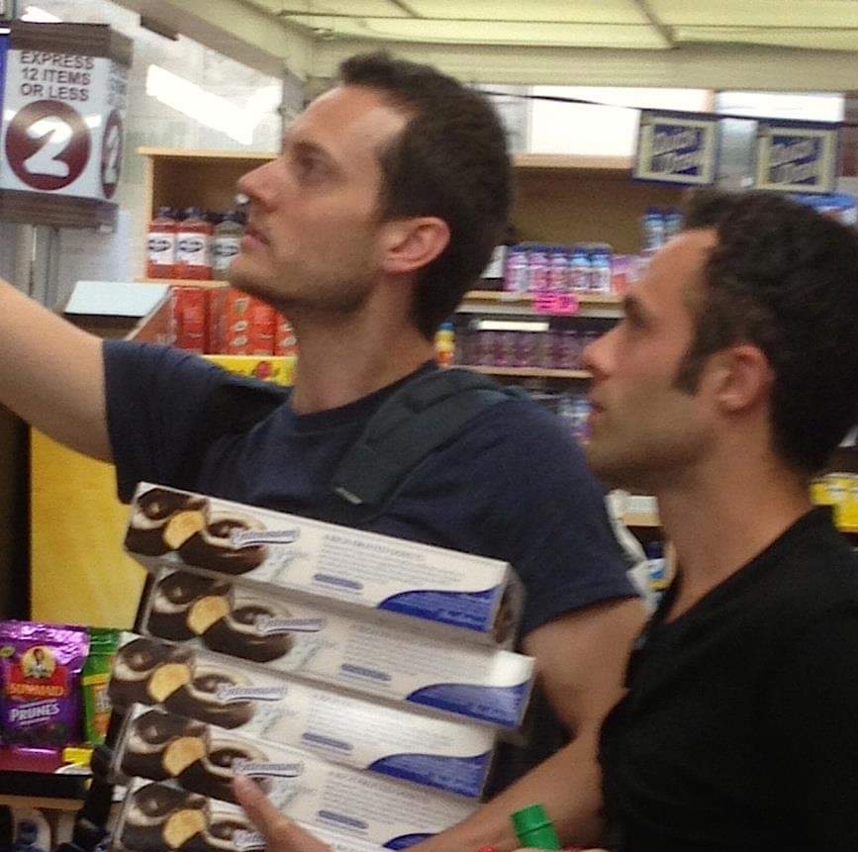


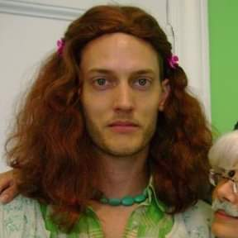
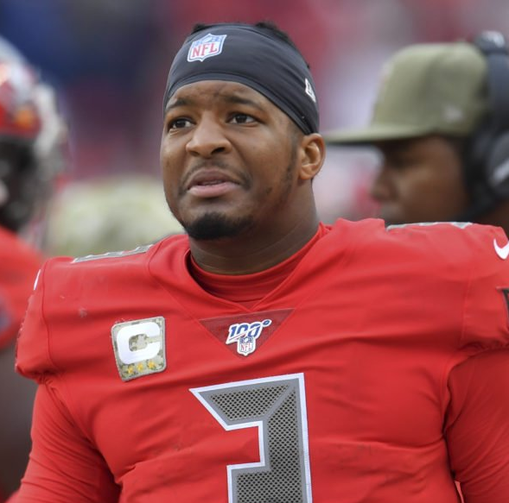
Chatty Chat
Kurt Contribution
Retiring Google Hangouts less the vid share here today
Put your name and a photo in
Mute Notifications
→ Sx3 Thread
→ dots upper right
→ Mute Notifications
You don’t have to catch up on everything.
Just jump in where the conversation is!
astute fantasy analysis and commentary in our chat
“That’s just your normal digestive system on travel days.”

Slide 7
2019
Looking Back…

Slide 8


2019 - Results
Jeff
Andrew
Ryan
Jim
Regular Season
Jeff | 10 | 3 | 1,889.28
Ryan | 9 | 4 | 1,997.76
Kurt | 9 | 4 | 1,872.58
Bill | 8 | 5 | 2,073.44
Aaron | 8 | 5 | 1,938.72
Andrew | 8 | 5 | 1,851.18
Albert | 7 | 6 | 1,695.26
Jake | 6 | 7 | 1,820
Trevor | 6 | 7 | 1,775.42
TrentShall | 5 | 8 | 1,787.96
Jim | 2 | 11 | 1,619.52
Aaron | 4th
Bill | 5th
Kurt | 6th
Albert | 7th
Trevor | 8th
TrentShall | 9th
Jake | 10th
Jim | 11th

Slide 9

JEFF Boyd Rage
REG SEASON
10-3 (1st)
145.3 pts/wk
PLAYOFFS
1 seed
196 pts/wk
THE CHAMP
Lamar Jackson | QB1 | $26 Draft
Kyler Murray | QB7 | $18 Draft
Miles Sanders | RB13 | $15 Draft
Joe Mixon | RB14 | Wk 8 FA
Kenyan Drake | RB15 | $8 Draft
James White | RB18 | $14 Draft
David Montgomery | RB25 | $16 Draft
DeVante Parker | WR12 | Wk 10 $10 FAAB
Jarvis Landry | WR13 | $9 Draft
Tyler Boyd | WR19 | $9 Draft
Calvin Ridley | WR26 | $15 Draft
TY Hilton | WR60 | $11 Draft
Brandin Cooks | WR63 | $13 Draft
Tyler Higbee | TE8 | Wk 13 FA
Wk | Pts
1 | 148.14
2 | 145.7
3 | 130.06
4 | 118.96
5 | 163.24
6 | 126.36
7 | 115.46
8 | 106.54
9 | 195.06
10 | 181.02
11 | 137.68
12 | 153.64
13 | 167.46
Wk | Pts
15 | 178.76
16 | 213.34
# Lineup Changes: 231 = 17/wk (3rd)
FAAB Spent: 100%
Trades Made: 0
Busted Starts (2pts or less): 5 (1st)

Slide 10


Jim’s 2020 Team Is…
Jim Doctor Strangelove
REG SEASON
2-11 (last)
125 pts/wk
PLAYOFFS
last seed
124 pts/wk
Goff | QB13 | $17 Draft
Jimmy G | QB15 | Wk 9 Trade
Big Ben | QB52 | $11 Draft
Foles | QB42 | $11 Draft
Dalton | QB25 | Wk 13 $1 FAAB
Mason Rudolph | QB30 | Wk 3 $25 FAAB
Michael Thomas | WR1 | $29 Draft
Marvin Jones | WR29 | $4 Draft
Tyreek Hill | WR32 | $30 Draft
Dede | WR42 | $16 Draft
Alshon | WR61 | $9 Draft
Funchess | WR187 | $1 Draft
Tarik | RB24 | Wk 10 FA
Latavius Murray | RB28 | $8 Draft
Sony Michel | RB31 | $18 Draft
Damien Williams | RB35 | $26 Draft
Jordan Howard | RB44 | $4 Draft
Hunter Henry | TE8 | $9 Draft
Noah Fant | TE14 | Wk 13 A
Wk | Pts
1 | 116.12
2 | 84.52
3 | 146.18
4 | 147.58
5 | 139.94
6 | 96.04
7 | 150.96
8 | 127.5
9 | 130.62
10 | 149.48
11 | 133.46
12 | 100.92
13 | 96.1
TWO-Time Unicorn!
Only 2 wins…
and one was against Caesar!
Only broke 150 once
3 week scores among top 15 worst all season
Busted Starts (2pts or less):
14 (last)
Two-nicorn

Slide 11

Jim’s 2020 Team Is…
Staying Positive
with Jake Paque
Two-nicorn

Slide 12
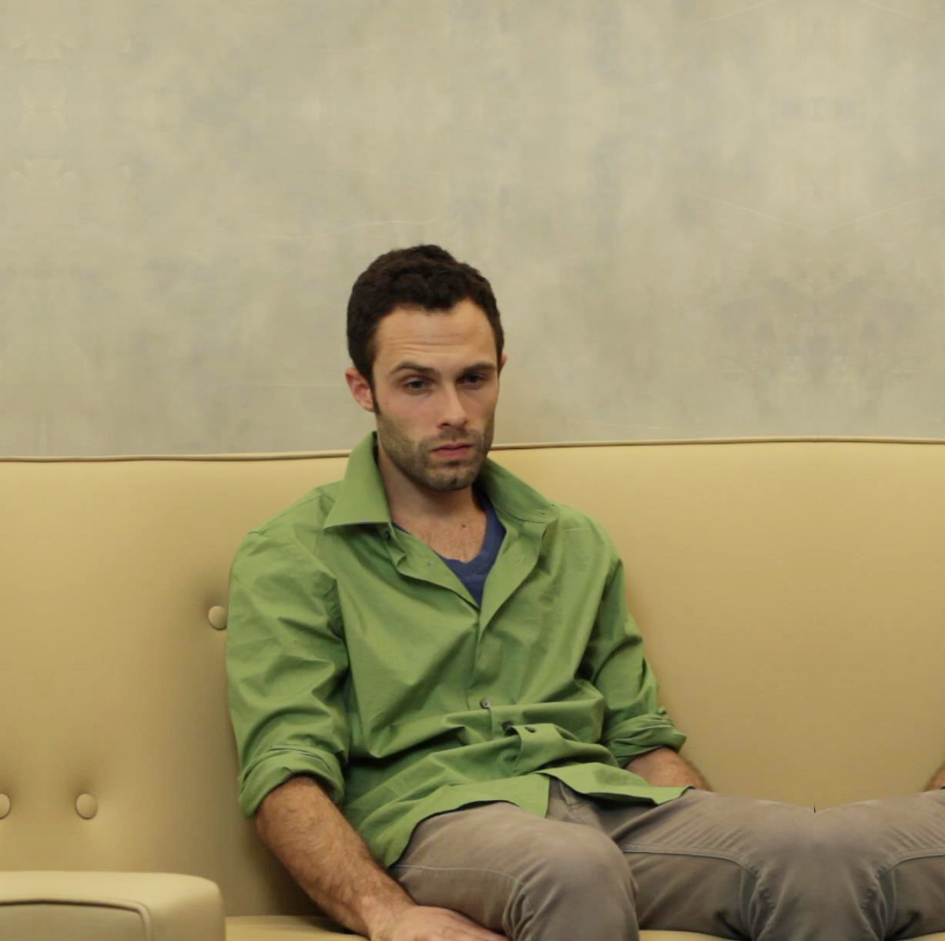
Staying Positive
Staying Positive
with Jake Paque
with Jake Paque
“It doesn’t matter. Nothing matters. They’re all worthless.”

Slide 13

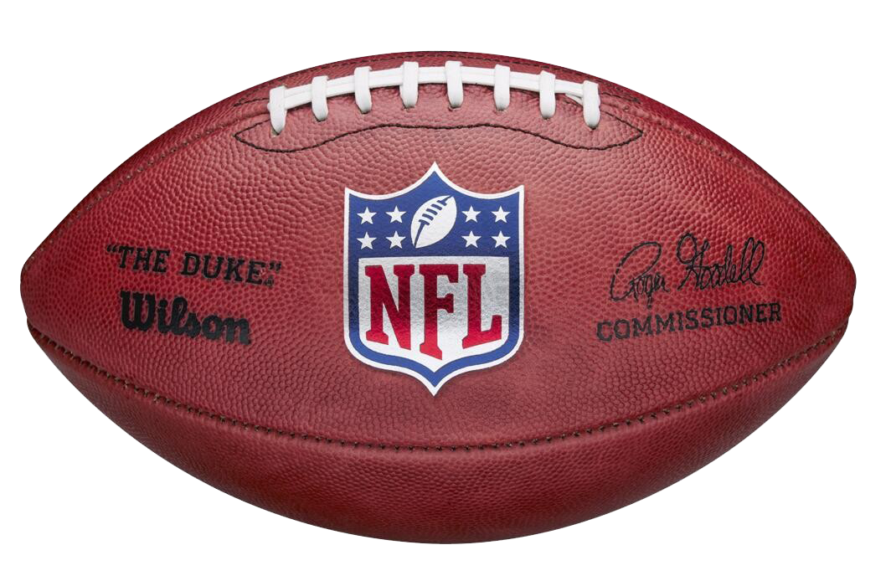
Stats!

Slide 14
Stats!
Kurt Contribution
astute fantasy analysis and commentary in our chat
“Hey guys. Sorry about
Jake’s grammar.”

Slide 15

2019: The Ones
QB
Player | Pts | Draft $ | By
Lamar | 426.18 | $26 | Jeff
Dak | 352.28 | $16 | Kurt
Russell | 335.6 | $20 | Aaron
Deshaun | 326.48 | $33 | Bill
Jameis | 323.86 | $10 | Kurt
Mahomes | 300.54 | $36 | Albert
Kyler | 293.28 | $18 | Jeff
Josh Allen | 290.06 | $10 | Bill
Rodgers | 287.38 | $34 | Ryan
Wentz | 283.86 | $21 | Andrew
Matt Ryan | 281.34 | $19 | Aaron
Brady | 270.18 | $16 | Ryan
RB
Player | Pts | Draft $ | By
CMC | 485.2 | $61 | Andrew
A Jones | 324.3 | $22 | Trevor
Zeke | 318.7 | $59 | Trevor
Ekeler | 316 | $7 | Jake
Henry | 310.1 | $17 | Trevor
Dalvin | 299.4 | $32 | Kurt
Fournette | 264.4 | $34 | Caesar
Chubb | 264.2 | $30 | Aaron
Saquon | 252.1 | $67 | Caesar
Kamara | 249.72 | $58 | Albert
Ingram | 246.5 | $13 | Ryan
Carson | 238.6 | $18 | Kurt
WR
Player | Pts | Draft $ | By
MT | 384.6 | $29 | Jim
Godwin | 283.6 | $19 | Bill
Julio | 281.6 | $43 | Caesar
Kupp | 279 | $18 | Jake
Hopkins | 273.54 | $44 | Kurt
Keenan | 263.5 | $26 | TrentShall
Edelman | 260.04 | $16 | Aaron
A Rob | 257.9 | $2 | Trevor
Gollady | 256 | $11 | Bill
Amari | 254 | $20 | TrentShall
Lockett | 253 | $21 | Ryan
D Parker | 250.2 | $0 | (Jeff $7 FAAB wk9)
TE
Player | Pts | Draft $ | By
Kelce | 256.3 | $28 | Albert
Kittle | 227 | $16 | Kurt
Waller | 226 | $0 | (Aaron $0 FA wk1)
Ertz | 216.6 | $21 | Ryan
Andrews | 209.2 | $3 | Aaron
Hooper | 193.7 | $5 | TrentShall
Cook | 169 | $4 | Trevor
Higbee | 164.4 | $0 | (Jeff $0 FA wk13)
Hunter | 151.2 | $9 | Jim
Goedert | 145.34 | $1 | Caesar
Witten | 139.9 | $0 | (Jake $0 FA wk14)
Gesicki | 136 | $0 | (Jim $0 FA wk14)

Slide 16
2019 Draft: QB, RB, WR, TE 1s … RB, WR 2s
Saquon | $67 | Caesar
CMC | $61 | Andrew
Zeke | $59 | Trevor
Kamara | $58 | Albert
Hopkins | $44 | Kurt
D Johnson | $43 | Caesar
Julio | $43 | Caesar
JuJu | $39 | Trevor
Davante | $38 | TrentShall
Conner | $38 | Jake
Gurley | $37 | Andrew
Mixon | $36 | TrentShall
Mahomes | $36 | Albert
Fournette | $34 | Caesar
A Rodgers | $34 | Ryan
Le’V | $33 | Bill
Watson | $33 | Bill
Dalvin | $32 | Kurt
A Brown | $31 | Bill
Tyreek | $30 | Jim
Chubb | $30 | Aaron
Odell | $30 | Jake
M Thomas | $29 | Jim
Evans | $29 | Trevor
Kelce | $28 | Albert
Lamar | $26 | Jeff
D Williams | $26 | Jim
Keenan | $26 | TrentShall
Devonta | $25 | Ryan
Melvin | $23 | Albert
A Jones | $22 | Trevor
Baker | $22 | Andrew
Mack | $22 | Jake
Ertz | $21 | Ryan
Lockett | $21 | Ryan
Wentz | $21 | Andrew
Amari | $20 | TrentShall
Russell | $20 | Aaron
Kerryon | $20 | Aaron
J Gordon | $20 | Aaron
Thielen | $19 | Ryan
Godwin | $19 | Bill
Woods | $19 | Andrew
M Ryan | $19 | Aaron
Jacobs | $19 | Aaron
Diggs | $18 | Kurt
Carson | $18 | Kurt
Kyler | $18 | Jeff
Sony | $18 | Jim
Kupp | $18 | Jake
Goff | $17 | Jim
D Henry | $17 | Trevor
Butker | $17 | TrentShall
Rivers | $17 | Albert
Cam | $17 | Aaron
Kittle | $16 | Kurt
Dak | $16 | Kurt
D Mont | $16 | Jeff
Dede | $16 | Jim
Brees | $16 | TrentShall
Brady | $16 | Ryan
Engram | $16 | Bill
Edelman | $16 | Aaron
Ridley | $15 | Jeff
Garoppolo | $15 | Trevor
Trubisky | $15 | Jake
J White | $14 | Jeff
Darnold | $14 | TrentShall
A.J. | $13 | Jeff
Cooks | $13 | Jeff
Ingram | $13 | Ryan
Cohen | $12 | Kurt
Miles | $12 | Jeff
Tevin | $12 | Ryan
MVS | $12 | Ryan
T.Y. | $11 | Jeff
Big Ben | $11 | Jim
Foles | $11 | Jim
Golladay | $11 | Bill
D.J. Moore | $11 | Jake
Carr | $11 | Jake
Jameis | $10 | Kurt
O.J. Howard | $10 | Jeff
Guice | $10 | Bill
J Allen | $10 | Bill
Boyd | $9 | Jeff
Jarvis | $9 | Jeff
Hunter | $9 | Jim
Alshon | $9 | Jim
Lindsay | $9 | TrentShall
Gallup | $9 | Andrew
Kirk | $9 | Aaron
Duke | $9 | Aaron
Drake | $8 | Jeff
Latavius | $8 | Jim
Dalton | $7 | Kurt
Cousins | $7 | Jeff
Barber | $7 | Ryan
DAL | $7 | Bill
Kareem | $7 | Albert
Ekeler | $7 | Jake
Tucker | $7 | Jake
Mariota | $6 | Trevor
D Henderson | $6 | Bill
Fuller | $6 | Bill
Shepard | $6 | Albert
Hooper | $5 | TrentShall
Fitzgerald | $5 | Ryan
M Williams | $5 | Albert
E Sanders | $5 | Andrew
Pettis | $5 | Aaron
Watkins | $5 | Jake
Breida | $5 | Jake
Njoku | $4 | Kurt
Howard | $4 | Jim
M Jones | $4 | Jim
J Cook | $4 | Trevor
McCoy | $4 | TrentShall
Ebron | $4 | Albert
T Williams | $4 | Albert
Tate | $4 | Albert
M Andrews | $3 | Aaron
A Robinson | $2 | Trevor
Sutton | $1 | TrentShall
Goedert | $1 | Caesar
Waller | undrafted
Higbee | undrafted
Witten | undrafted
Gesicki | undrafted
D Parker | undrafted
AJ Brown | undrafted
J Brown | undrafted
Chark | undrafted

Slide 17
2019 Draft: The Super Sale Team
 | Player | Draft Cost | EOS Rank | EOS Pts
QB1 | Jameis | $10 | QB5 | 323.86
QB2 | J Allen | $10 | QB8 | 290.06
WR1 | D Parker | $0 | WR12 | 250.2
WR2 | Chark | $0 | WR17 | 228.8
RB1 | Ekeler | $7 | RB4 | 316
RB2 | Drake | $8 | RB15 | 219.8
TE | Waller | $0 | TE3 | 226
Flex | AJ Brown | $0 | WR18 | 228.1
K | Matt Gay | $0 | K4 | 150
DST | NE | $0 | D1 | 287.32
 |  | $35 |  | 2520.14 158/wk
EOS Points For
Andrew | 2,391.58
Aaron | 2,371.52
Bill | 2,327.44
Ryan | 2,306.76
Jeff | 2,278.32
Trevor | 2,207.42
TrentShall | 2,201.96
Kurt | 2,127.28
Jake | 2,056.00
Albert | 1,931.30
Jim | 1,922.42

Slide 18
2019 Draft: The Money Burn Team
 | Player | Draft Cost | EOS Rank | EOS Pts
QB1 | Baker | $22 | QB19 | 235
QB2 | Cam | $17 | QB49 | 17
WR1 | An. Brown | $31 | WR159 | 16
WR2 | Ju Ju | $39 | WR64 | 115
RB1 | Da. Johnson | $43 | RB37 | 142
RB2 | J Conner | $38 | RB36 | 146
TE | Engram | $16 | TE16 | 112
Flex | D Williams | $26 | RB35 | 147
K | Badgley | $1 | K29 | 64
DST | DAL | $7 | D25 | 125
 |  | $240 |  | 1119 69/wk
EOS Points For
Andrew | 2,391.58
Aaron | 2,371.52
Bill | 2,327.44
Ryan | 2,306.76
Jeff | 2,278.32
Trevor | 2,207.42
TrentShall | 2,201.96
Kurt | 2,127.28
Jake | 2,056.00
Albert | 1,931.30
Jim | 1,922.42

Slide 19

Start / Sit Fails
20+ Point Players Left on Bench:
Less than 2 pts Scored from Starter:
Owner | # of Times | Total Pts
Jeff | 13 | 389.02
Andrew | 11 | 305.6
Trevor | 10 | 280.72
Kurt | 10 | 275.21
TrentShall | 10 | 253.44
Ryan | 9 | 251.4
Bill | 9 | 224.7
Albert | 7 | 215.14
Jim | 7 | 200.9
Jake | 6 | 192.98
Aaron | 5 | 139.26
Player | Points | Week | Owner | W/L
Fuller | 56.7 | 5 | Jeff | W
Sammy | 49.3 | 1 | Jake | W
Daniel Jones | 46.28 | 16 | Albert | W
Marvin Jones | 43.3 | 7 | Jim | L
Daniel Jones | 40.82 | 10 | Albert | W
Daniel Jones | 40.74 | 3 | Albert | W
Drake | 40.6 | 14 | Jeff | W
Desean | 39.4 | 1 | Jake | W
Colts D | 38.8 | 16 | Aaron | L
Manny Sanders | 38.6 | 14 | Andrew | W
Tannehill | 37.88 | 12 | Andrew | W
Jameis | 37.8 | 4 | Kurt | L
James White | 37.7 | 13 | Jeff | W
Chark | 37.4 | 5 | Ryan | L
AJ Brown | 36.1 | 14 | Jim | L
Trubisky | 36.06 | 14 | Trevor | W
Parker | 35.9 | 13 | Jeff | W
Lockett | 35.78 | 3 | Ryan | W
Keenum | 35.7 | 1 | Trevor | W
Owner | # of Times
Jim | 14
Albert | 9
Jake | 9
Ryan | 8
Trevor | 7
Kurt | 7
TrentShall | 7
Andrew | 6
Bill | 6
Aaron | 5
Jeff | 5
Player | Points | Week | Owner | W/L
Darnold | -14.66 | 7 | Andrew | L
Baker | -6 | 5 | Andrew | L
Kyle Allen | -5.68 | 8 | Aaron | W
Mariota | -5.08 | 6 | Trevor | L
Rosen | -4.6 | 6 | Jim | L
Foles | -3.98 | 13 | Kurt | W
Keenum | -2.52 | 4 | Trevor | L
Brees | -2.48 | 2 | TrentShall | L
Kyle Allen | -1.3 | 11 | Aaron | L
Pollard | -0.36 | 16 | Kurt | L
Goff | -0.28 | 10 | Jake | L
M Rudolph | -0.2 | 12 | Jim | W
Geronimo | 0 | 1 | Andrew | W
Broncos D | 0 | 1 | Bill | L
Melvin | 0 | 1 | Albert | W
OJ Howard | 0 | 2 | Jeff | W
Alshon | 0 | 2 | Jim | L
Agholor | 0 | 4 | Kurt | L
Sammy | 0 | 5 | Jake | L
Jim
Andrew
Left 20+ pts on the bench
ELEVEN times (305 pts)
Had the 2 worst starts in the league:
Darnold -14.66, Baker -6
Started a player that scored less than 2 pts FOURTEEN TIMES!

Slide 20
Player | $ | Wk | Finish Position Rank | Finish Pts | To
Diontae Johnson | $0 | 5 | WR 38 | 173 | Bill
Deebo | $0 | 11 | WR 31 | 192 | Aaron
Goedert | $0 | 12 | TE 10 | 145 | TrentShall
Mostert | $0 | 14 | RB 27 | 165 | Andrew
Fant | $1 | 11 | TE 14 | 114 | Kurt
Crowder | $1 | 4 | WR 28 | 197 | Andrew
Slayton | $1 | 11 | WR 35 | 181 | Kurt
Latavius | $5 | 7 | RB 28 | 159 | Aaron
Chark | $9 | 3 | WR 17 | 228 | Ryan
D Parker | $10 | 7 | WR 12 | 250 | Jeff
Mark Andrews | $11 | 2 | TE 5 | 209 | Andrew
NE Def | $12 | 2 | DEF 1 | 287 | Bill
Minshew | $16 | 2 | QB 20 | 232 | Andrew
McLaurin | $20 | 2 | WR 27 | 197 | Bill
FAABulous … Best Waiver Buys

Slide 21
Not So FAABulous … Worst Waiver Buys
Player | $ | Week | Finish Position Rank | Finish Pts | To
AJ Green | $47 | 9 | WR FAIL | 0 | Aaron
Chris Thompson | $36 | 2 | RB 53 | 93 | Ryan
Ty Johnson | $36 | 8 | RB 67 | 62 | TrentShall
Brian Hill | $36 | 11 | RB 65 | 67 | TrentShall
John Ross | $31 | 2 | WR 72 | 100 | Bill
D Robinson | $30 | 3 | WR 70 | 101 | Jim
Wayne Gallman | $26 | 4 | RB 79 | 48 | Kurt
Mason Rudolph | $25 | 3 | QB 30 | 110 | Jim
Gio | $20 | 2 | RB 61 | 68 | Bill
Phillip Dorsett | $19 | 4 | WR 69 | 102 | Albert
Dissly | $16 | 4 | TE 37 | 73 | Jake
Chris Thompson | $16 | 5 | RB 53 | 93 | Andrew
Matt Moore | $16 | 8 | QB 41 | 43 | Jeff
Dissly | $15 | 3 | TE 37 | 73 | Jim
Mike Davis | $12 | 2 | RB 105 | 11 | Jim
Aaron
Trent & Marshall
Spent $36 FAAB on Ty Johnson
Spent $36 FAAB on Brian Hill
“I don’t even know who those guys are,” said Andrew.
Emptied the FAAB ($47)
on AJ Green wk 9
Proceeded to get…
ZERO points

Slide 22

Not So FAABulous … Worst Waiver Buys
Player | $ | Week | Finish POS Rank | Finish Pts | To
AJ Green | $47 | 9 | WR FAIL | 0 | Aaron
Chris Thompson | $36 | 2 | RB 53 | 93 | Ryan
Ty Johnson | $36 | 8 | RB 67 | 62 | TrentShall
Brian Hill | $36 | 11 | RB 65 | 67 | TrentShall
John Ross | $31 | 2 | WR 72 | 100 | Bill
D Robinson | $30 | 3 | WR 70 | 101 | Jim
Wayne Gallman | $26 | 4 | RB 79 | 48 | Kurt
Mason Rudolph | $25 | 3 | QB 30 | 110 | Jim
Gio | $20 | 2 | RB 61 | 68 | Bill
Phillip Dorsett | $19 | 4 | WR 69 | 102 | Albert
Dissly | $16 | 4 | TE 37 | 73 | Jake
Chris Thompson | $16 | 5 | RB 53 | 93 | Andrew
Matt Moore | $16 | 8 | QB 41 | 43 | Jeff
Dissly | $15 | 3 | TE 37 | 73 | Jim
Mike Davis | $12 | 2 | RB 105 | 11 | Jim
Kurt Contribution
astute fantasy analysis and commentary in our chat
“I have only ever made love to
two cats in my life.”

Slide 23

Owner | Lineup Changes | # Per Week
Ryan | 431 | 26.9
Aaron | 362 | 22.6
Jeff | 271 | 16.9
Jake | 225 | 14.1
Kurt | 201 | 12.6
Jim | 172 | 10.8
Bill | 145 | 9.1
TrentShall | 145 | 9.1
Andrew | 133 | 8.3
Albert | 113 | 7.1
Trevor | 101 | 6.3
Tinker Tinker!
… Most Lineup Changes
Ryan
Rage quit, moving all players to the bench, leaving the chat group, and swearing off fantasy forever THREE different times.
You gotta chill out, man.
* Typical start/sit move is 2 changes

Slide 24
Player | # Times Added
Adrian Peterson RB - WAS | 4
Dallas Goedert TE - PHI | 4
Diontae Johnson WR - PIT | 4
Kyle Rudolph TE - MIN | 4
O.J. Howard TE - TB | 4
Tony Pollard RB - DAL | 4
Vance McDonald TE - PIT | 4
A.J. Brown WR - TEN | 3
Auden Tate WR - CIN | 3
Chris Herndon TE - NYJ | 3
Chris Thompson RB - WAS | 3
Danny Amendola WR - DET | 3
Darren Fells TE - HOU | 3
Jared Cook TE - NO | 3
Jimmy Graham TE - GB | 3
Latavius Murray RB - NO | 3
Marquez Valdes-Scantling WR - GB | 3
Marquise Brown WR - BAL | 3
Mohamed Sanu WR - NE | 3
Noah Fant TE - DEN | 3
Raheem Mostert RB - SF | 3
Ronald Jones RB - TB | 3
Ryquell Armstead RB - JAX | 3
Will Fuller WR - HOU | 3
This Time it’s Different
… Most added players

Slide 25

FAAB
… Total Year Spends
Spender | Total Year Spend
Kurt | 120
Jim | 110
Bill | 110
Andrew | 108
Jake | 108
Jeff | 100
Aaron | 90
Ryan | 90
Trentshall | 90
Albert | 80
Scrooge McDuck | 34
Trevor
2016 - $35 FAAB spent
2017 - $34 FAAB spent
2018 - $60 FAAB spent
2019 - $34 FAAB spent
If you’re not gonna spend it,
please give it to Aaron.

Slide 26
2019 Trades
Went To | Player | Player | Went to | Week
Bill | Russell, Duke | Josh Allen, Hollywood | Aaron | 2
Kurt | Keenan | Diggs, Cohen, 10 FAAB | TrentShall | 2
Ryan | Evans, Jimmy G, A Jones | Brady, Ertz, Tevin | Trevor | 3
TrentShall | Minshew | Darnold | Andrew | 3
TrentShall | Bridgewater | Kyle Allen | Aaron | 7
Bill | Tevin, Robby, JuJu | Duke, Jacoby, McLaurin | Trevor | 7
Ryan | Stafford, DJ Moore | Larry Fitz, Jimmy G, 5 FAAB | Jake | 7
Jim | Jimmy G, 5 FAAB | Goff | Jake | 9
Albert | Ingram, Greg Olsen, Chark | Kelce, Melvin | Ryan | 10
Andrew | Davante | Gurley | Trentshall | 10
Aaron | Zeke, Brady | J. Samuels, J Allen, Chubb | Trevor | 10
Andrew | DJ Moore, 5 FAAB | John Brown, Driskel | Ryan | 11
Andrew | Tannehill | Baker | Trentshall | 11
Albert | Ryan Finley | Miles, 5 FAAB | Bill | 12
Jake | Jaylen Samuels | Ekeler | Jake | 12
Jeff
3 years and not 1 trade.
Not even close.
Answer your messages and make some trades, damnit!

Slide 27
Big Weeks & Weak Weeks
Weak Weeks
Big Weeks
Points | Week | Owner | W/L
65.74 | 13 | Albert | L
73.7 | 7 | Andrew | L
77.7 | 16 | Kurt | L
79.26 | 2 | TrentShall | L
80.48 | 4 | Trevor | L
84.52 | 2 | Jim | L
88.06 | 4 | Kurt | L
89.58 | 12 | Ryan | L
90.88 | 12 | Aaron | W
92.88 | 11 | Bill | L
94.2 | 12 | TrentShall | L
96.04 | 6 | Jim | L
96.1 | 13 | Jim | W
96.36 | 5 | Albert | L
99.88 | 16 | Trevor | L
Points | Week | Owner | W/L
238.88 | 8 | Ryan | W
213.34 | 16 | Jeff | W
203.02 | 6 | Bill | W
200.62 | 14 | Trevor | W
196.22 | 3 | Albert | W
195.72 | 5 | Aaron | W
195.06 | 9 | Jeff | W
191.98 | 5 | Trevor | W
191.56 | 15 | Andrew | W
191.48 | 2 | Bill | W
189.22 | 3 | Kurt | W
188.64 | 8 | Bill | W
188.54 | 12 | Trevor | W
188.22 | 7 | Ryan | W
181.02 | 10 | Jeff | W
180.9 | 14 | Andrew | W
180.88 | 4 | Andrew | W
180.08 | 11 | Andrew | W
Ryan Wk 8
Player | Stats | Pts
Stafford | 342 Pass Yds 3 Pass TDs, 1 INT | 28.38
Rodgers | 305 Pass Yds 3 Pass Tds 29 Rush Yds | 35.6
Devonta | 39 Rush Yards 63 Rec Yds | 16.2
A Jones | 67 Rush Yds 159 Rec yds 2 Rec TDs | 44.1
Evans | 198 Rec Yds 2 Rec TDs | 43.8
Lockett | 100 Rec Yds | 17.84
Hockenson | 21 Rec Yds | 3.1
Chark | 79 Rec Yds 1 Rec TD | 19.9
Prater | 4 PAT, 50+ | 10
49ers D | 11 Pts 7 Sck, 3 INT | 19.96
 |  | 238.88
Albert
Albert Wk 13
Player | Pts
Rivers | 18.6
D Jones | 4.2
Ingram | 8.2
Kamara | 12.4
Lockett | 0
Chark | 6.7
G Olsen | 5.2
RoJo | 0.8
D Carlson | 3
Browns | 6.64
 | 65.74
Final week of the reg season…
While in the playoff hunt…
Scores 65.74 points (6.5 / player)

Slide 28
FAAB … Weekly Spend
Bill
Spent $89 FAAB by Week 3
$31 – John Ross (WR72)
$20 – McLaurin (WR27)
$20 – Gio (RB61)
$12 – NE Def (okay that was good)
$6 – Peyton Barber (RB43)
Calm down, man.

Slide 29
FAAB … Weekly Spend
Kurt Contribution
astute fantasy analysis and commentary in our chat
“My little pony rare twinkle hope, mint condition.”

Slide 30
Mini Games
Most Pts Reg Season
Most Pts Team Wk
Most Pts Started Player
Closest Margin Defeat
Bill – 2,073.44
159 pts/wk avg
Ryan – 238.88
23.8 pts/player avg
Ryan – Rodgers – 57.28
429 Pass Yards (17.16)
5 Pass TDs (30)
6 Rush Yds (0.6)
1 Rush TD (6)
Bonuses (3.5)
Jake lost by 0.02
Jake won. Week was over and he was up 130.14 – 130.06…
Wake up Wed to NFL stat corrections…
Kupp yds changed from 102 to 101
Jake loses 0.1
LOSES
130.04 – 130.06
Jake
Wk 1 | 150.68
Wk 2 | 191.48
Wk 3 | 160.34
Wk 4 | 149.22
Wk 5 | 190.48
Wk 6 | 203.02
Wk 7 | 149.32
Wk 8 | 188.64
Wk 9 | 172.96
Wk 10 | 116.82
Wk 11 | 92.88
Wk 12 | 153.3
Wk 13 | 154.3
Stafford | 28.38
Rodgers | 35.6
Devonta | 16.2
A Jones | 44.1
Evans | 43.8
Lockett | 17.84
Hockenson | 3.1
Chark | 19.9
Prater | 10
49ers D | 19.96
Got beat by a 1 yard stat correction.

Slide 31
2020
The Year Ahead…

Slide 32
Draft Details

Slide 33
New Rules
Roster Change
QB Scoring
IR Spot
COVID Contingencies
QB | 1
RB | 2
WR | 2
TE | 1
Flex W/R/T | 2
K | 1
D | 1
Bench | 6
+4 TD
-2 INT
2 spots
IR, NON, SUS, PUP, EXE, COV or OPT
24 hours to move from Reserve spot once activated
Past 24 hours and Aaron will move that player for you, dropping your lowest YTD scorer
8 weeks to call a full season
Less, and all buy-ins refunded, no champ, etc. crowned
If season ends early, final ranks determined by points for ONLY.

Slide 34
Schedule Parity
+1 H2H win
+1 top 6 scorer
+1 H2H win
+0.5 top 6 scorer
If Normal
Owner | W | L | Playoffs?
Jeff | 10 | 3 | Y
Kurt | 10 | 3 | Y
Ryan | 9 | 4 | Y
Aaron | 8 | 5 | Y
Bill | 7 | 6 | Y
Andrew | 7 | 6 | Y
Albert | 7 | 6 | N
TrentShall | 6 | 7 | N
Jake | 5 | 8 | N
Jim | 5 | 8 | N
Trevor | 4 | 9 | N
Owner | Pts | Playoffs?
Kurt | 20 | Y
Bill | 18 | Y
Ryan | 18 | Y
Aaron | 17 | Y
Jeff | 17 | Y
Andrew | 14 | Y
Jake | 12 | N
TrentShall | 12 | N
Albert | 11 | N
Jim | 9 | N
Trevor | 8 | N
Owner | Pts | Playoffs?
Kurt | 15 | Y
Jeff | 13.5 | Y
Ryan | 13.5 | Y
Bill | 12.5 | Y
Aaron | 12.5 | Y
Andrew | 10.5 | Y
Albert | 9 | N
TrentShall | 9 | N
Jake | 8.5 | N
Jim | 7 | N
Trevor | 6 | N
Neither makes any diff for who makes playoffs
… But both would change seeding pretty significantly

Slide 35
Schedule Parity
+1 H2H win
+1 top 6 scorer
+1 H2H win
+0.5 top 6 scorer
If Normal
Owner | W | L | Playoffs?
Jeff | 10 | 3 | Y
Kurt | 10 | 3 | Y
Ryan | 9 | 4 | Y
Aaron | 8 | 5 | Y
Bill | 7 | 6 | Y
Andrew | 7 | 6 | Y
Albert | 7 | 6 | N
TrentShall | 6 | 7 | N
Jake | 5 | 8 | N
Jim | 5 | 8 | N
Trevor | 4 | 9 | N
Owner | Pts | Playoffs?
Kurt | 20 | Y
Bill | 18 | Y
Ryan | 18 | Y
Aaron | 17 | Y
Jeff | 17 | Y
Andrew | 14 | Y
Jake | 12 | N
TrentShall | 12 | N
Albert | 11 | N
Jim | 9 | N
Trevor | 8 | N
Owner | Pts | Playoffs?
Kurt | 15 | Y
Jeff | 13.5 | Y
Ryan | 13.5 | Y
Bill | 12.5 | Y
Aaron | 12.5 | Y
Andrew | 10.5 | Y
Albert | 9 | N
TrentShall | 9 | N
Jake | 8.5 | N
Jim | 7 | N
Trevor | 6 | N
Kurt Contribution
astute fantasy analysis and commentary in our chat
“Just like the Meatloaf song.”
Neither makes any diff for who makes playoffs
… But both would change seeding pretty significantly

Slide 36
Schedule Randomizer

Slide 37
Reminders
Auction Draft
FAAB Rules
Trades
You can join the draft 30 minutes before the start: at 130p EST
Draft Order is randomly set 30 minutes before the start
20 seconds to nominate, clock goes back to 10 seconds if new bid
If you bid more than the next person, ALL of what you bid is deducted
Nominating a player = $1 bid
System forces you to have at least $1 for each roster spot … NO $0 players
No exceptions or changes will be made if you disconnect/autodraft
Waivers process approximately 3am EST on Wednesday morning (Tuesday night)
If 2 owners bid the same, priority goes to the person who is lower in the league rankings
If you bid more than the 2nd highest person, ALL of what you bid is deducted
You may trade FAAB budget
Processed immediately,
no veto vote
  All trades are approved, so long as there’s no collusion-y cheating/tanking.
Be communicative and try to respond quickly to proposals
Trade Deadline: Friday, November 20, 2020 (before wk 11)

Slide 38
Prizes & Payouts
Champion | $625
2nd Place | $300
3rd Place | $100
Most Pts Reg Season | $50
Most Team Pts in a Week | $50
Most Player Pts in a week | $50
Closest Margin of Defeat | $25 (to the loser)

Slide 39
Pay Up!
PAID/COMPLETE: Aaron, Andrew, Bill, Darren
$100 Owed: Errbody Else
Cash
Venmo (@aaroncao, or caoac@yahoo.com)
Cash App ($aaroncao)
PayPal (info@jonnypool.com)
Chase Quick Pay (caoac@yahoo.com)
BTC, LTC, ETH (ask me for details. If coinbase send to caoac@yahoo.com)

Slide 40
Next Year’s Draft
Continue Labor Day wknd (Sun/Mon) tradition
Last preseason game is wk before Labor Day
Do it in person?

Slide 41
Next Year’s Draft
Continue Labor Day wknd (Sun/Mon) tradition
Last preseason game is wk before Labor Day
Do it in person?
Kurt Contribution
astute fantasy analysis and commentary in our chat
“Make him borscht in order to drive up beet prices.”

Slide 42
Good Luck!!!
Owner | Avg Finish | # Playoff Appearances | % Years Playoffs Made | 2019 | 2018 | 2017 | 2016 | 2015 | 2014 | 2013 | earnings/losses
Aaron | 4.71 | 4 | 57.1% | 4 | 1 | 7 | 4 | 2 | 7 | 8 | +$325
Bill | 5.43 | 5 | 71.4% | 5 | 9 | 1 | 9 | 5 | 5 | 4 | +$200
Andrew | 5.57 | 4 | 57.1% | 2 | 7 | 9 | 3 | 4 | 3 | 11 | -$150
Kurt | 5.67 | 4 | 66.7% | 6 | 6 | 3 | 8 | 9 | 2 |  | -$250
Jake | 6.00 | 5 | 71.4% | 10 | 4 | 11 | 5 | 6 | 4 | 2 | -$350
Albert | 6.20 | 2 | 40.0% | 7 | 3 | 10 | 10 | 1 |  |  | +$375
Jeff | 6.33 | 1 | 33.3% | 1 | 10 | 8 |  |  |  |  | +$325
Trevor | 6.57 | 4 | 57.1% | 8 | 12 | 4 | 6 | 7 | 6 | 3 | -$600
Jim | 8.60 | 1 | 20.0% | 11 | 8 | 2 | 12 | 10 |  |  | -$150
TrentShall | 9.00 | 0 | 0.0% | 9 |  |  |  |  |  |  | -$100
 | 2013 | 2014 | 2015 | 2016 | 2017 | 2018 | 2019
CHAMP | Joey | Whitney | Albert | Bobby | Bill | Aaron | Jeff
2nd | Jake | Kurt | Aaron | Whitney | Jim | Whitney | Andrew
3rd | Trevor | Andrew | Sophie | Andrew | Kurt | Albert | Ryan
Toilet | Bobby C | Bear | Sam | Jim | Sam | Trevor | Jim

