Slide 1
Sx3
2018

Slide 2
Sx3 6th Anniversary!
2013
Champ
D’Glester (Joey)
2nd
Majik Jake
3rd
Team PRISM (Trevor)
Toilet
Public Enemies (Bobby C)
2014
Champ
Whitness
2nd
Lady Capulet (Kurt)
3rd
Cinderella Diapers
(Andrew)
Toilet
The Knights Who Say GiovaNI (Bear)
2015
Champ
Sharknados (Albert)
2nd
Points Dot Points (Aaron)
3rd
Gerby The Mole
(Sophie)
Toilet
Soul-Less Inferno (Sam)
2016
Champ
Mohante
2nd
Whitness
3rd
One Chicken I Lost It
(Andrew)
Toilet
DaByrds (Jim)
2017
Champ
Falcon Punch (Bill)
2nd
Marquette Steamer (Jim)
3rd
Cinna – a - Poet
(Kurt)
Toilet
Soul-ly Guessing

Slide 3
2017 Draft: QB,RB,WR,TE 1s … RB,WR 2s
 |  | Andrew | Kurt | Bill | Trevor | Whitney | Sam | Jeff | Albert | Jake | Aaron | Jim | Bobby
--> | 1 | Lev (Jef) | David Johnson | Antonio | Odell | Devonta | Shady | Julio (Andrew) | Rodgers | Melvin | Jordy | Brady | Evans | -->
<-- | 2 | Gronk | Crowell | Gurley | Fournette | Jordan Howard | Brees | Dez | Zeke | Demarco | Michael Thomas | Ajayi | AJ | <--
--> | 3 | Ty Mont | Baldwin | Cooks | Marshawn | Amari | Pryor | Lamar | Kelce | T.Y. | Kareem | Jarvis | Hyde | -->
<-- | 4 | Greg Olsen | CJ Anderson | Dalvin | Jimmy Graham | Nuke | Allen Robinson | Demaryius | Jordan Reed | Alshon | Keenan | McCaffery | Davante | <--
--> | 5 | Abdullah | Golden | Emmanuel | Martavis | Ingram | Gore | Crabtree | Tyreek | Matt Ryan | Mariota | Diggs | Doug Martin | -->
<-- | 6 | Garcon | Delanie | Bilal | Russell | DeSean | Rudolph | Mixon | Blount | Kelvin | Woodhead | Cobb | Fitz | <--
--> | 7 | Derrick Henry | Dak | DeVante | Tevin | Brate | Britt | Watkins | Decker | Crowder | Eifert | Martellus | Luck | -->
<-- | 8 | Eddie Lacy | Corey Coleman | Terrance West | Snead | J Stew | Sproles | Moncrief | McFadden | Rob Kelley | Duke | Gillislee | Ertz | <--
--> | 9 | Carr | Kirk | Jordan Matthews | Chris Hogan | Big Ben | Perkins | Brandon Marshall | Thielen | Maclin | Rishard | Gostkowski | Jacquizz | -->
<-- | 10 | John Brown | Tyrell Williams | James White | Samaje | Marvin Jones | Zay Jones | Corey Davis | Jeremy Hill | Forte | AP | Rawls | Jamaal Williams | <--
--> | 11 | DeAndrew Washington | Riddick | Ginn | Hunter Henry | Latavius | Shepard | Prosise | Vereen | Ebron | Kevin White | Vikings | Cam | -->
<-- | 12 | Tucker | Fiedorowicz | Tyrod | Seahawks | Beasley | Gates | Stafford | Ju Ju | Smallwood | Rex | Jameis | Doyle | <--
--> | 13 | Jamaal | Steelers | Chiefs | D'Onta | Dwayne Allen | Broncos | Rivers | Godwin | Witten | Cupp | Gio | Cardinals | -->
<-- | 14 | Funchess | Lutz | Austin Hooper | Bailey | Falcons | Palmer | Giants | Panthers | Pats | Texans | Robert Woods | Bryant | <--
--> | 15 | Chargers | Marqise | Vinatieri | Manning | Cario | Crosby | Hauschka | Kai | Duston Hopkins | Boswell | Jared Cook | Robby Anderson | -->

Slide 4
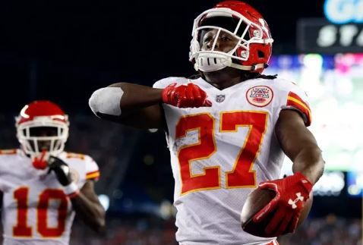
2017 Memories
KAREEEEEMMMM!!!!
Week 1:
148 ru yds, 1 TD
98 rec yds, 2 TDs
48.1 Points
Aaron feels great about his 3rd round pick

Slide 5
The 2017 1’s - QB
Player | Pos. Rank | Draft Pos. | Drafted By | Points
Russell Wilson | 1 | 6.9 | Trevor | 400.92
Alex Smith | 2 | undrafted | Jim (fa wk 2) | 354.18
Tom Brady | 3 | 1.11 | Jim | 353.88
Carson Wentz | 4 | undrafted | Kurt (fa wk 3) | 345.24
Matthew Stafford | 5 | 12.6 | Jeff | 320.64
Philip Rivers | 6 | 13.7 | Jeff | 319.4
Cam Newton | 7 | 11.12 | Bobby | 313.48
Kirk Cousins | 8 | 9.2 | Kurt | 312.12
Jared Goff | 9 | undrafted | Whitney (wvrs $0 wk 5) | 309.76
Drew Brees | 10 | 2.7 | Sam | 297.06
Ben Roethlisberger | 11 | 9.5 | Whitney | 296.74
Dak Prescott | 12 | 7.2 | Kurt | 284.16

Slide 6
The 2017 1’s - RB
Player | Position Rank | Draft Position | Drafted By | Points
Todd Gurley | 1 | 2.1 | Bill | 395.3
Le'Veon Bell | 2 | 1.1 | Jeff | 346.6
Alvin Kamara | 3 | undrafted | Bobby (fa wk 2) | 339.28
Kareem Hunt | 4 | 3.1 | Aaron | 306.7
Melvin Gordon | 5 | 1.9 | Jake | 292.1
Mark Ingram | 6 | 5.5 | Whitney | 284
LeSean McCoy | 7 | 1.6 | Sam | 267.6
Leonard Fournette | 8 | 2.9 | Trevor | 239.2
Christian McCaffrey | 9 | 4.2 | Jim | 238.4
Carlos Hyde | 10 | 3.12 | Bobby | 234.8
Dion Lewis | 11 | undrafted | Andrew (fa wk 7) | 228.8
Duke Johnson | 12 | 8.3 | Aaron | 216.78

Slide 7
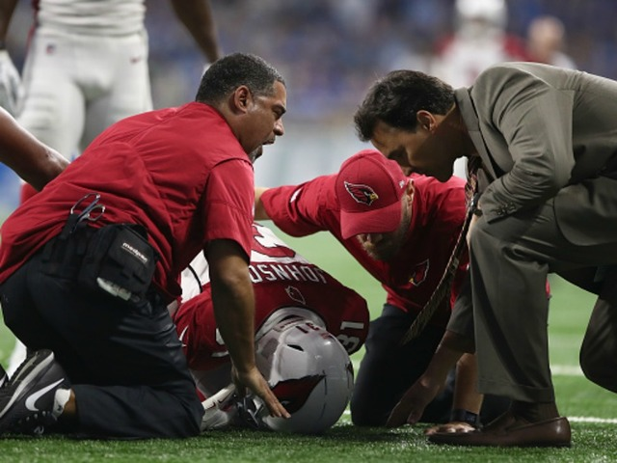
2017 Memories
Oh Lamentable Day!
Week 1: David Johnson
12 ru yds, 1 fum
6-67 rec
13 Fantasy Points
Injures his wrist and becomes hold-ably questionable the remainder of the season.
Poor Kurt.

Slide 8
The 2017 1’s - WR
Player | Position Rank | Draft Position | Drafted By | Points
Antonio Brown | 1 | 1.3 | Bill | 324.24
DeAndre Hopkins | 2 | 4.8 | Whitney | 318.3
Keenan Allen | 3 | 4.3 | Aaron | 291.2
Larry Fitzgerald | 4 | 6.1 | Bobby | 265.44
Tyreek Hill | 5 | 5.8 | Albert | 263.86
Jarvis Landry | 6 | 3.11 | Jim | 263.04
Michael Thomas | 7 | 2.3 | Aaron | 260.5
Julio Jones | 8 | 1.7 | Andrew | 259.4
Adam Thielen | 9 | 9.8 | Albert | 246.7
A.J. Green | 10 | 2.1 | Bobby | 232.8
Golden Tate | 11 | 5.2 | Kurt | 229.92
Marvin Jones | 12 | 10.8 | Whitney | 228.1

Slide 9
The 2017 1’s - TE
Player | Position Rank | Draft Position | Drafted By | Points
Travis Kelce | 1 | 3.8 | Albert | 235.5
Rob Gronkowski | 2 | 2.12 | Andrew | 231.9
Zach Ertz | 3 | 8.1 | Bobby | 203.4
Delanie Walker | 4 | 6.11 | Kurt | 174.5
Evan Engram | 5 | undrafted | Aaron (wvrs wk 4 $0) | 173.6
Jimmy Graham | 6 | 4.9 | Trevor | 171
Jack Doyle | 7 | 12.1 | Bobby | 170
Kyle Rudolph | 8 | 6.7 | Sam | 158.2
Cameron Brate | 9 | 7.5 | Whitney | 143.1
Benjamin Watson | 10 | undrafted | Jeff (fa wk 3) | 137.2
Jared Cook | 11 | 15.11 | Jim | 134.8
Eric Ebron | 12 | 11.9 | Jake | 132.4

Slide 10
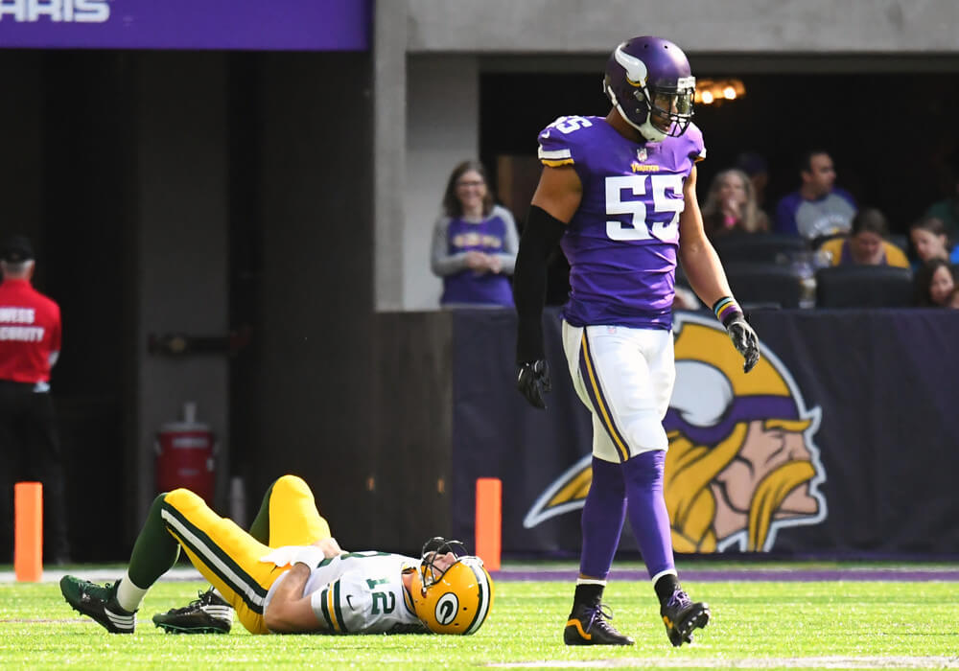
2017 Memories
Rodgers is Down
Week 6
Breaks collarbone
Albert’s 1st round busts.
Aaron’s 1st round (Jordy) busts.
The entire state of Wisconsin cries.

Slide 11
This Time it’s Different
… Most added players
Player | # Times Added
Danny Amendola WR - NE | 4
Jameis Winston QB - TB | 4
Josh McCown QB - NYJ | 4
Brandon LaFell WR - CIN | 3
Charles Clay TE - BUF | 3
Eric Ebron TE - DET | 3
Jared Goff QB - LA | 3
Josh Doctson WR - WAS | 3
Robert Woods WR - LA | 3
Tyler Kroft TE - CIN | 3

Slide 12
FAABulous … Best Waiver Buys
 | FAAB Spend | Week | Finish POS Rank | Finish Pts | To
Evan Engram | 0 | 4 | 5 | 173.6 | Peaches n' Kareem
Jack Doyle | 0 | 2 | 7 | 170 | Califlatulation
Jared Goff | 0 | 5 | 9 | 309.76 | The Whitness
Benjamin Watson | 0 | 8 | 10 | 137.2 | Don't Stop Bell Le'Veon
Eric Ebron | 0 | 16 | 12 | 132.4 | FALCON PUNCH
Case Keenum | 0 | 12 | 13 | 274.38 | Don't Stop Bell Le'Veon
Robby Anderson | 5 | 9 | 18 | 206 | Califlatulation
Nelson Agholor | 20 | 2 | 21 | 197.5 | Soul-ly Guessing
Devin Funchess | 12 | 3 | 23 | 196 | FALCON PUNCH
Deshaun Watson | 38 | 5 | 24 | 196.86 | Bowember the Ty-tons

Slide 13
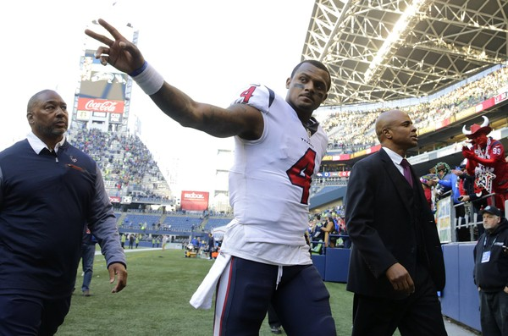
2017 Memories
Deshaun Watson
Lights the NFL on fire…
Week | Att | Comp | Yds | TD | Int | Sck | Ru TD | Fum | Pts
1 | 12 | 23 | 102 | 1 | 1 | 4 |  | 1 | 5.68
2 | 15 | 24 | 125 |  |  | 3 | 1 |  | 17.7
3 | 22 | 33 | 301 | 2 | 2 | 2 |  | 2 | 21.1
4 | 25 | 34 | 283 | 4 | 1 | 1 | 1 |  | 39.7
5 | 16 | 31 | 261 | 5 |  | 3 |  |  | 45.5
6 | 17 | 29 | 225 | 3 | 1 | 1 |  |  | 27.3
8 | 19 | 30 | 402 | 4 | 3 | 5 |  |  | 39.7
Week 8 tears his ACL… in practice

Slide 14
Not So FAABulous … Worst Waiver Buys
 | FAAB Spend | Week | Finish POS Rank | Finish Pts | To
Amari Cooper | 55 | 4 | 36 | 165.4 | Mohante
Jalen Richard | 30 | 8 | 49 | 97.9 | Califlatulation
Aaron Jones | 30 | 5 | 61 | 82 | Bowember the Ty-tons
Andre Ellington | 26 | 4 | 57 | 87 | The Sharknados
Trevor Siemian | 25 | 6 | 30 | 123.1 | Califlatulation
Austin Ekeler | 25 | 11 | 43 | 110.3 | The Sharknados
Rob Kelley | 23 | 6 | 85 | 43.84 | Soul-ly Guessing
Alfred Morris | 21 | 9 | 67 | 73.2 | Peaches n' Kareem
Bennie Fowler | 20 | 2 | 80 | 82.24 | Soul-ly Guessing

Slide 15
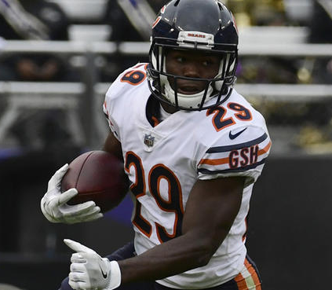
2017 Memories
Leading into week 2…
The very first waiver transaction of the year…
Jeff buys Tarik Cohen…
for $100
… then he dropped him week 11

Slide 16
FAAB … Weekly Spend

Slide 17
FAAB … Total Year Spends
Spender | Total Year Spend
Cinna - a poet | $110
Bowember the Ty-tons | $100
Don't Stop Bell Le'Veon | $100
FALCON PUNCH | $100
Marquette Steamer | $100
Soul-ly Guessing | $100
Dorsal Levens | $87
Peaches n' Kareem | $85
Mohante | $83
Califlatulation | $80
The Whitness | $75
The Sharknados | $51

Slide 18
Start / Sit Fails
20+ Point Players Left on Bench:
Most Points Left on Bench:
Week | Owner | Player | Points
13 | Jim | Alex Smith | 48.14
7 | Bobby | Amari | 47
3 | Jim | Diggs | 39.8
8 | Andrew | D. Watson | 39.78
11 | Whitney | Big Ben | 36.96
14 | Bobby | Dak | 36.58
16 | Whitney | Goff | 35.84
7 | Jim | Alex Smith | 35.68
3 | Bobby | Fitz | 34.9
8 | Albert | JuJu | 34.8
14 | Whitney | Big Ben | 34.74
5 | Jim | Alex Smith | 33.86
11 | Jeff | Stills | 33.5
15 | Andrew | Foles | 33.48
11 | Kurt | Cousins | 32.98
3 | Whitney | Jordan Howard | 32.6
15 | Albert | Bortles | 32.04
4 | Bill | Bilal | 32
3 | Andrew | Chris Thompson | 31.8
4 | Trevor | Eli | 31.72
14 | Andrew | Hundley | 31.7
12 | Jeff | Keenum | 31.28
12 | Jim | Jamaal Williams | 31
16 | Kurt | Gio | 30.8
5 | Sam | McKinnon | 30.64
14 | Bobby | Davante Adams | 30.4
13 | Albert | Bortles | 30.06
Owner | # of Times | Points
Jeff | 12 | 303.2
Andrew | 11 | 309
Albert | 10 | 265.02
Jim | 10 | 303.82
Whitney | 10 | 270.88
Bill | 8 | 197.52
Bobby | 8 | 242.4
Aaron | 7 | 165.5
Kurt | 7 | 196.5
Sam | 6 | 148.42
Jake | 5 | 118.4
Trevor | 3 | 72.02

Slide 19
2017 Trades
Matt Ryan (QB15) to Trevor …
James White (RB38) to Jake
Week 3
Isaiah Crowell (RB33) + Dak (QB12) to Bobby …
Larry Fitz (WR4) to Kurt
Week 4

Slide 20
Mini Games
$50 - Most Points for a Single Started Player in a Single Week
Julio Jones - Week 12 – 55.3 Points - Andrew
$50 - Most Points Scored by a Team in a Single Week
Week 3 – 179.8 Points - Bill
$50 - Most Points Scored Over the Reg Season
1647.06 Points – 126.69 Per Week Average! – Bill
$25 - Closest Margin of Victory
Sam - Lost week 3 to Jim by 0.72 points

Slide 21

2018

Slide 22
Schedule Randomizer

Slide 23
FAAB Rules & Process
$100 Budget per Owner per Year
Waivers process approximately 3am EST on Wednesday morning (Tuesday night)
If 2 owners bid the same, priority goes to the person who is lower in the league rankings
If you bid more than the 2nd highest person, ALL of what you bid is deducted
You may trade FAAB budget

Slide 24
Trade Trade Trade!
Processed immediately
No Veto Vote
  All trades are approved, so long as there’s no collusion-y cheating/tanking.
  Doesn’t matter if anyone feels the trade is lopsided, or otherwise dislikes it.
Be communicative and try to respond quickly to proposals
Trade Deadline: Friday, November 23, 2018

Slide 25
Next Year’s Draft
?????
Do it in person?
Do it 1 week earlier, so Jim can make it (he has a standing Europe vaca every Labor Day)???

Slide 26
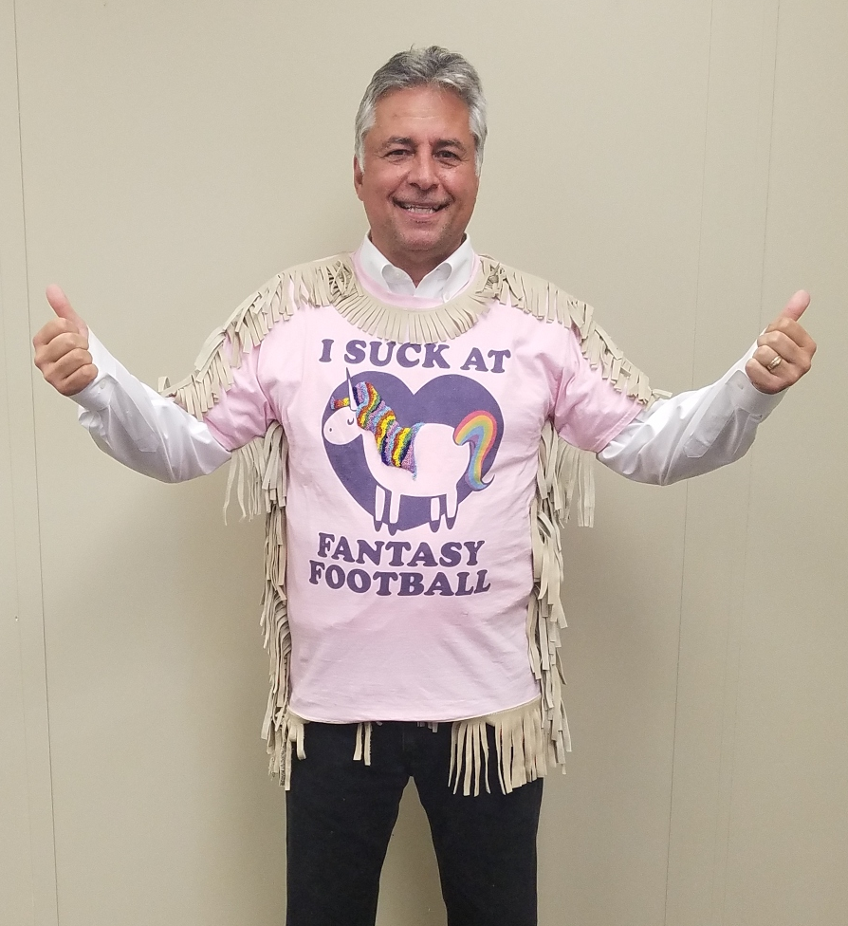
Big Ben – QB 15
Cam – QB 19
Tyrell Williams – WR 19
Stills – WR 43
Cobb – WR 54
Hurns – WR 78
Coates – WR 90
Jeremy Hill – RB 22
Ryan Mathews – RB 32
Christine Michael – RB 35
Ivory – RB 50
Langford – RB 63
Graham – TE 4
Reg Season Record:
2-11-0
Reg Season Pts Per Week:
99.4
Playoffs Points Per Week:
81.1
Jim sucked 2 years ago

Slide 27

Brees – QB 10
Agholor – WR 21
Ginn – WR 34
Paul Richardson – WR 40
Martavis – WR 48
Fowler – WR 80
McCoy – RB 7
McKinnon – RB 16
Tarik – RB 18
Gore – RB 20
Rudolph – TE 8
Hooper – TE 15
Gates – TE 26
Reg Season Record:
5-8-0
Reg Season Pts Per Week:
100.4
Playoffs Points Per Week:
97.17
Sam sucked last year

Slide 28
Sam’s 2018 Team Is…
????

Slide 29
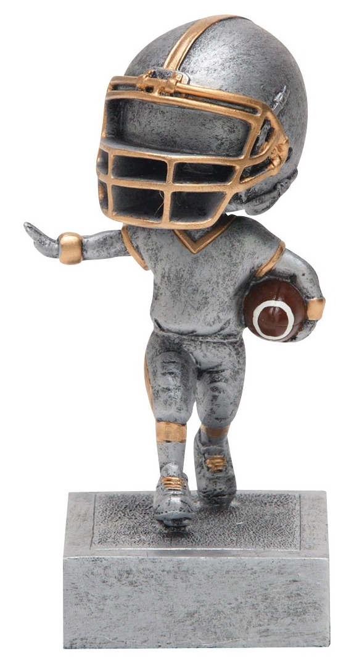
Matt Ryan – QB 15
Antonio Brown – WR 1
Cooks – WR 15
Funchess – WR 23
Mike Wallace – WR 39
Gurley – RB 2
Drake – RB 30
Collins – RB 21
Bilal – RB 31
CJ Anderson – RB19
Sefarian-Jenkins – TE 20
Regular Season Record:
7-6-0
Regular Season Pts Per Week:
126.7
Playoffs Points Per Week:
139.8
Bill

Slide 30
Good luck!
Draft starts at 7p EST

