Slide 1
Sx3
Where Jake’s fantasy hopes
and dreams come to die

Slide 2
This Hangout will be active from now through the entire draft.
Feel no pressure to stay on during the preso or through the draft.
You can mute your video / audio at any time

Slide 3
Sx3 5th Anniversary!
2013
Champ
D’Glester (Joey)
2nd
Majik Jake
3rd
Team PRISM (Trevor)
Toilet
Public Enemies (Bobby C)
2014
Champ
Whitness
2nd
Lady Capulet (Kurt)
3rd
Cinderella Diapers
(Andrew)
Toilet
The Knights Who Say GiovaNI (Bear)
2015
Champ
Sharknados
2nd
Points Dot Points (Aaron)
3rd
Gerby The Mole
(Sophie)
Toilet
Soul-Less Inferno (Sam)
2016
Champ
Mohante
2nd
Whitness
3rd
One Chicken I Lost It
(Andrew)
Toilet
DaByrds

Slide 4
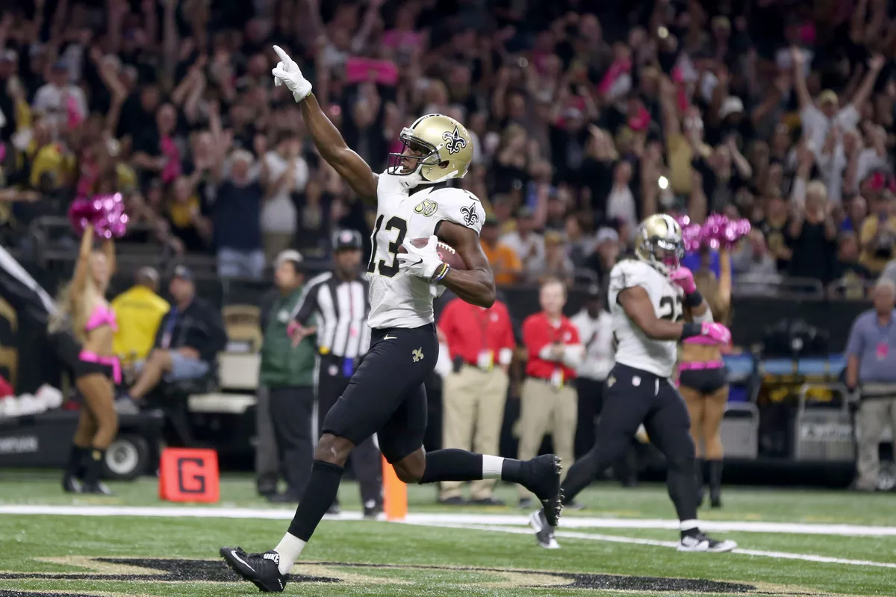
Everyone questioned Whitney for ‘reaching’ for Michael Thomas
in the 7th round.
92 Recs for 1,137 yds & 9 TDs
WR 8 by our scoring
You want your guy, go get ‘em!

Slide 5
There’s a threshold to that
“you want your guy go get em”
thing though…

Slide 6
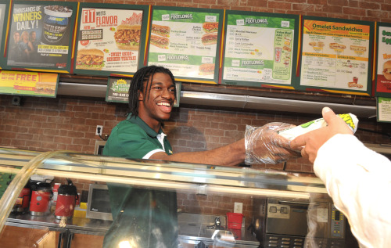
Andrew drafted RGIII

Slide 7
2016 Draft: QB,RB,WR,TE 1s … RB,WR 2s
 |  | Sam | Bobby | Jim | Kurt | Whitney | Trevor | Jake | Bill | Andrew | Sophie | Aaron | Albert
--> | 1 | Rodgers | Odell | Cam | Gurley | David Johnson | Julio | AP | Antonio | Lamar | Hopkins | AJ | Gronk | -->
--> | 2 | Devonta | Zeke | Lacy | Robinson | Jordy | Marshall | Evans | Dez | Keenan | Amari | Ingram | Jamaal | -->
--> | 3 | Moncrief | Demaryius | Cobb | CJ | Forte | Woodhead | Alshon | Doug Martin | Jarvis | Watkins | Shady | Le'Veon | -->
<-- | 4 | Latavius | TY | Decker | Maclin | Baldwin | Reed | Cooks | Hyde | Floyd | Barnidge | Edelman | John Brown | <--
--> | 5 | Diggs | Luck | Hill | Crabtree | Greg Olsen | Brees | Jstew | Russell | DeMarco | Foster | R Mathews | Shepard | -->
<-- | 6 | Kelce | Fleener | Langford | DeAngelo | Carson | Gio | Golden | Kelvin | Rawls | Ameer | Lockett | Matt Jones | <--
--> | 7 | Jennings | Fitz | C-Mike | Brady | Michael Thomas | Gore | Emmanuel | J Matthews | Marvin | Melvin | Delanie | Tyrod | -->
<-- | 8 | Carolina | Duke | Sanu | Gates | Derrick Henry | DeSean | Crow | Yeldon | Sims | Snead | Hurns | Tavon | <--
--> | 9 | Garcon | Ware | Kansas City | T Benjamin | Corey Coleman | Ivory | Ertz | T Smith | Julius | Bilal | Josh Gordon | Kamar | -->
<-- | 10 | Zach Miller | Tajae Sharpe | Dwayne Allen | Starks | D Washington | DeVante Parker | Riddick | Ajayi | Denver | Houston | Tevin | Funchess | <--
--> | 11 | Boldin | McKinnon | Gostkowski | Los Angeles | Dorsett | Arizona | Wheaton | Fuller | Tyler Boyd | Blount | Kevin White | Eifert | -->
<-- | 12 | Hightower | Seattle | LaFell | Cousins | Pittsburgh | Terrance | Rivers | Vjax | Jared Cook | Jameis | The Zarlo | Cairo Santos | <--
--> | 13 | Mariota | Hauschka | Jordan Howard | Rudolph | Mike Wallace | Graham Gano | Booker | Ebron | Stafford | Carr | Eli | Bortles | -->
<-- | 14 | McManus | Martellus | Big Ben | Crosby | The Nooge | ASJ | Minnesota | New England | Bailey | Tucker | Sproles | Green Bay | <--
--> | 15 | Ladarius Green | Chris Hogan | Josh Doctson | James White | Matt Ryan | Dalton | Hopkins | Boswell | RGIII | Witten | New York Jets | Vereen | -->

Slide 8
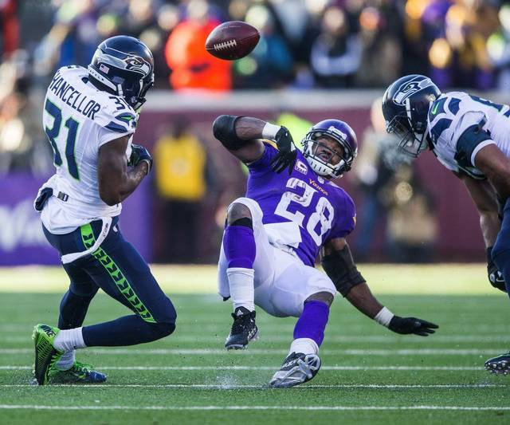
AP
Wk 1: 31 yds, 1.6 ypc
Wk 2: 19 yds, 1.6 ypc
Wk 3: 22 yds, 3.7 ypc
& 1 Torn Meniscus
Jake wins the biggest 1st round bust.

Slide 9
2016 Draft: QB,RB,WR,TE 1s … RB,WR 2s

Slide 10
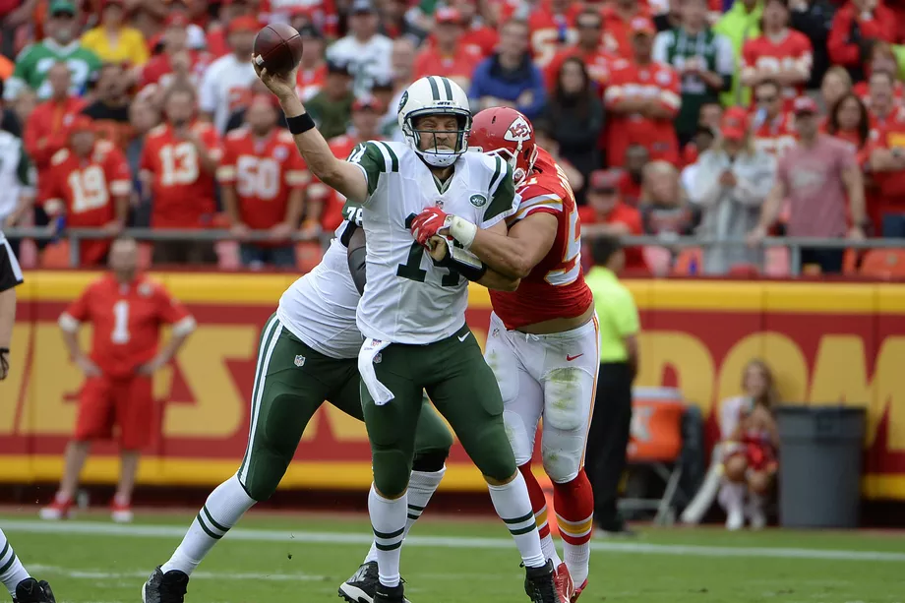
Fitz Week 3
Throws SIX interceptions in 1 game.
Including a pick 6
Whitness cries.

Slide 11
The 2016 1’s - QB
 | Pos Rank | Draft Position | Drafted By | Points
Rodgers | QB 1 | 1.01 | Sam | 453.52
Ryan | QB 2 | 15.08 | Whitney | 420.96
Brees | QB 3 | 5.07 | Trevor | 394.32
Luck | QB 4 | 5.11 | Bobby | 353.2
Cousins | QB 5 | 12.04 | Kurt | 341.28
Dak | QB 6 | undrafted | undrafted | 329.88
Brady | QB 7 | 7.09 | Kurt | 325.06
Carr | QB 8 | 13.03 | Sophie | 320.48
Stafford | QB 9 | 13.04 | Andrew | 314.78
Tyrod | QB 10 | 7.01 | Albert | 298.42
Mariota | QB 11 | 13.12 | Sam | 294.94
Russell | QB 12 | 5.05 | Bill | 294.56

Slide 12
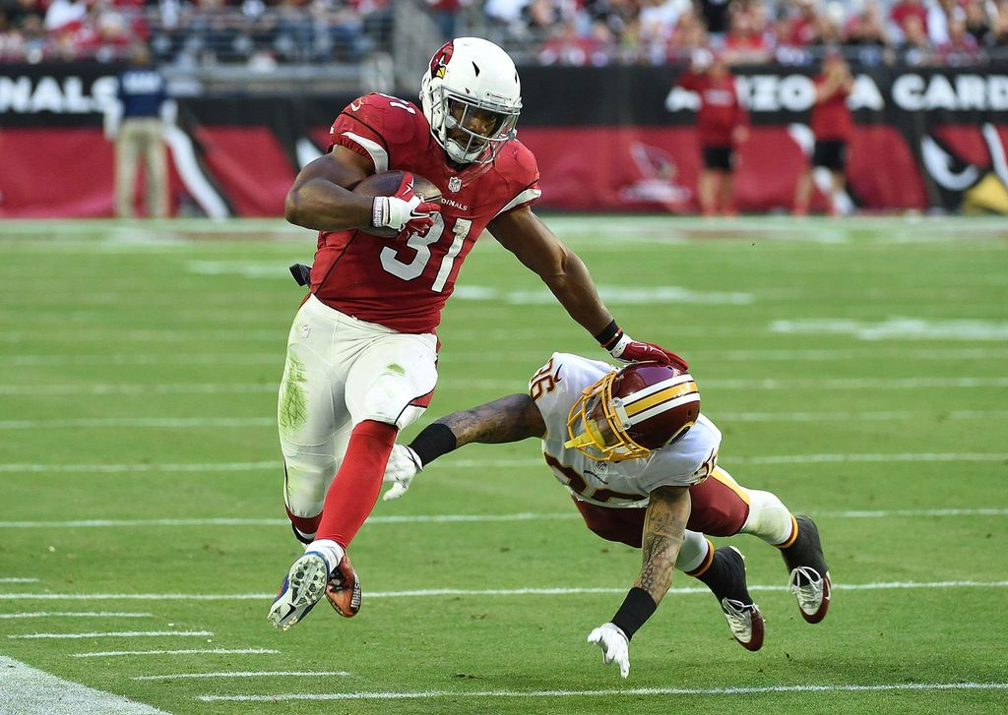
David Johnson
Gains 100+ scrimmage yards in 15 consecutive games.
Whitness rejoices.

Slide 13
The 2016 1’s - RB
 | Pos Rank | Draft Position | Drafted By | Points
DJ | RB 1 | 1.05 | Whitney | 414.8
Zeke | RB 2 | 2.02 | Bobby | 337.9
Le’V | RB 3 | 3.01 | Albert | 325.4
Shady | RB 4 | 3.02 | Aaron | 307.3
DeMarco | RB 5 | 5.04 | Andrew | 302.8
Devonta | RB 6 | 2.01 | Sam | 288.1
Melvin | RB 7 | 7.03 | Sophie | 253.6
Ingram | RB 8 | 2.11 | Aaron | 247.2
Jordan Howard | RB 9 | 13.10 | Jim | 237.1
Blount | RB 10 | 11.03 | Sophie | 236.9
Ajayi | RB 11 | 10.08 | Bill | 227.3
Gore | RB 12 | 7.07 | Trevor | 216.2

Slide 14
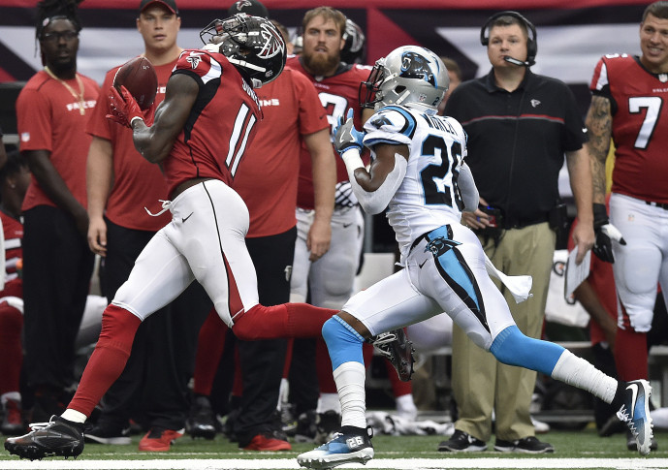
Julio Week 4
300 receiving yards
12 Receptions, 1 TD
52.5 Fantasy Points
Trevor wins 157 - 107

Slide 15
The 2016 1’s - WR
 | Pos Rank | Draft Position | Drafted By | Points
Antonio | WR 1 | 1.08 | Bill | 317.82
Odell | WR 2 | 1.02 | Bobby | 309.74
Jordy | WR 3 | 2.05 | Whitney | 309.7
Evans | WR 4 | 2.07 | Jake | 308.1
T.Y. | WR 5 | 4.02 | Bobby | 281.7
Julio | WR 6 | 1.06 | Trevor | 270.4
Tyreek | WR 7 | undrafted | undrafted | 263.04
Michael Thomas | WR 8 | 7.08 | Whitney | 258.7
Baldwin | WR 9 | 4.05 | Whitney | 258.6
Cooks | WR 10 | 4.07 | Cooks | 253.88
Davante | WR 11 | undrafted | undrafted | 252.2
Fitzgerald | WR 12 | 7.11 | Bobby | 244.8

Slide 16
The 2016 1’s - TE
 | Pos Rank | Draft Position | Drafted By | Points
Travis Kelce | TE 1 | 6.01 | Sam | 230.5
Greg Olsen | TE 2 | 5.08 | Whitney | 210.8
Kyle Rudolph | TE 3 | 13.09 | Kurt | 210
Jimmy Graham | TE 4 | undrafted | undrafted | 192.3
Delanie Walker | TE 5 | 7.02 | Aaron | 189.1
Zach Ertz | TE 6 | 9.06 | Jake | 185.92
Martellus Bennett | TE 7 | 14.02 | Bobby | 171.1
Cameron Brate | TE 8 | undrafted | undrafted | 171
Dennis Pitta | TE 9 | undrafted | undrafted | 169.9
Jordan Reed | TE 10 | 4.06 | Trevor | 168.6
Jason Witten | TE 11 | 15.03 | Sophie | 153.3
Antonio Gates | TE 12 | 8.04 | Kurt | 147.8

Slide 17
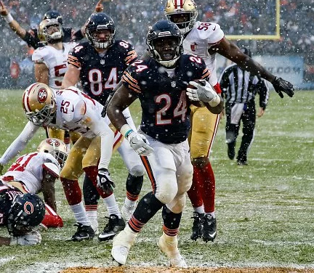
Drafted by Jim, 13th Round
Dropped Week 2
Finished as the RB 9
So close, Jim!

Slide 18
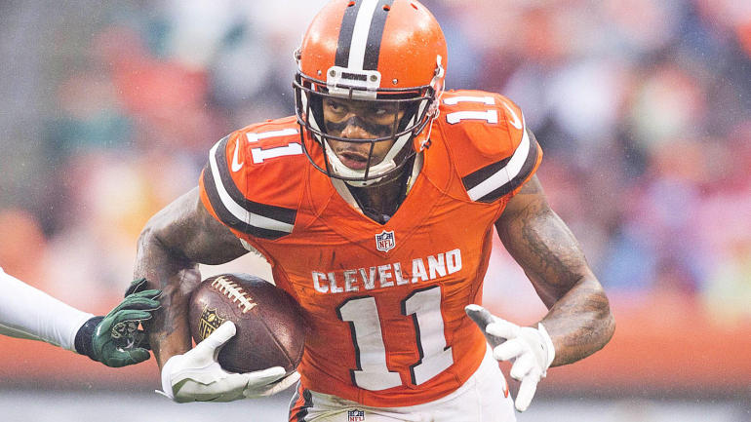
Terrelle Pryor Week 3
8 catches, 144 yards
14 snaps at QB
4 rushes 21 yards, 1 TD
2 snaps at safety
32.9 Fantasy Points
… on the Waiver Wire

Slide 19
FAABulous … Best Waiver Buys
Player | FAAB Spent | By | Position Rank | Week
Jay Ajayi | $ 25 | Sophie | RB 11 | 7
Davante Adams | $ 25 | Albert | WR 11 | 8
Terrelle Pryor | $ 22 | Sam | WR 20 | 4
Jordan Howard | $ 21 | Aaron | RB 9 | 4
Golden Tate | $ 21 | Kurt | WR 18 | 8
Ty Montgomery | $ 11 | Bobby | RB 28 | 15
Dennis Pitta | $ 10 | Andrew | TE 9 | 3
Jamison Crowder | $ 9 | Aaron | WR 21 | 4
Jay Ajayi | $ 5 | Jake | RB 11 | 5
Darren Sproles | $ 5 | Jake | RB 23 | 5
Darren Sproles | $ 5 | Albert | RB 23 | 8
Marcus Mariota | $ 5 | Jake | QB 11 | 6
Cameron Brate | $ 5 | Bill | TE 8 | 4
Tyreek Hill | $ 3 | Kurt | WR 7 | 10
Kirk Cousins | $ 2 | Aaron | QB 5 | 7
Zach Ertz | $ 0 | Albert | TE 6 | 9
Chris Thompson | $ 0 | Trevor | RB 26 | 3
Rishard Matthews | $ 0 | Trevor | WR 23 | 8
Kirk Cousins | $ 0 | Whitney | QB 5 | 10

Slide 20
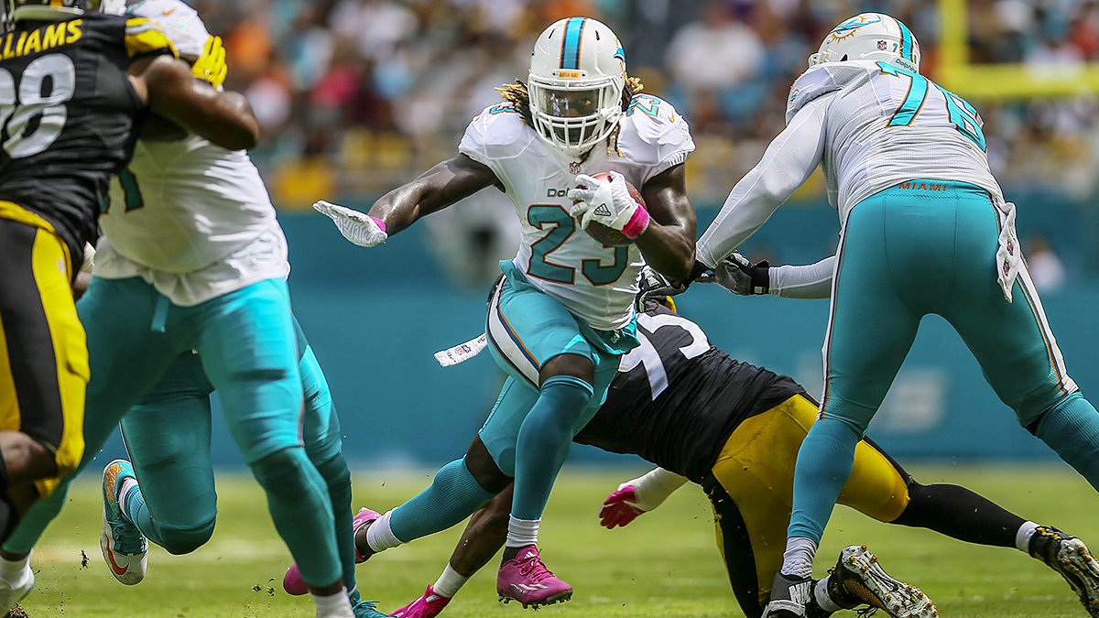
Jay Ajayi has three
200 yard games
Week 6 v PIT (waiver wire)
Week 7 v BUF (Sophie wins 162-78)
W16 @ BUF (Sophie wins 108-80)

Slide 21
Not So FAABulous … Worst Waiver Buys
Player | FAAB Spent | By | Position Rank | Week
Charcandrick West | $ 32 | Kurt | RB 52 | 9
Ladarius Green | $ 31 | Bobby | TE 40 | 14
Wendell Smallwood | $ 30 | Kurt | RB 66 | 12
Fozzy Whittaker | $ 28 | Sam | RB 57 | 3
Jacquizz Rodgers | $ 25 | Jim | RB 54 | 7
Allen Hurns | $ 21 | Jim | WR 78 | 9
Dontrelle Inman | $ 20 | Albert | WR 47 | 13
Trevor Siemian | $ 20 | Whitney | QB 26 | 4
Orleans Darkwa | $ 18 | Sam | RB 99 | 4
Will Fuller | $ 15 | Andrew | WR 60 | 2
Colin Kaepernick | $ 15 | Jake | QB 24 | 12
Marquess Wilson | $ 15 | Albert | WR 139 | 13
Cameron Artis Payne | $ 15 | Whitney | RB 96 | 3
Kenneth Dixon | $ 12 | Bill | RB 47 | 11
Jeremy Kerley | $ 11 | Andrew | WR 52 | 6
Robert Woods | $ 11 | Sam | WR 66 | 5
Knile Davis | $ 10 | Bill | RB 107 | 7

Slide 22
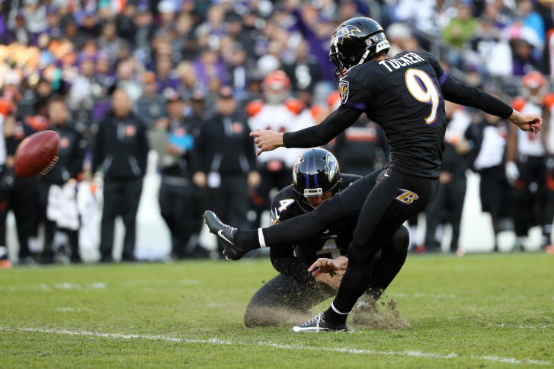
Justin Tucker…
Perfect Thru Wk 13
28/28 FG & 20/20 PAT
Ten 50+ yd FGs (NFL record)
Sophie lobbies to change the league to be only kickers

Slide 23
FAAB … Weekly Spend

Slide 24
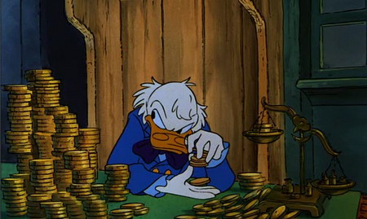
FAAB … Total Year Spends
Big Spenders
Cheapskates
Trevor
Kurt | $ 100
Aaron | $ 97
Sam | $ 92
Andrew | $ 85
Bobby | $ 81
Jim | $ 81
Jake | $ 81
Sophie | $ 72
Whitney | $ 67
Albert | $ 65
Bill | $ 39
Trevor | $ 0
And he still made the playoffs!

Slide 25
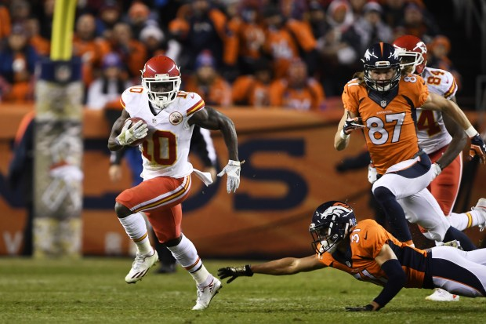
Tyreek Week 12…
Scores a rushing, receiving and return TD in the same game
38.06 fantasy points
…on Kurt’s bench

Slide 26
Start / Sit Fails
20+ Point Players Left on Bench:
Most Points Left on Bench:
 | # of times | points
Jake | 14 | 371.2
Jim | 13 | 328.64
Whitney | 13 | 325.1
Bill | 10 | 254.38
Bobby | 10 | 235.24
Sophie | 8 | 219.52
Aaron | 8 | 216.28
Albert | 7 | 169.18
Kurt | 5 | 135.86
Sam | 5 | 111.7
Trevor | 4 | 91.14
Andrew | 3 | 80.38
Player | Points | Week | Owner
Matty Ice | 39.02 | 4 | Whitney
Tyreek | 38.06 | 12 | Kurt
Bilal | 35.9 | 14 | Sophie
Big Ben | 34.9 | 4 | Jim
Russell | 34.6 | 16 | Bill
Kaep | 34.14 | 12 | Jake
Ingram | 34.1 | 9 | Aaron
Emmanuel | 33.7 | 3 | Jake
Snead | 33.2 | 1 | Sophie
Rob Kelly | 32.7 | 11 | Sophie
Jordan Howard | 31.2 | 8 | Aaron
R Mathews | 30.9 | 10 | Jim
Fuller | 30.78 | 4 | Andrew
Ingram | 30.7 | 12 | Aaron
Big Ben | 30.42 | 10 | Jim
Jeremy Hill | 30.2 | 7 | Jim
Emmanuel | 30.2 | 12 | Jake

Slide 27
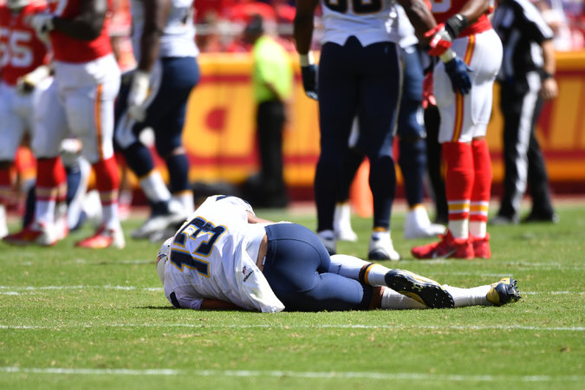
Keenan’s Down.
So are Andrew’s hopes.
(week 1)

Slide 28
2016 Trades
Travis Benjamin to Trevor … Chris Thompson to Kurt - Week 8
Jordy Nelson to Aaron … Ty Montgomery to Whit - Week 8
Freeman & Pryor to Aaron … Jordy & Jordan Howard to Sam - Week 9
Pryor to Kurt … Crabtree to Aaron - Week 10
Britt & Hightower to Whit … Ty Montgomery & Baldwin to Andrew - Week 10
Meredith to Sam … Zach Miller to Andrew - Week 11
Crabtree to Jake, Rivers to Aaron - Week 11

Slide 29
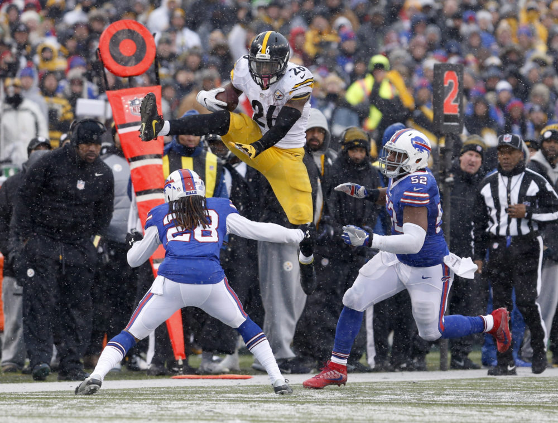
Le’Veon Goes Off
236 Rushing Yards
3 TDs
4 Recs, 62 Yards
54.8 Fantasy Points
Helping Albert… on a bye ☹

Slide 30
Mini Games
$50 - Most Points for a Single Started Player in a Single Week
Le'Veon Bell - Week 14 - 54.8 Points - Albert
$50 - Most Points Scored by a Team in a Single Week
Week 5 - 194.7 Points - Bobby
$50 - Most Points Scored Over the Full Season
2171.8 Points - 135.7 Per Week Average! – Bobby
$25 - Closest Margin of Victory
Jake - Lost week 4 to Andrew by 1.18 points

Slide 31
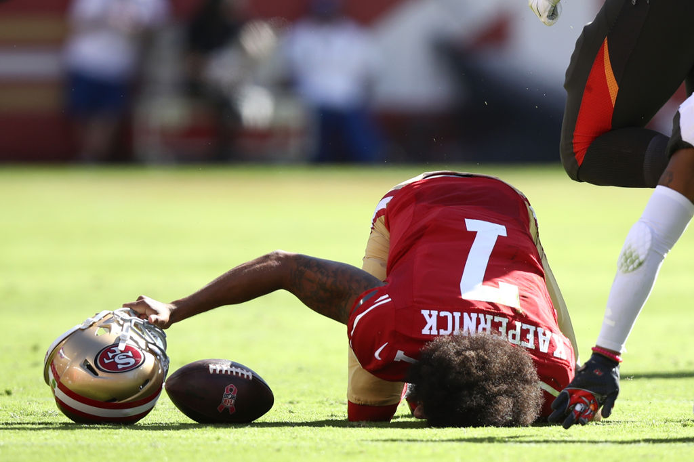
Jake Started Colin Kapernick in round 1 of the playoffs.
The week before Kaep went 1/5 for 4 yards and 5 sacks, then got injured.
Tough times for Jake.

Slide 32

2017

Slide 33
Schedule Randomizer

Slide 34
FAAB Rules & Process
$100 Budget per Owner per Year
Waivers process approximately 3am EST on Wednesday morning (Tuesday night)
If 2 owners bid the same, priority goes to the person who is lower in the league rankings
If you bid more than the 2nd highest person, ALL of what you bid is deducted
You may trade FAAB budget

Slide 35
New QB Scoring
 | NEW Pts | OLD Pts | Pts Diff
Aaron Rodgers | 519.52 | 453.52 | 66
Matt Ryan | 482.96 | 420.96 | 62
Drew Brees | 438.32 | 394.32 | 44
Andrew Luck | 389.2 | 353.2 | 36
Tom Brady | 377.06 | 325.06 | 52
Dak Prescott | 367.88 | 329.88 | 38
Kirk Cousins | 367.28 | 341.28 | 26
Derek Carr | 364.48 | 320.48 | 44
Matthew Stafford | 342.78 | 314.78 | 28
Marcus Mariota | 328.94 | 294.94 | 34
Ben Roethlisberger | 322.66 | 290.66 | 32
Tyrod Taylor | 320.42 | 298.42 | 22
Philip Rivers | 317.44 | 293.44 | 24
Russell Wilson | 314.56 | 294.56 | 20
Andy Dalton | 307.64 | 287.64 | 20
Blake Bortles | 305.6 | 291.6 | 14
Carson Palmer | 300.12 | 276.12 | 24
Jameis Winston | 300.1 | 280.1 | 20
Sam Bradford | 285.38 | 255.38 | 30
Player | Points
David Johnson | 414.8
Ezekiel Elliott | 337.9
Le'Veon Bell | 325.4
Antonio Brown | 317.82
Odell Beckham | 309.74
Jordy Nelson | 309.7
Mike Evans | 308.1
LeSean McCoy | 307.3
DeMarco Murray | 302.8
Devonta Freeman | 288.1
T.Y. Hilton | 281.7
Julio Jones | 270.4
Tyreek Hill | 263.04
Michael Thomas | 258.7
Doug Baldwin | 258.6
OLD
4 Points per TD
-2 per INT
NEW
6 Points per TD
-4 per INT

Slide 36
Trade Trade Trade!
Processed immediately
No Veto Vote
  All trades are approved, so long as there’s no collusion-y cheating/tanking.
  Doesn’t matter if anyone feels the trade is lopsided, or otherwise dislikes it.
Be communicative and try to respond quickly to proposals
Trade Deadline: Sunday, November 26, 2017

Slide 37
Tanking (Or Being Lazy)
Don’t do it
Trades that are clearly tanking will be nixed
You must start a full lineup every week. If you do not…
First Offense:
50 Points will be deducted from your season points total
Second Offense:
100 points will be deducted from your season points total AND
You will lose (last place) whatever draft order competition we have next year.

Slide 38
Next Year’s Draft
Sunday, September 2nd, 2018
Festivities: 5pm EST
Draft: 7pm EST
In person? NYC? Chicago? Vegas?
BLOCK YOUR CALENDARS NOW!

Slide 39
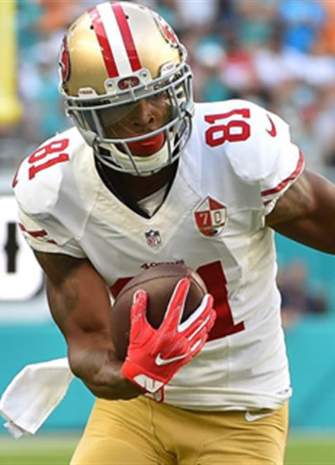
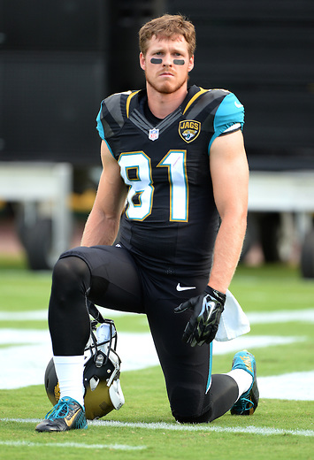



Sam/Kurt Team Icon Battle
Week 16:
Sam & Kurt, head to head, picked each other’s flex & DEF.
Any non-injured & active player.
Winner got to choose the loser’s team icon next year
Kurt got the best of the flex / DEF…
Streater – 18.3 Points … Colts D – 5.72 Points
Walters – 9.9 Points … Jets D - -0.44 Points (that’s a negative)
But Sam got the best of the matchup on the heels of
Rodgers – 38.18 points, Jordy – 37.4 points, Meredith 29.4 Points, Kelce 35.5 points… 179 total team points! Highest score in week 16 in the league.
Sam Gave Kurt:
Kurt Gave Sam:
Rod Streater
Bryan Walters

Slide 40

Sam/Kurt Team Icon Battle
Cinna – a Poet

Slide 41

Big Ben – QB 15
Cam – QB 19
Tyrell Williams – WR 19
Stills – WR 43
Cobb – WR 54
Hurns – WR 78
Coates – WR 90
Jeremy Hill – RB 22
Ryan Mathews – RB 32
Christine Michael – RB 35
Ivory – RB 50
Langford – RB 63
Graham – TE 4
Reg Season Record:
2-11-0
Reg Season Pts Per Week:
99.4
Playoffs Points Per Week:
81.1
Jim, You Suck.

Slide 42
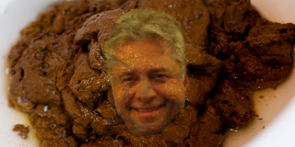
Jim’s 2018 Team Is…
Marquette Steamer
(Urban Dictionary ‘Cleveland Steamer’ for reference) ☺

Slide 43
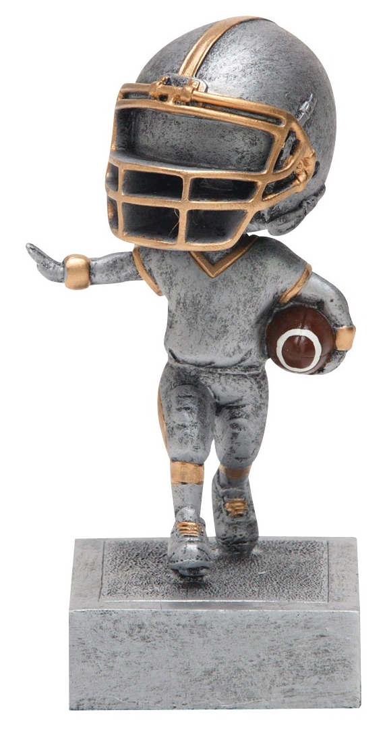
Luck – QB 4
Odell – WR 2
T.Y. – WR 5
Larry Fitz – WR 12
Demaryius – WR 17
Zeke – RB 2
Ware – RB 17
Ty Montgomery – RB 28
Martellus – TE 7
Witten – TE 11
Regular Season Record:
8-5-0
Regular Season Pts Per Week:
136.31
Playoffs Points Per Week:
133.3
Mohante

Slide 44
Good luck!
Draft starts at 930p EST

