Slide 1
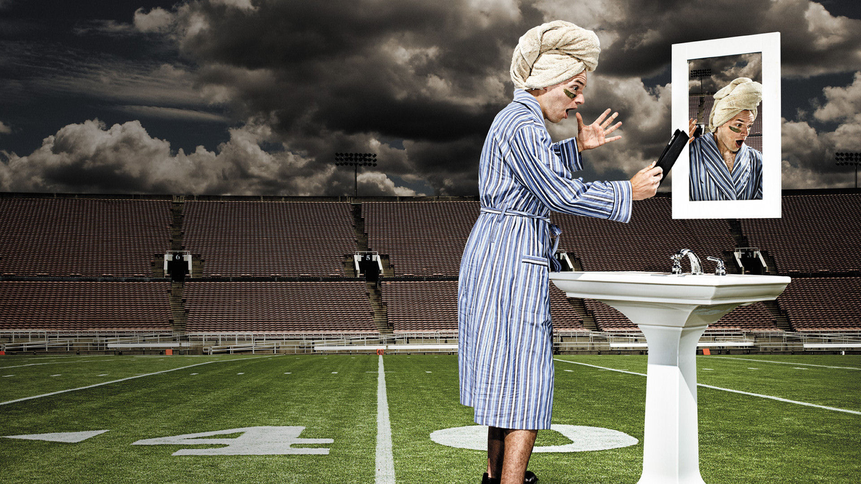
Sunday
Sunday
Sunday
2016

Slide 2



first of all…
FUCKING
FOOTBALL
BITCHES!

Slide 3
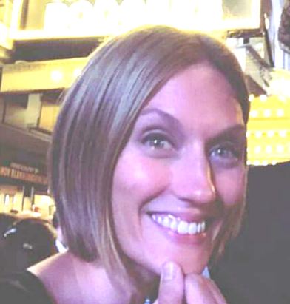












Sophie
Kurt
Albert
Jake
Sam
Andrew
Bill
Aaron
Whitney
Julia
Trevor
Jim
Bobby

Slide 4
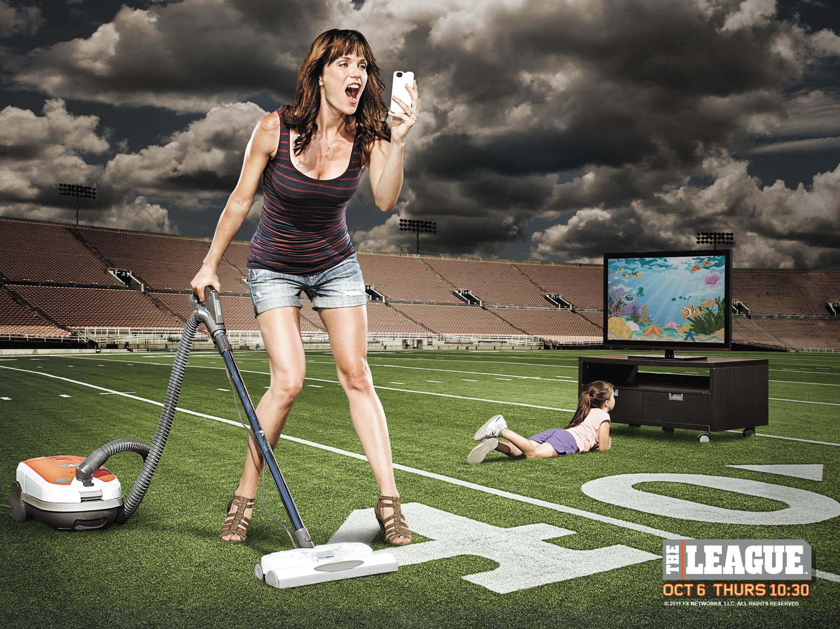
HOUSEKEEPING
Disconnet Phones from WiFi
5 min pick time (2m30s Jerk Time)
Thank you Julia

Slide 5

NEW RULES
No More Keepers
Randomized Draft Order
FAB Waivers

Slide 6
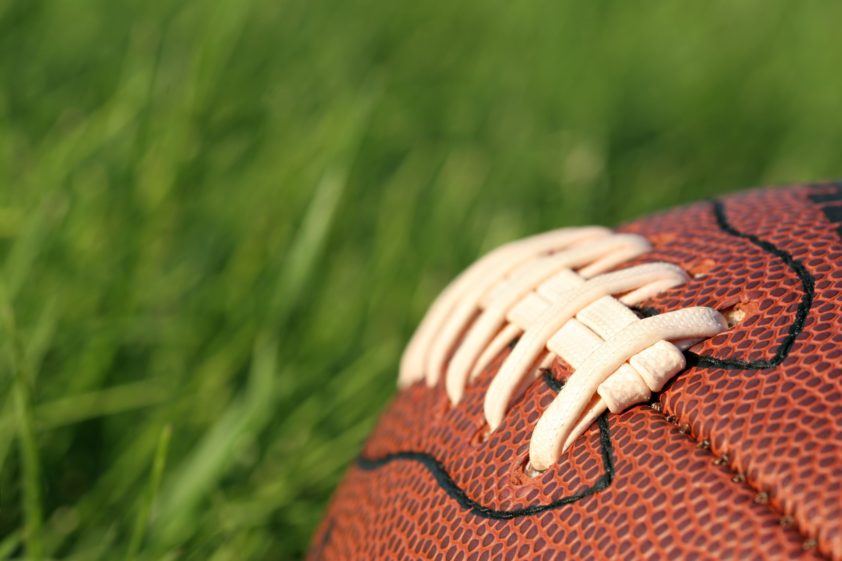

SHOWCASE
SHOWDOWN!
sponsored by

Slide 7



Slide 8
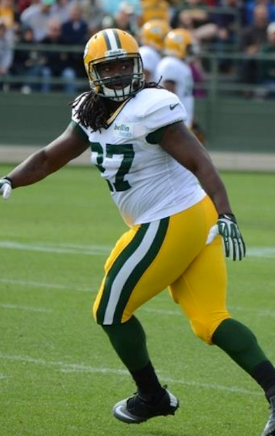
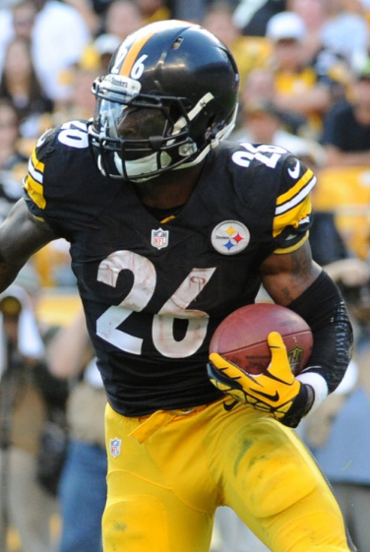
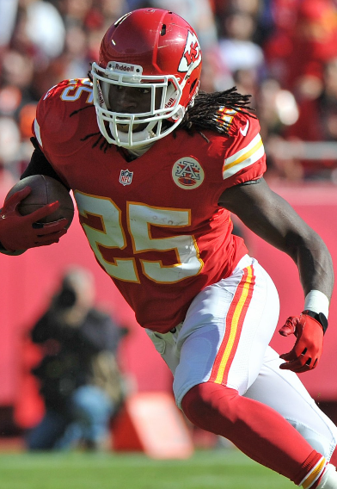
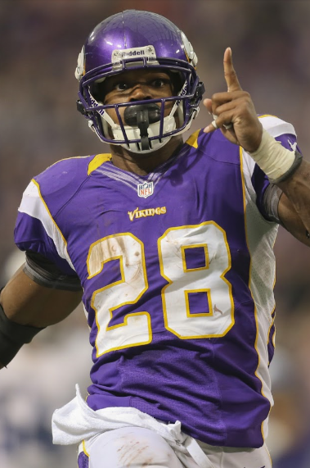
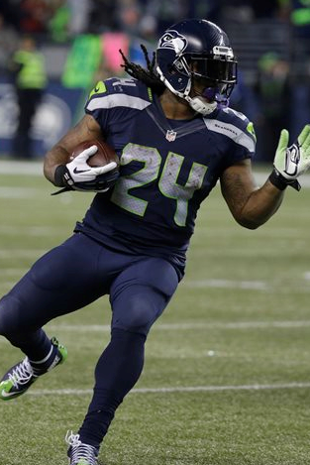
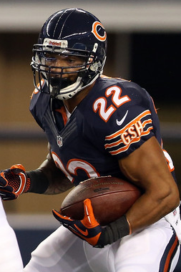
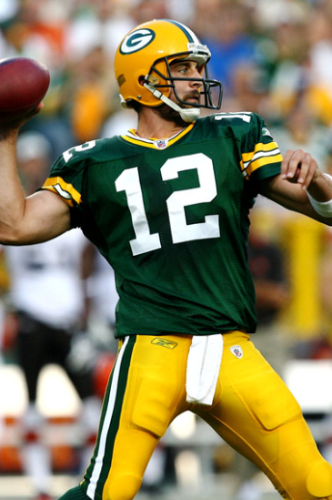
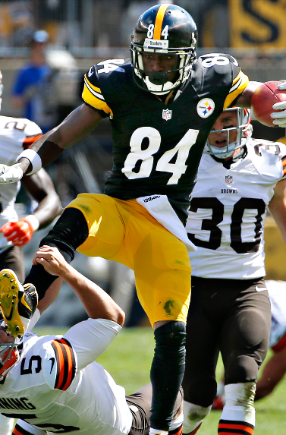
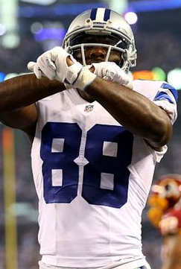
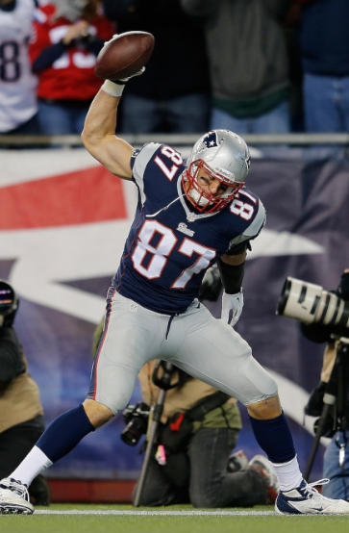
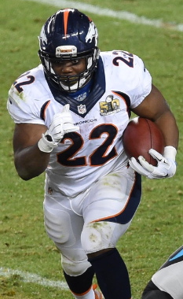
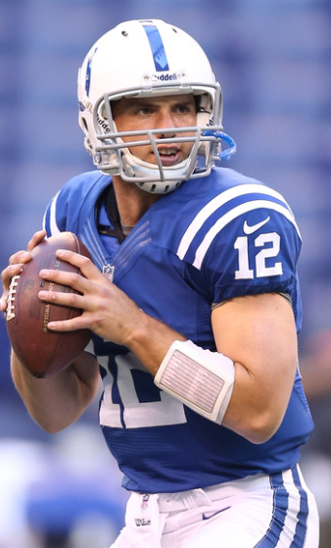
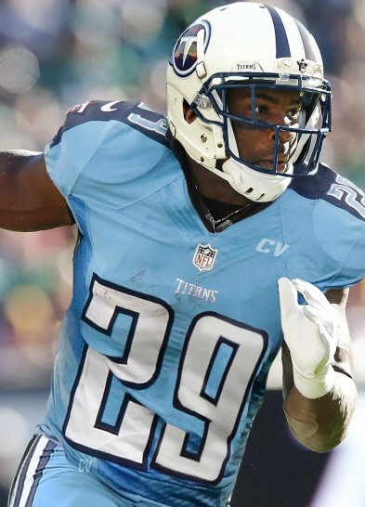
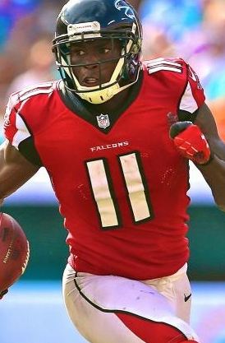
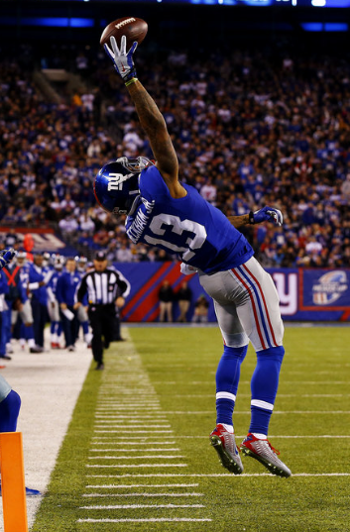
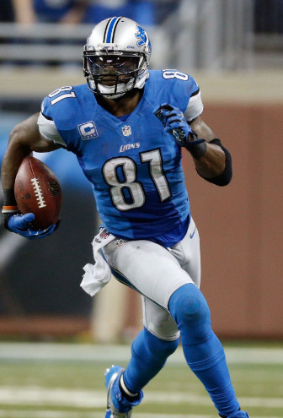
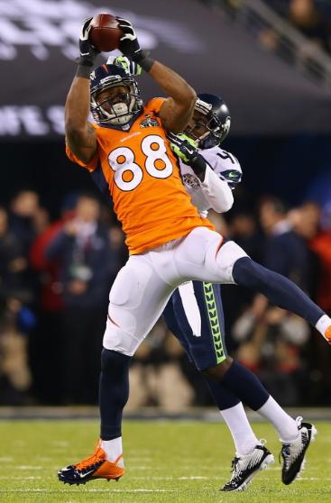
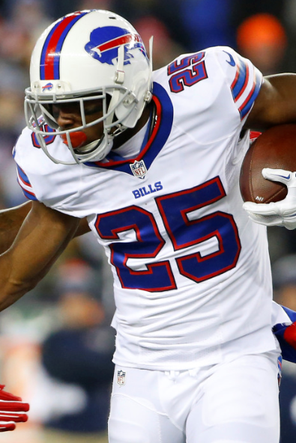
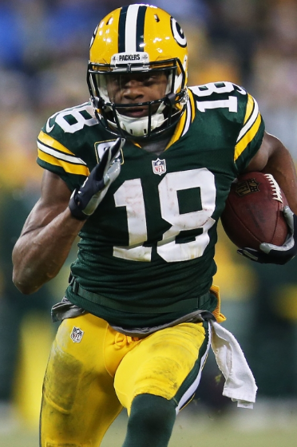
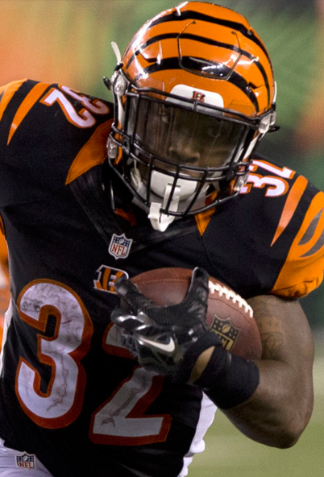
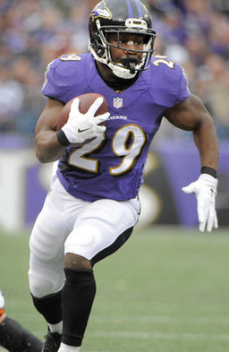
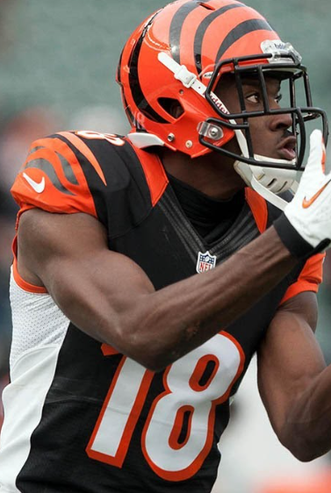
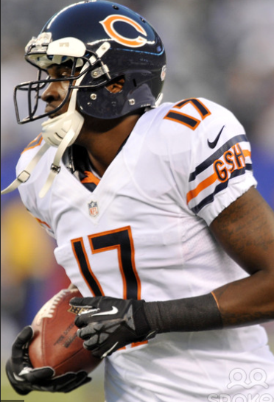
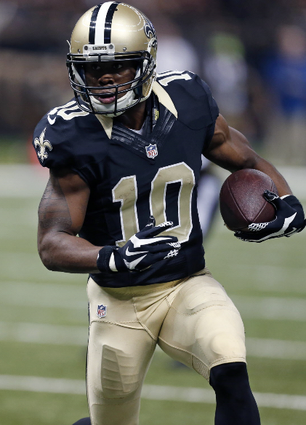
1
2
3
4
5
6
7
8
FAT
STONED
BROKEN
SKITTLES
CHEESE
9
10
11
12
13
14
15
16
FEET
PEYTON
KIDNEY
LINEMEN
OLD
17
18
19
20
21
22
23
24
REX RYAN
CORN
TALENT
GRAVITY
TISSUES

Slide 9
Who Had the Best Pick 1 & 2?
Pick 5, 20
Lynch, Forsett
Pick 1, 24
Lacy, Cooks
Pick 9, 16
Dez, Calvin
Andrew
Whitney
Bobby
Pick 2, 23
Le’Veon, Alshon
Pick 6, 19
Forte, Cobb
Pick 10, 15
Gronk, Odell
Aaron
Sophie
Albert
Pick 7, 18
Rodgers, Shady
Pick 3, 22
Jamaal, A.J.
Pick 11, 14
C.J., Julio
Kurt
Sam
Trevor
Pick 4, 21
Peterson, Hill
Pick 38, 17
Antonio, Demaryius
Pick 12, 13
Luck, DeMarco
Jake
Bill
Jim

Slide 10
Who Had the Best Pick 1 & 2?
Antonio Brown
Pick 3
Demaryius Thomas
Pick 22
Bill
683 pts!
410.18 pts
WR 1, 1 Overall
272.9 pts
WR 11, 28 Overall

Slide 11
Who Had the WORST Pick 1 & 2?
Pick 5, 20
Lynch, Forsett
Pick 1, 24
Lacy, Cooks
Pick 9, 16
Dez, Calvin
Andrew
Whitney
Bobby
Pick 2, 23
Le’Veon, Alshon
Pick 6, 19
Forte, Cobb
Pick 10, 15
Gronk, Odell
Aaron
Sophie
Albert
Pick 7, 18
Rodgers, Shady
Pick 3, 22
Jamaal, A.J.
Pick 11, 14
C.J., Julio
Kurt
Sam
Trevor
Pick 4, 21
Peterson, Hill
Pick 38, 17
Antonio, Demaryius
Pick 12, 13
Luck, DeMarco
Jake
Bill
Jim

Slide 12
Who Had the WORST Pick 1 & 2?
Marshawn Lynch
Pick 5
Justin Forsett
Pick 20
Whitney
208.1 pts
83.7 pts
RB 141, 207 Overall
124.4 pts
RB40, 140 Overall

Slide 13
Draft Rounds 1 & 2
1. Bill – 683 Antonio / Demaryius
2. Albert – 598.14 Gronk / Odell
3. Trevor – 528.9 C.J / Julio
4. Sam – 490.44 Rodgers / Shady
5. Jake – Peterson / Hill
6. Sophie – 427.5 Forte / Cobb
7. Andrew – 406 Lacy / Cooks
8. Kurt – 384 Jamaal / A.J.
9. Bobby – 340 Dez / Calvin
10. Jim – 321.74 Luck / DeMarco
11. Aaron – 276.9 Le’Veon / Alshon
12. Whitney – 208.1 Lynch / Forsett

Slide 14

Top 10 – When Were They Drafted?
Quarterbacks
Player | Points | Pos Rank | Overll Rank | Rnd
Cam | 394.58 | 1 | 2 | 10
Brady | 357.2 | 2 | 4 | 7
Russell | 340.26 | 3 | 6 | 3
Bortles | 326.62 | 4 | 9 | not drafted
Palmer | 325.24 | 5 | 10 | 12
Brees | 323.7 | 6 | 11 | 6
Rodgers | 308.74 | 7 | 14 | 1
Cousins | 306.44 | 8 | 16 | not drafted
Eli | 304.88 | 9 | 17 | 13
Rivers | 297.48 | 10 | 18 | 14
Running Backs
Player | Points | Pos Rank | Ovrll Rank | Rnd
Freeman | 320.4 | 1 | 12 | 10
Peterson | 271.7 | 2 | 29 | 1
D. Johnson | 243.22 | 3 | 38 | 11
Woodhead | 243.1 | 4 | 39 | 7
Lamar | 238.4 | 5 | 43 | 3
D. Martin | 238.3 | 6 | 44 | 6
DeAngelo | 235.4 | 7 | 47 | 10
Forte | 215.7 | 8 | 58 | 1
Gurley | 215.4 | 9 | 61 | 6
Latavius | 206.8 | 10 | 65 | 3
Wide Receivers
Player | Points | Pos Rank | Ovrll Rank | Rnd
Antonio | 410.18 | 1 | 1 | 1
Julio | 385.6 | 2 | 3 | 2
Marshall | 350.7 | 3 | 5 | 5
Hopkins | 338.6 | 4 | 7 | 3
Odell | 335.84 | 5 | 8 | 2
A. Robinson | 311.5 | 6 | 13 | 5
Landry | 307.94 | 7 | 15 | 4
Fitz | 283.5 | 8 | 21 | 10
A.J. Green | 282.7 | 9 | 22 | 2
Baldwin | 274.9 | 10 | 25 | 12
Tight End
Player | Points | Pos Rank | Ovrll Rank | Rnd
Gronk | 262.3 | 1 | 32 | 1
Delanie | 248.4 | 2 | 35 | 8
Reed | 246.2 | 3 | 37 | 13
Barnidge | 240.3 | 4 | 42 | not drafted
Olsen | 230.4 | 5 | 51 | 4
Eifert | 192.5 | 6 | 75 | 9
Watson | 192.5 | 7 | 76 | not drafted
Kelce | 190.5 | 8 | 77 | 4
Ertz | 172.66 | 9 | 92 | 11
Witten | 164.3 | 10 | 105 | 5

Slide 15
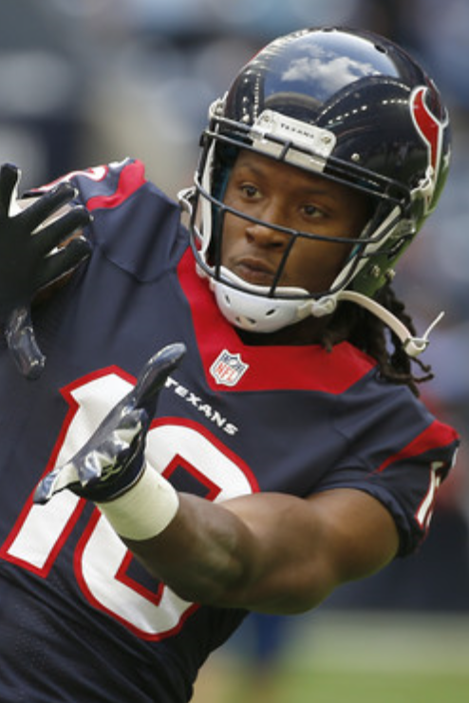
Keepers!
Sam
Bobby
Jim
Kurt
Whitney
Trevor
1
2
3
4
5
6
7
8
9
10
11
12
Jake
Bill
Andrew
Sophie
Aaron
Albert

Slide 16
Keepers!
Sam
Bobby
Jim
Kurt
Whitney
Trevor
1
2
3
4
5
6
WHO’S LEFT?
Odell
D. Johnson
Gurley
A.J. Green
A. Robinson
Zeke
Lamar
Dez
Le’Veon
Keenan
Marshall
Devonta
8
9
10
7
Nuke
11
12
Jake
Bill
Andrew
Sophie
Aaron
Albert

Slide 17
Schedule Randomizer

Slide 18
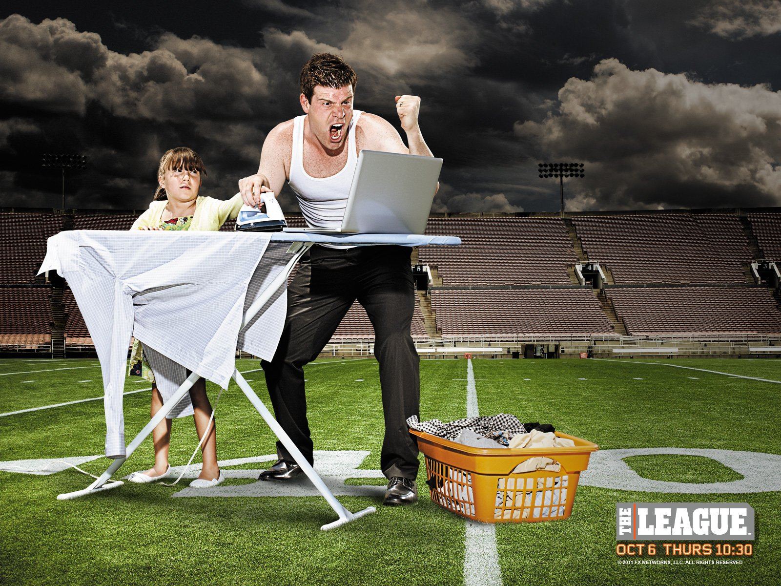
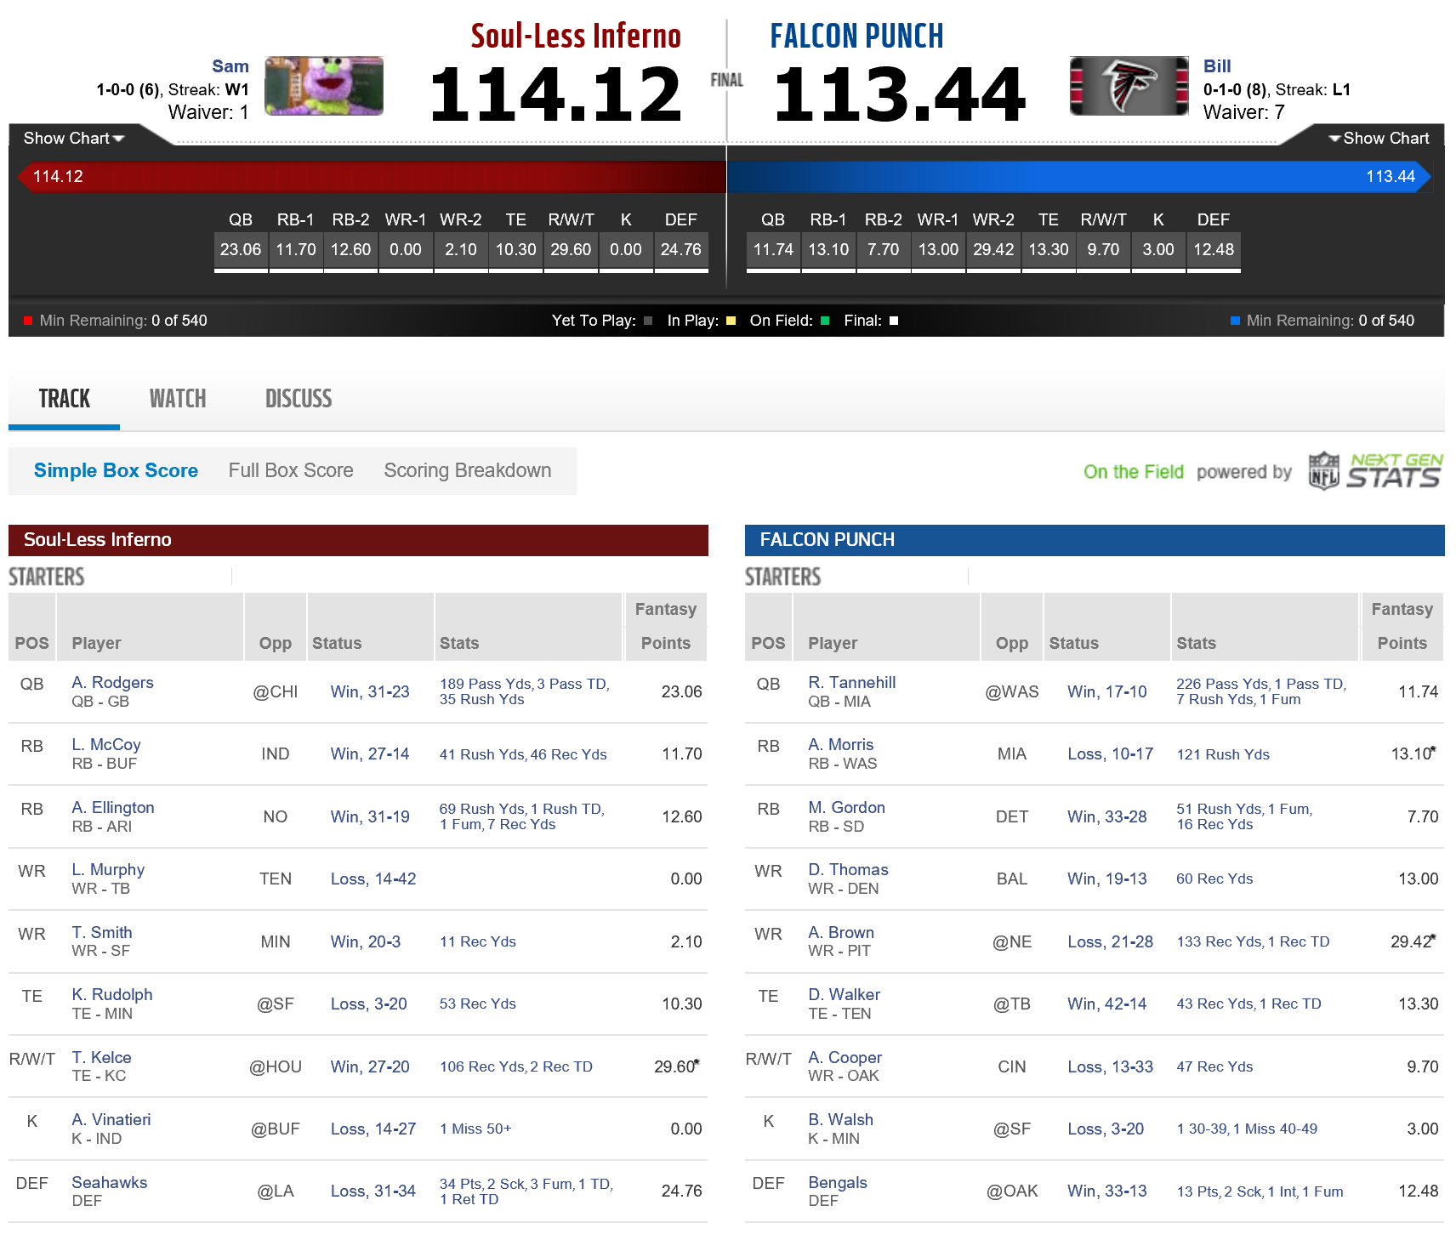
Remember When…
Bill lost by 0.68 points

Slide 19
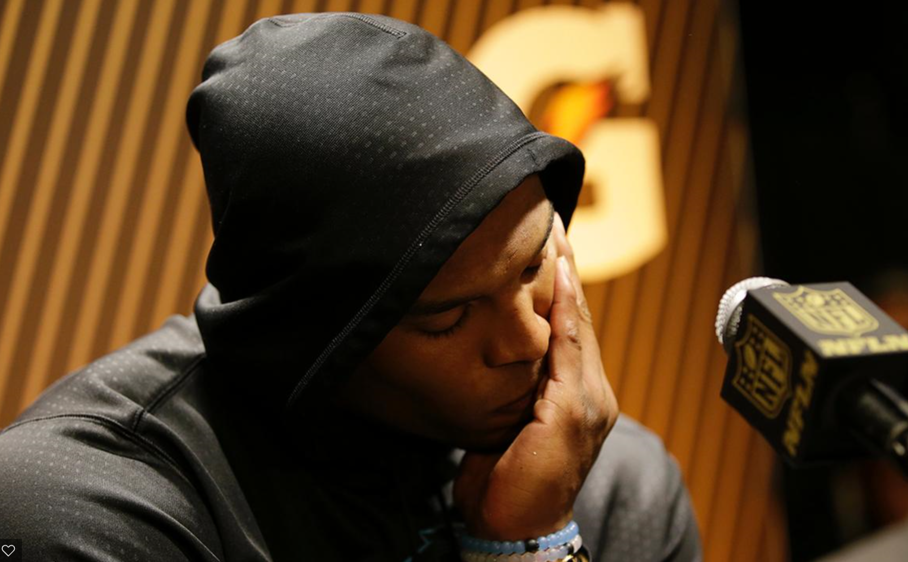
Remember When…
Kurt made a great decision
Drafted 10th round, pick 118, then…

Slide 20
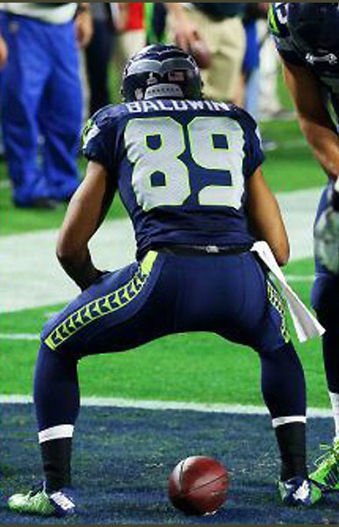
Remember When…
Kurt made another great decision

Slide 21
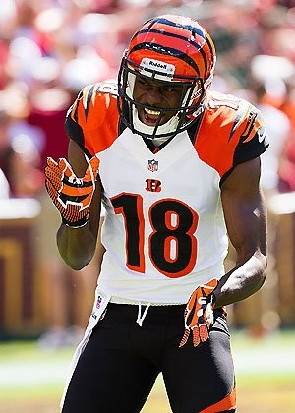
Remember When…
Kurt made an actual good decision

Slide 22
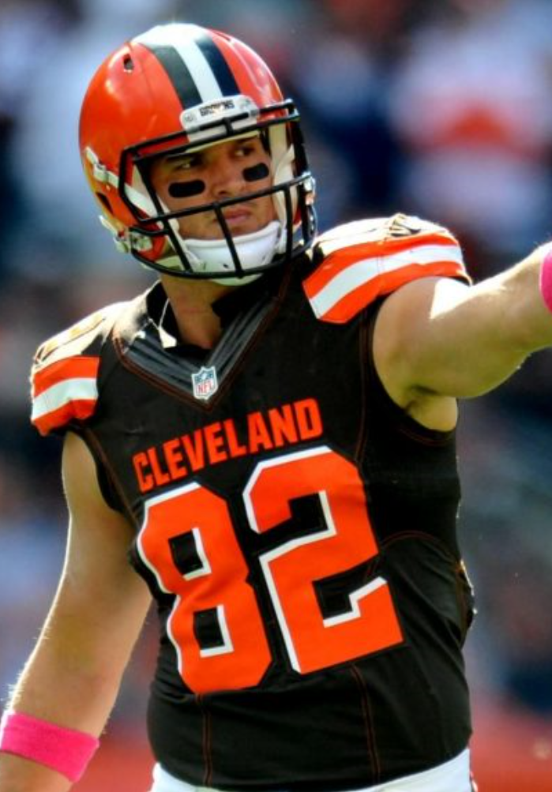
Remember When…
Gary Barnidge
 | G | R | Yds | TD
2015 | 16 | 79 | 1,043 | 9
All 6 Previous Years Combined | 92 | 44 | 603 | 3

Slide 23


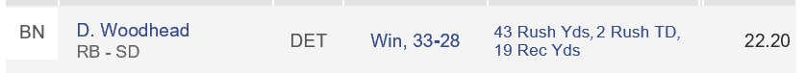






A Lot.
Remember When…
Andrew made great start/sit decisions…

Slide 24
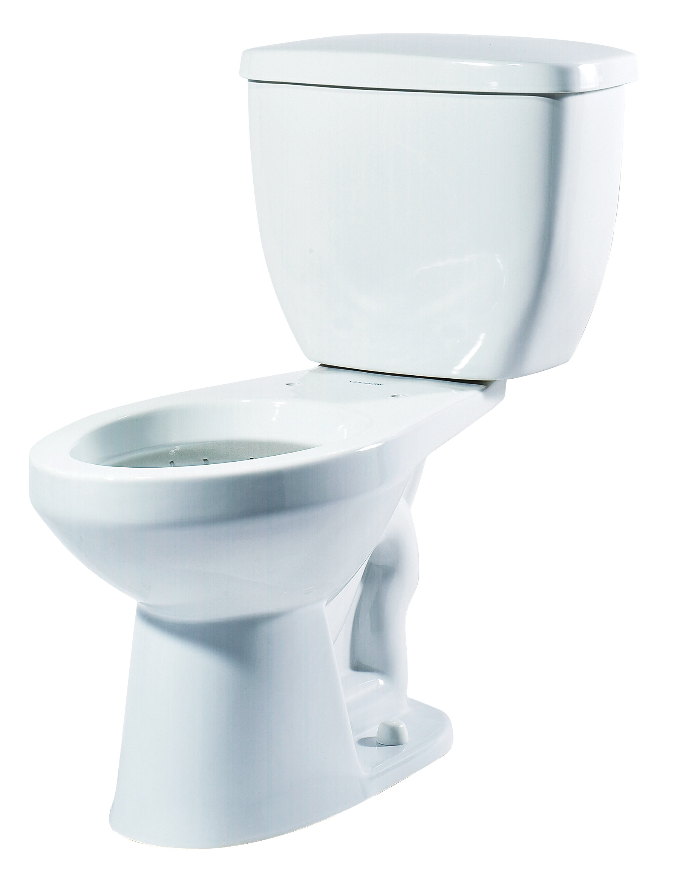
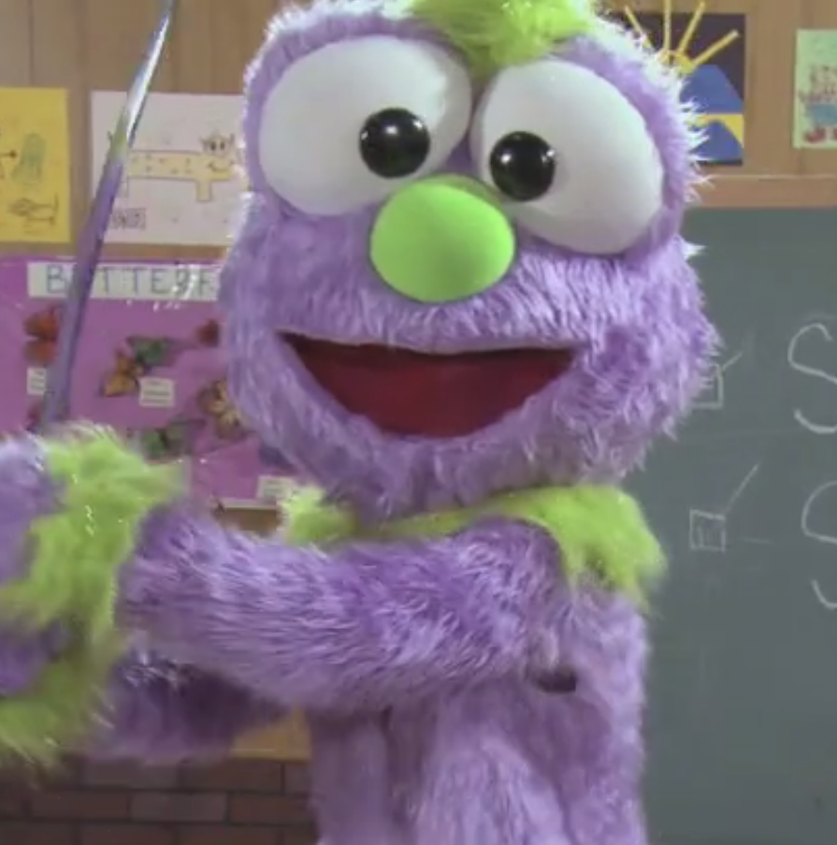

110.2 points per week avg
87.5 wk 4 90.34 wk 5 85.78 wk 8 80.68 wk 16
Rodgers QB7, 14 overall
Spiller RB56, 198 overall
Hillman RB25, 101 overall
Gio RB16, 82 overall
Amendola WR39, 98 overall
Kamar WR29, 71 overall
Evans WR24, 59 overall
Kelce TE8, 77 overall
R. Rodgers TE11, 107 Overall
Matt Jones RB44, 150 Overall
4-11-0
Congrats Sam!

Slide 25
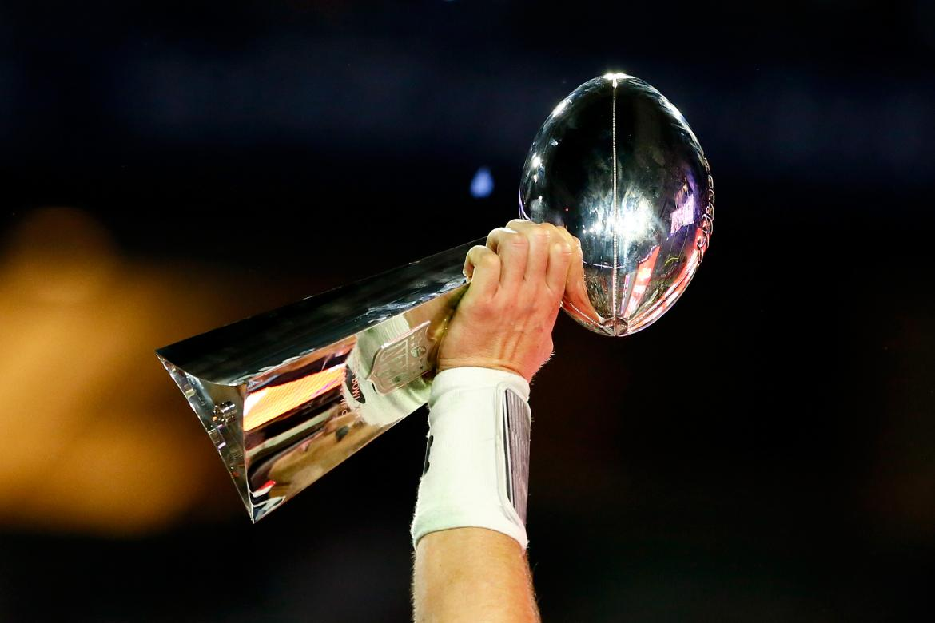

139.2 points per week avg
197.8 wk 12 191.78 wk 14
Odell WR5, 8 overall
Gurley RB9, 69 overall
Gronk TE1, 32 overall
Russell QB3, 6 overall
De’Angelo RB7, 47 overall
Baldwin WR10, 25 overall
Maclin WR14, 36 Overall
Bortles QB4, 9 Overall
10-6-0
Congrats Albert!

Slide 26
GOOD LUCK!
I hope your teams fail miserably.

